Slide 1
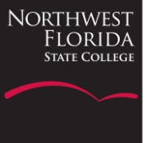
Strengthening a Community College Geoscience Program Through Collaborations with University and Research Faculty
Allison Beauregard
Northwest Florida State College

Slide 2
Goals of Partnerships
Challenge top students without losing general education students
Maintain my own connection to current research
Notes:
So why do research at community colleges? – for me, the biggest drivers to trying to start a research program at my college was obvious. Its why we all went into science – its about having students learn through doing, its about letting them use the scientific method, and its about passing on the excitement of being the first person to look at new data.
Additionally, on a more self-centered note, it can be isolating working at a community college and not having any colleagues in your discipline. And while teaching is my primary interest, I do miss research and find it difficult to keep current in my field. So doing some research with my students is one way to limit this isolation and keep me engaged in my field.

Slide 3
Research Across a Spectrum:
Within course curriculum
On-campus internships
Off-campus internships
Notes:
As a way to overcome some of the obstacles of doing research at a 2YC, I have been collaborating on projects with faculty from both a university and a research institution.
I present two different approaches for effectively incorporating research into the community college setting that each rely on partnerships with other institutions.

Slide 4
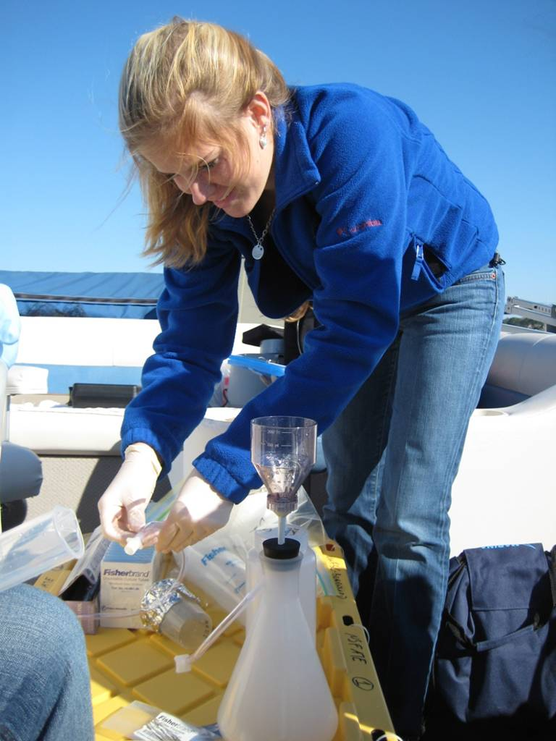
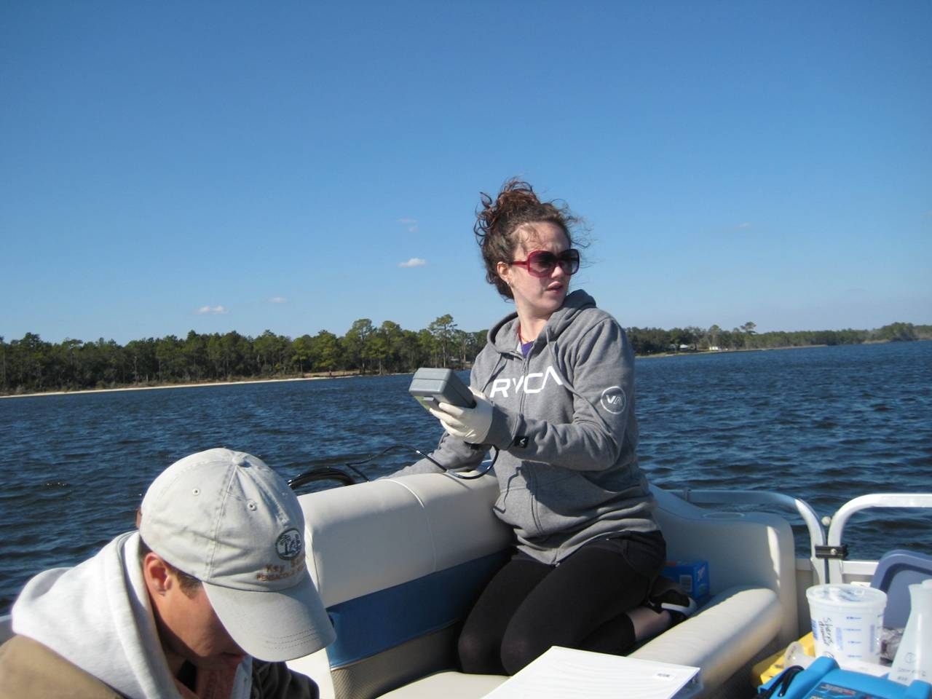
1. Research in the Classroom
Funded under NSF – ATE program
Developed new field/technology -based course at community college
Co-taught by faculty from 2YC & local 4YC & graduate student from 4YC
Course focused on water quality research project throughout semester
Includes 3 field trips to local estuary
End of semester student presentations

Slide 5
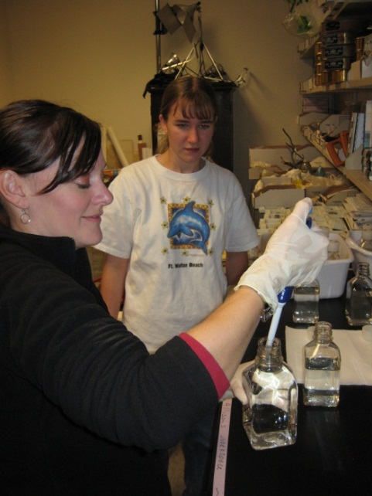
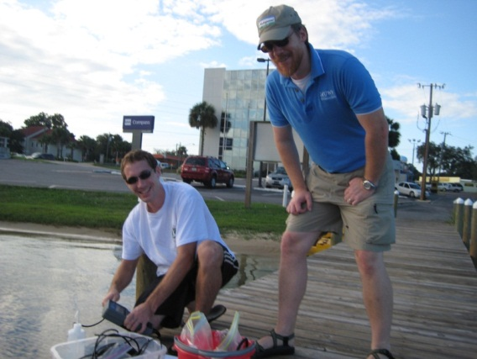
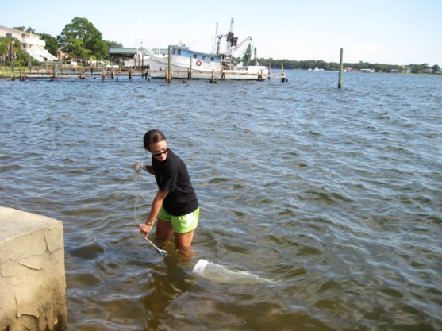
2. On Campus Intern Research
Collaborative research focused on local water quality and Red Tide outbreaks
Ongoing project since 2008
Provides lots of experience to students:
  15 2YC students (including 6 dual enrolled in HS)
  3 4YC undergraduate students
  5 graduate students from 4YC
Notes:
+ several more who just come on one or two sampling trips

Slide 6
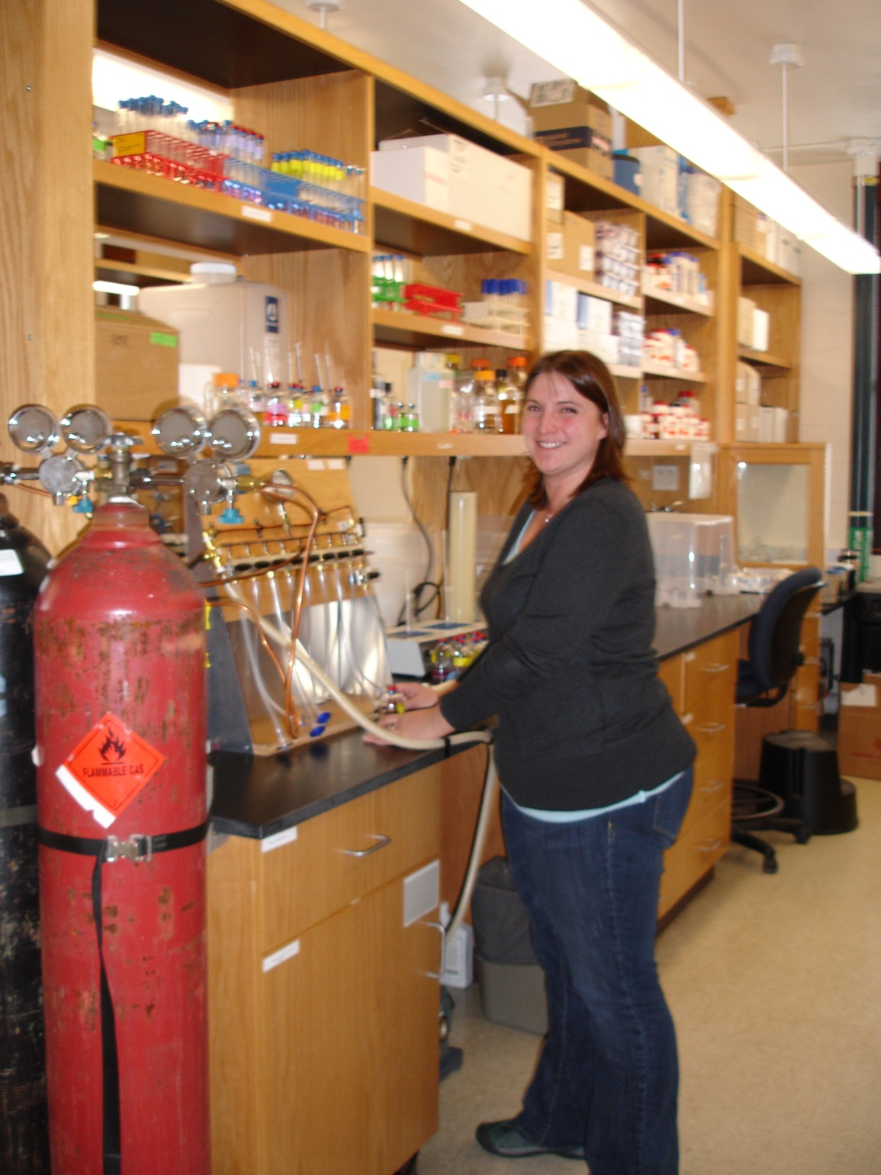
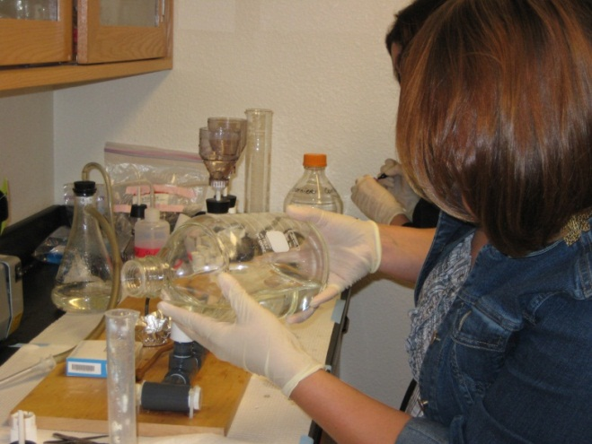
3.Off-campus Intern Research
Funded under NSF – Biological Oceanography (broader impacts)
Focused on hydrothermal vent research
Intensive 10-week summer internship
Students worked at Marine Biological Lab, Woods Hole
4 students participated over 2 summers
Students do end of summer presentations at MBL and NWFSC
Notes:
We also created a summer internship program so that four of my students went to work in Julie’s lab in Mass for 10 weeks. Each of the students worked in his or her own research project for the summer and it was really a life changing experience for them.

Slide 7
Effectiveness
In class research– significantly higher scores on content
In class research– significantly higher technology acceptance measures
MBL internship – 3 of 4 students increased score on content pre/post test (average increase of 12%)
MBL internship – confidence/attitude indicators showed variable change from more confident to less confident (small sample size, plus seeing all the science in such depth makes student realize how much more there is to learn)

Slide 8
Student Feedback
In class research - “… you still hold the distinction of facilitating the toughest, most challenging, most rewarding class I’ve taken in college…. The class that you and Dr. S put together is absolutely awesome and I feel that I’m a better student from being exposed to yours and his instruction.”
MBL internship – “My favorite part of the internship was being able to extract and run DNA on the gel by myself. I loved that the post-docs trusted us with the equipment… That really built my confidence ...”

Slide 9
Outcomes & Benefits of Collaborations:
Engages students at all levels (general ed to majors)
“Flexes” my research muscles
Avenue for me to connect with scientific community
Builds relationships with other institutions
Boosts reputation of community college
Strengthens proposals
Notes:
There are huge benefits to these collaborations for the community college partner
one of the biggest of which is access to university’s grant resources – things like their Institutional Research Board, knowledge on the grant writing process and how to use Fast Lane. I found this assistance invaluable when I was working on my proposals
I want to make clear that I am not from a community college that is particularly supportive of faculty going after external funding. In fact, when I submitted my first proposal, I had to call the President of the College and walk him through Fast Lane so that we could sign up as an institution because no one at my college had ever used Fast Lane before.–- but I have figured out a way to work around these obstacles and make it happen.
As a community college instructor, you have to be pro-active and seek out colleagues to collaborate with at 4-yr universities. It isn’t likely that someone is going to seek you out – but you can bring benefits to the table as well! Sometimes I think that we feel like the ugly step-sister as folks from community colleges – why would someone from a university want to partner with ME?!
But we DO have a lot to offer!
- student recruitment – as more and more students start their college careers at community colleges, this one is getting to be really important- this is a way that university faculty can promote their programs to our students
- access to different funding sources – ATE is only for community colleges
-great broader impacts for other types of proposals
- with my research colleague who doesn’t do any teaching – I think she likes stretching her “teaching muscles”

Slide 10
Acknowledgements
Dr. Matthew Schwartz, University of West Florida
Dr. Julie Huber, Marine Biological Laboratory
NSF Advanced Technological Education
  DUE-0902898 (Beauregard)
  DUE-0902897 (Schwartz)
NSF Biological Oceanography
  OCE-0929167

