Slide 1
Preparing Students for What’s Next: Geotechnical Employment at a
USGS Water Science Center
Presented at a workshop “Preparing Students in Two-year Colleges for Success in Geoscience Degrees and Careers”
July 19, 2012, UW Tacoma, Tacoma, WA
--
Rick Dinicola, Associate Director
U.S. Geological Survey Washington Water Science Center
Tacoma, WA
U.S. Department of the Interior
U.S. Geological Survey

Slide 2
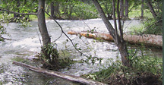
Who we are
U.S. Geological Survey
  Nation's largest earth-science research agency
  Mission is to publish and disseminate accurate and impartial earth science information to all
Washington Water Science Center
  Mission is to provide information on Washington's water resources for the overall benefit of the State and Nation
  Most activities fall into two categories:
    Collection of hydrologic data (Data program)
    Water-resources investigations (Studies program)
  90 employees, ½ in data, ½ in studies, 10 students
  2-yr degree opportunities mostly in data

Slide 3
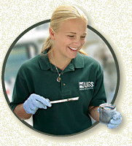
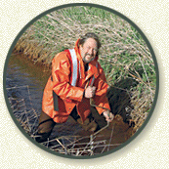
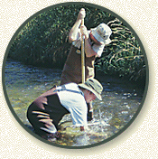
Who we hire as Hydrologic Technicians
Graduates from recognized hydro-tech feeder programs
  Spokane CC, Water Resources Technology
2 or 4-yr Grads with science and math skills
  Environmental Science or similar degree preferred
  Broader environmental science education most suitable for our Studies program

Slide 4
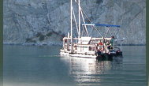
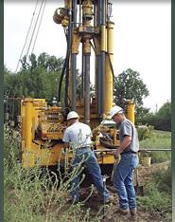
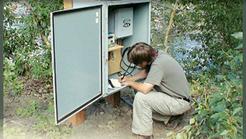
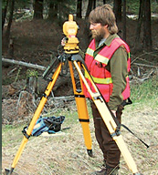
Knowledge, skills, abilities we look for
Math and science background
Passion for working outdoors
Additional specialty skills and
interests that could add to
our program

Slide 5
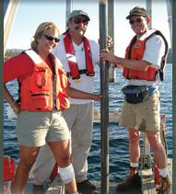
What we look for in a USGS Scientist
PhD or MS degrees in physical or biological science, civil/environmental engineering
Excellent writing and
communication skills
Passion for science
Broad understanding
of the role of science
in society

Slide 6
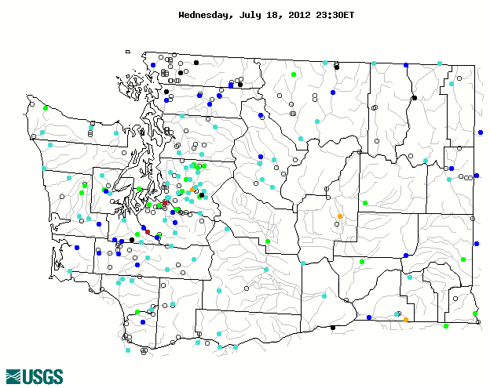
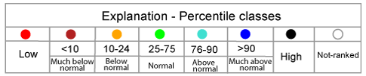
Thank you

