Slide 1
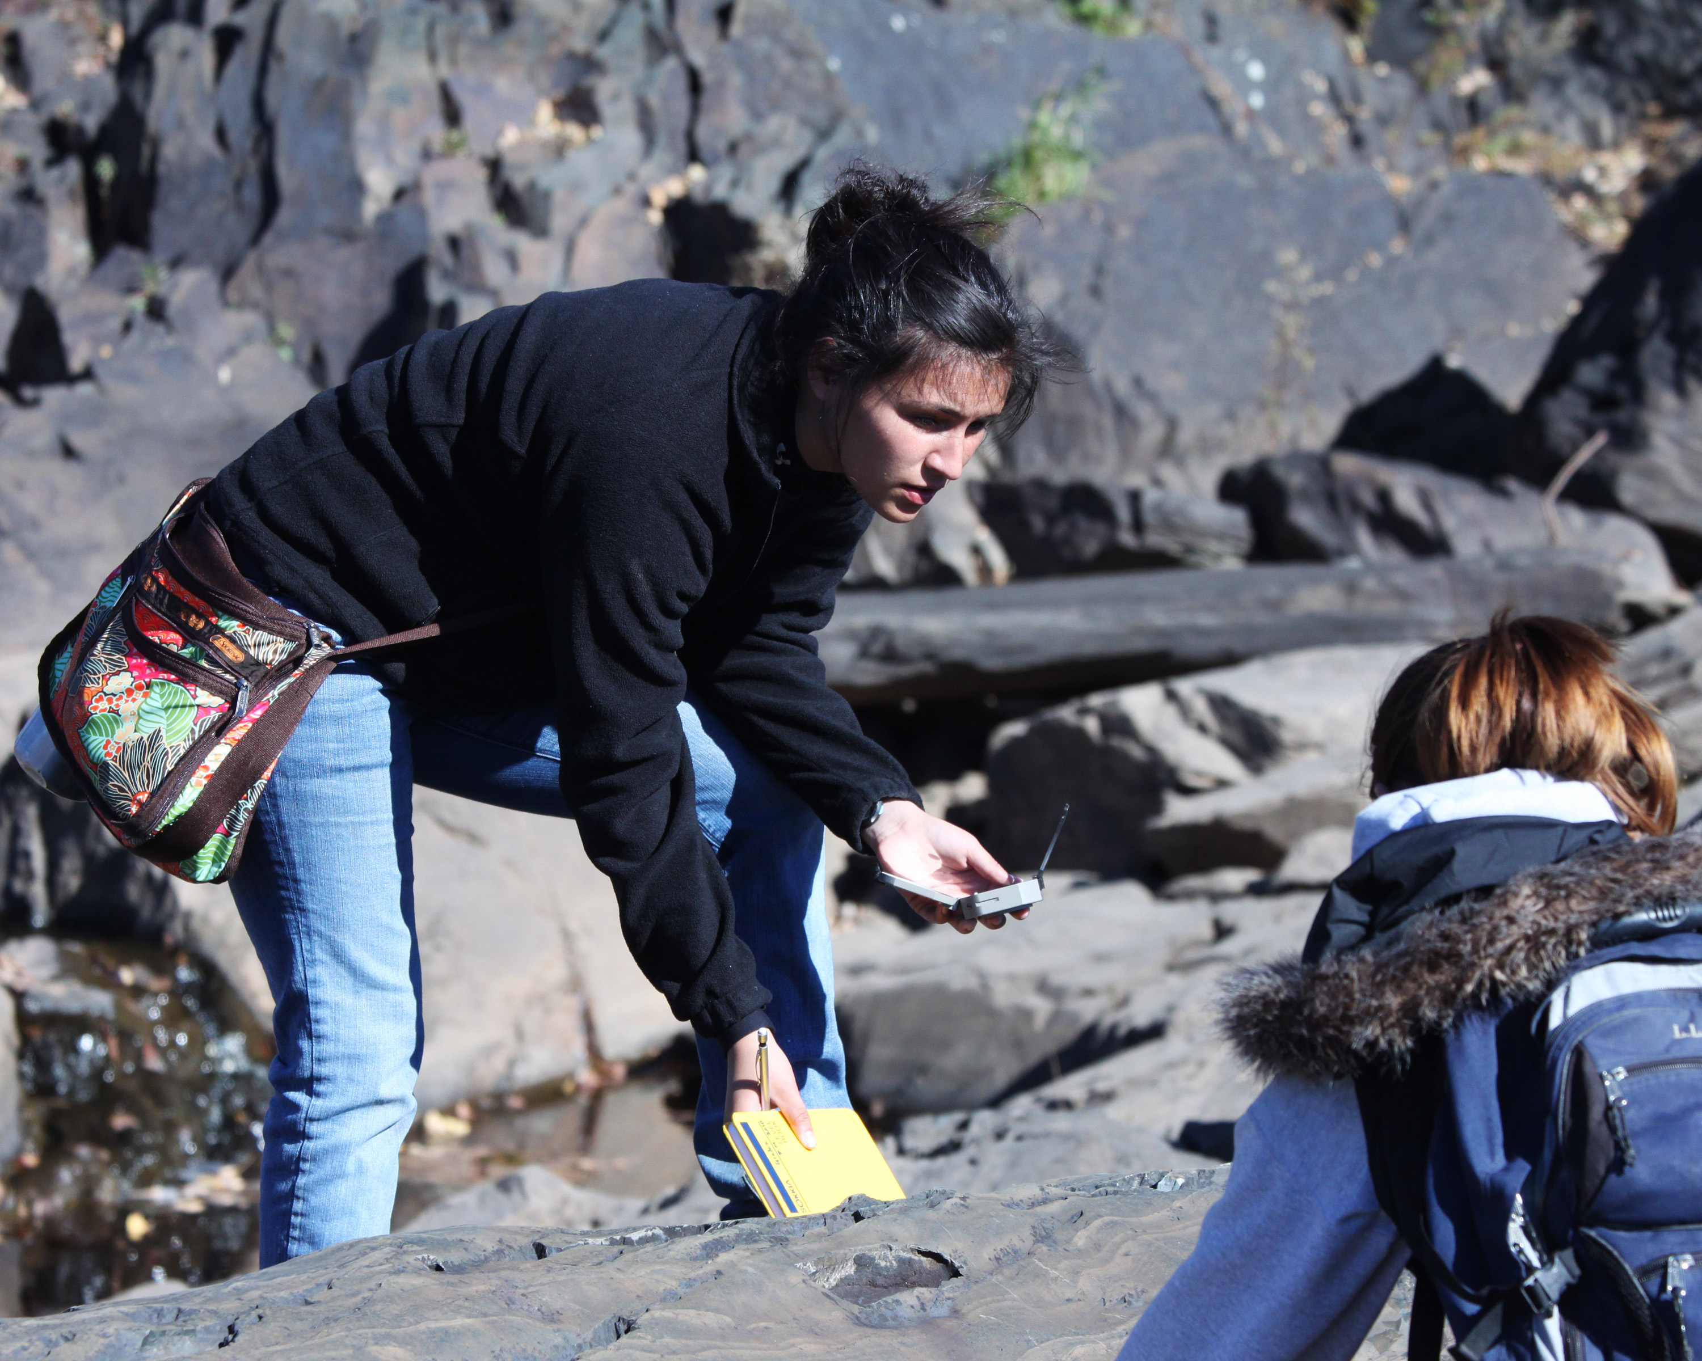
Teaching Students How to Learn
Why Not Be Explicit?
Dexter Perkins
University of North Dakota
Karl Wirth
Macalester College
GSA Short Course
2011 Annual Meeting of the Geological Society of America
Minneapolis, Minnesota

Slide 2
Workshop Outline
Introduction
Learning About Learning
Reflective Journaling
Knowledge Surveys
Exam Wrappers
Discussion

Slide 3
In Small Groups
Introduce yourself:
Name
Institution
What you teach
What brought you to this workshop?
Your goals for the morning?

Slide 4

Why am I here?

Slide 5

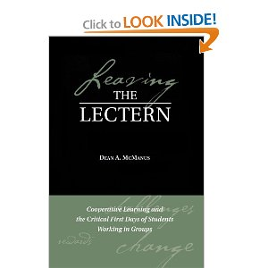
Chapman Conference, Scrutiny of Undergraduate Geoscience Education, Washington, DC, Sept 7-11, 1994
Teaching Mineralogy at Smith College, 1996

Slide 6



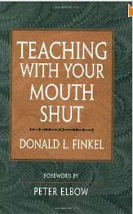

Slide 7
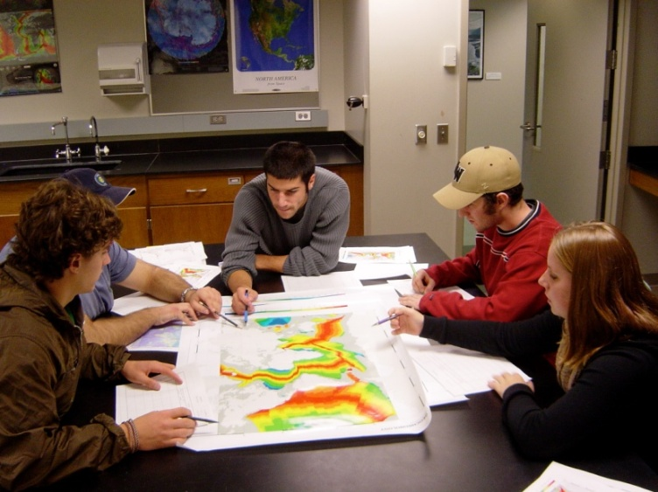

But . . .
many students don’t know how to learn!

Slide 8
You want students to learn to identify igneous rocks in intro geo lab
Give them some samples to “learn”
Give them some samples and have them develop their own classification scheme and key for identification
Have them complete a table listing rock properties
Model how you identify a rock
Give them a flow-chart to use

Slide 9
Memory Exercise
Follow directions on handout
Listen as phrases are read aloud
Rate each according to directions
Score as directed

Slide 10
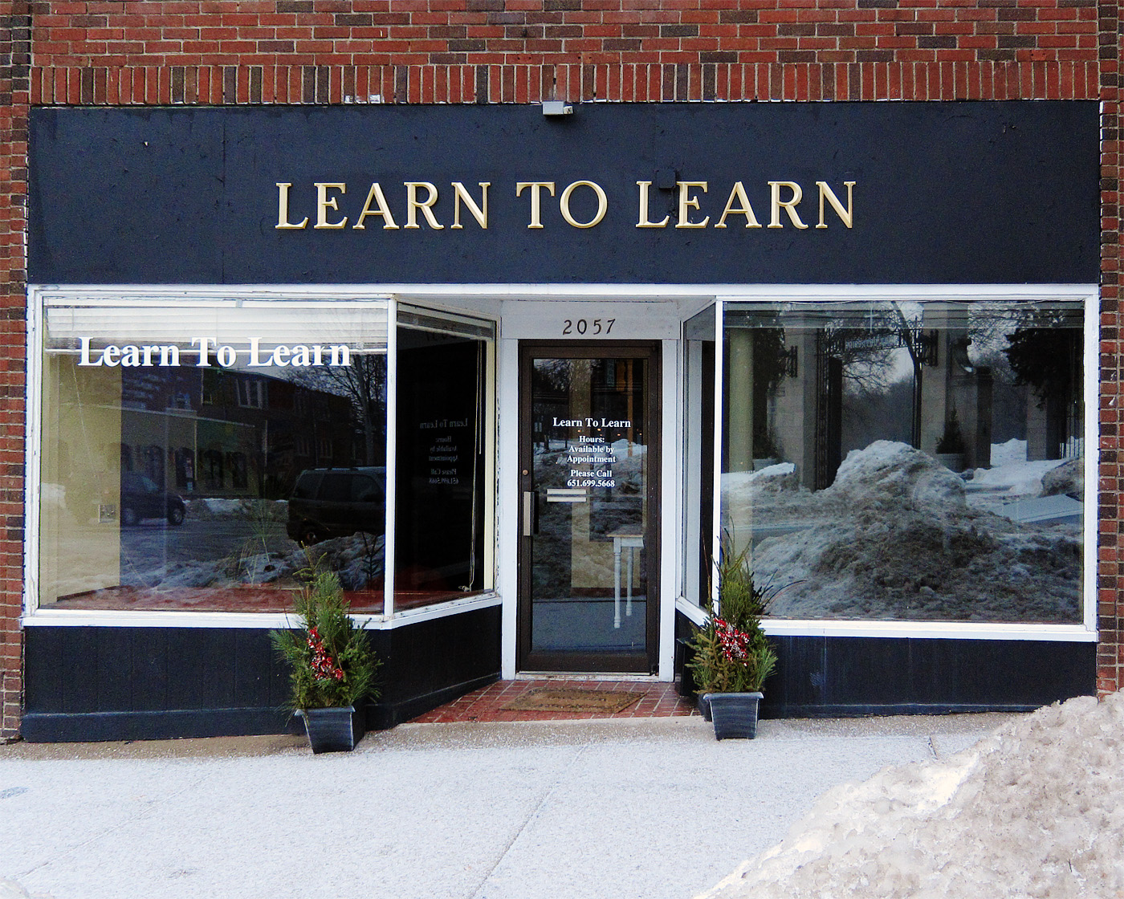
Reflective Prompt
What do you MOST wish your students knew and understood about their thinking and learning?

Slide 11
Reflective Prompt
Why Go To College?
What are the skills that your future employers want you to have?

Slide 12
Goals of Higher Education
Teamwork
Critical Thinking and Reasoning
Oral and Written Communication
Ability to Locate and Work With Information
Self-Knowledge
Global Knowledge
Application of Knowledge & Problem-Solving
AAC&U Survey of Employers (2007)

Slide 13
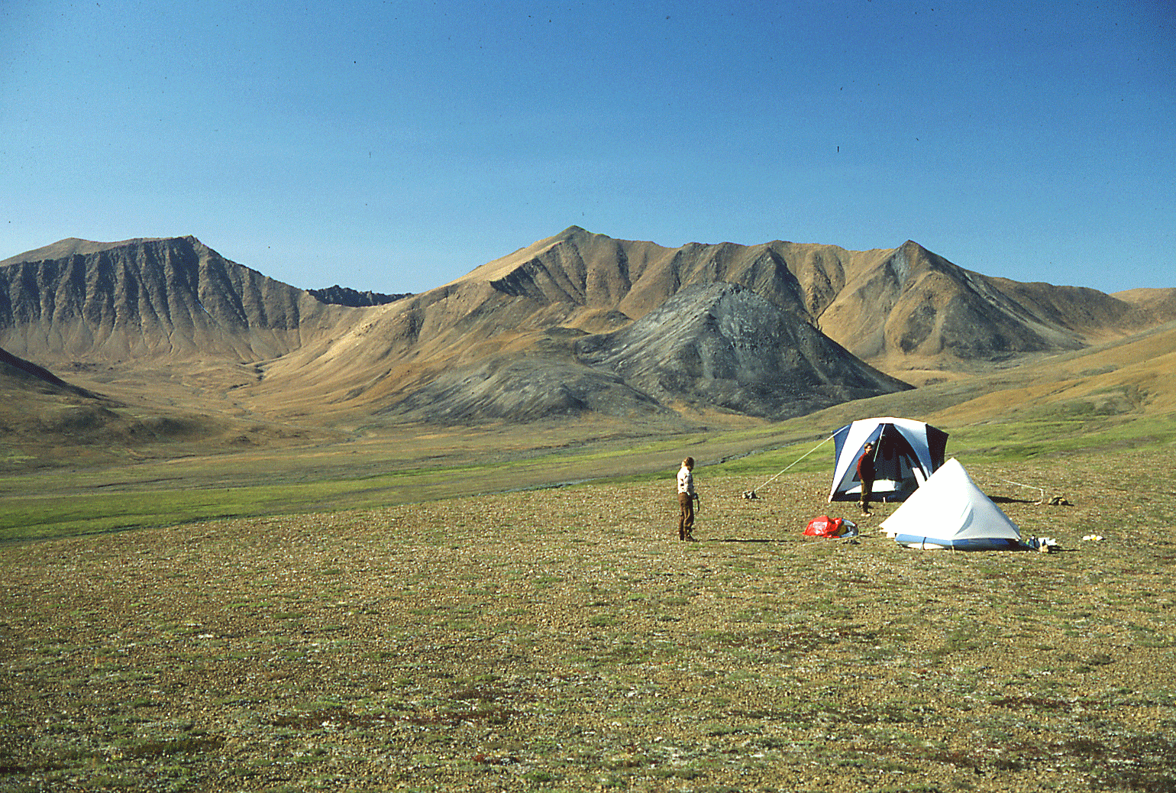
The Role of Higher Education is…
“to help college students become Intentional Learners who can adapt to new environments, integrate knowledge from different sources, and continue learning throughout their lives.”
Greater Expectations
(2002 AAC&U Report)

Slide 14
Intentional Learners are
Self-Directing
Self-directing learners are highly motivated, independent, and strive toward self-direction and autonomy. They take the initiative to diagnose their learning needs, formulate learning goals, identify resources for learning, select and implement learning strategies, and evaluate learning outcomes.
Savin-Baden and Major (2004)
Notes:
Wirth - Talking About Teaching
14

Slide 15
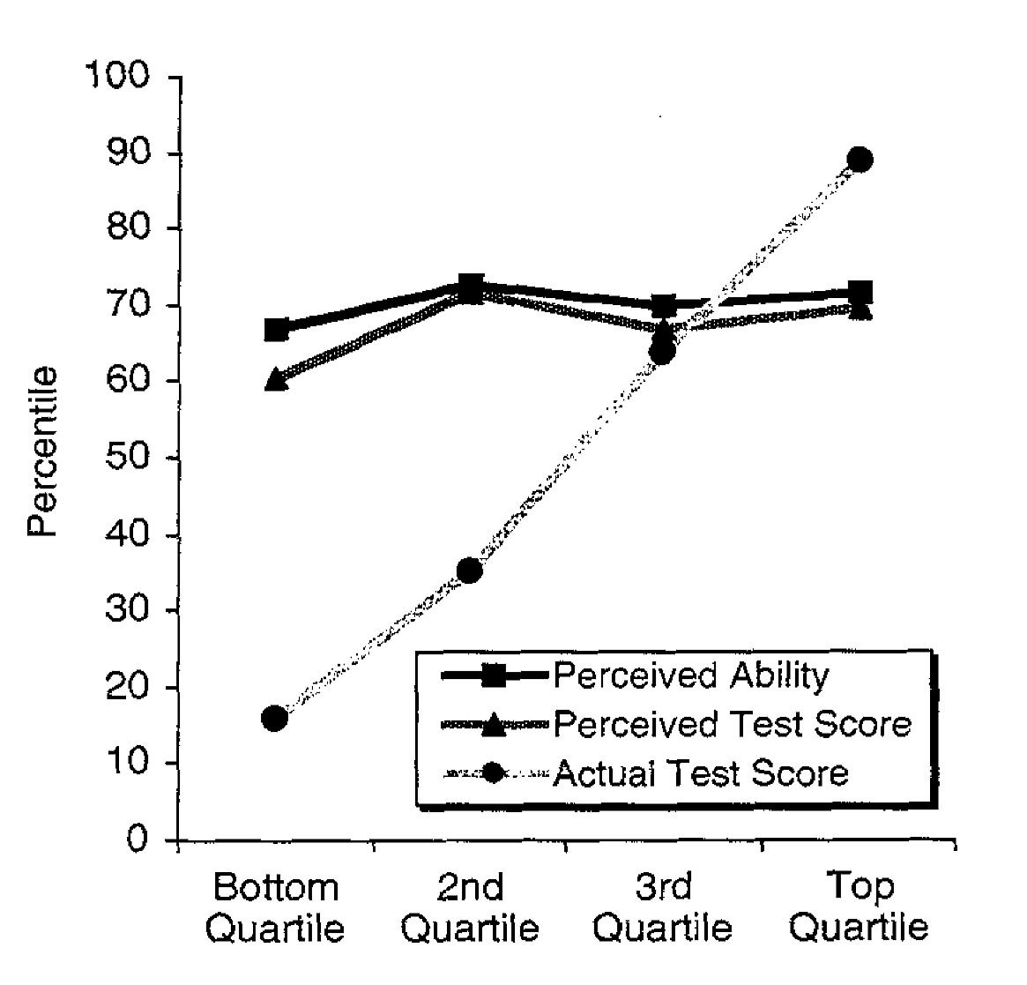
Self-Assessment
Kruger and Dunning (1999)
Notes:
Wirth - Cutting Edge Metacognition Workshop
10/7/11
15

Slide 16

How can we make this happen?

Slide 17
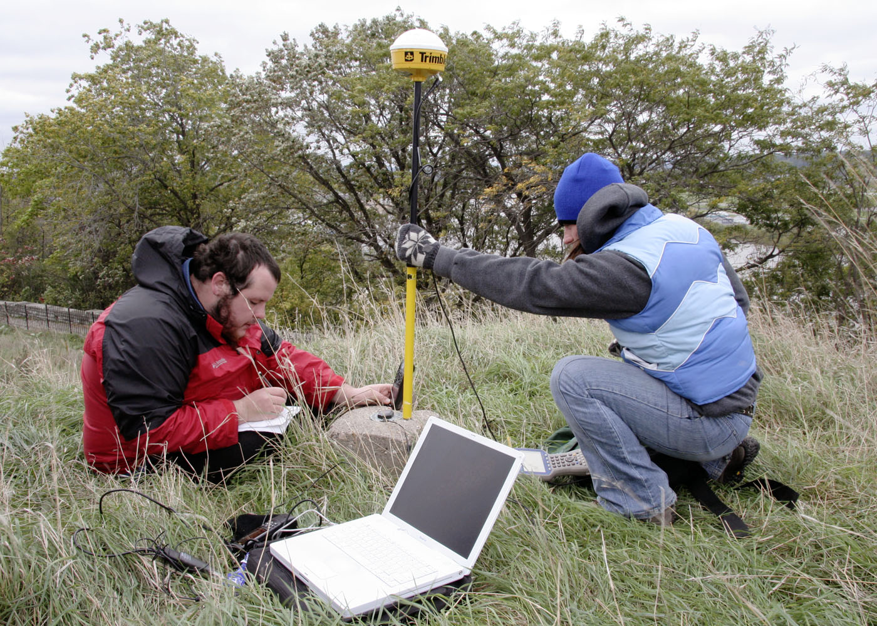
The “Language” of Learning
Purpose of Education
Levels of Thinking
Affective Domain
Significant Learning
Meanings of Learning
Research on The Brain
Intellectual Development
Critical Thinking
Metacognition
Learning Styles
Behavioral Dimensions of Grades

Slide 18
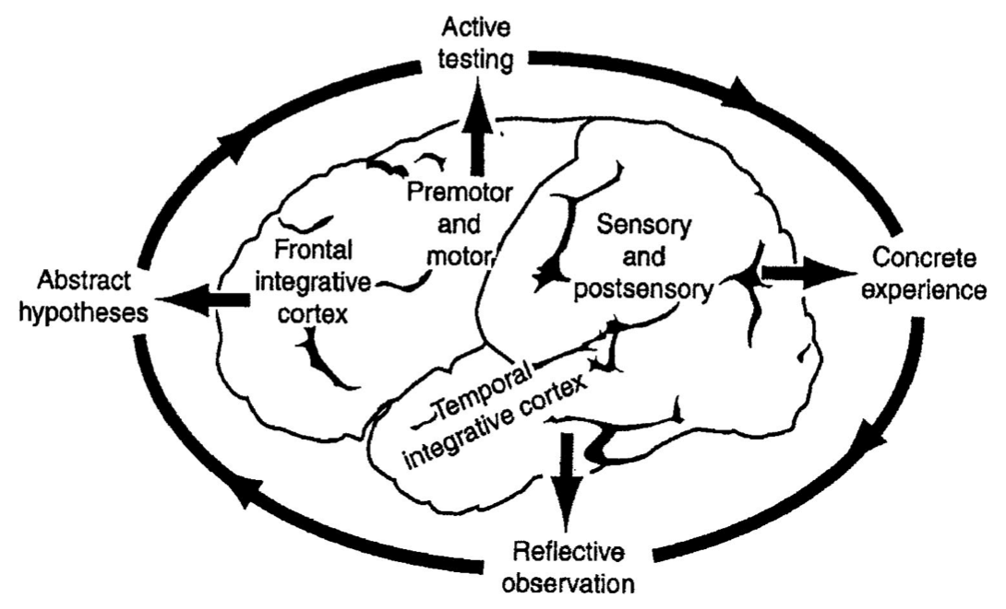
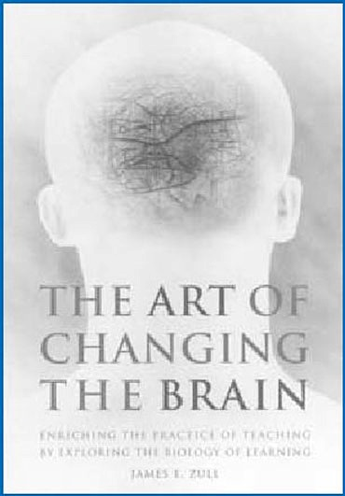
Kolb Cycle & The Brain
Zull (2002)
Notes:
Strategies: cognitive, motivational, environmental
Strategies: self regulation, planning, monitoring, correcting errors, self-assessment

Slide 19
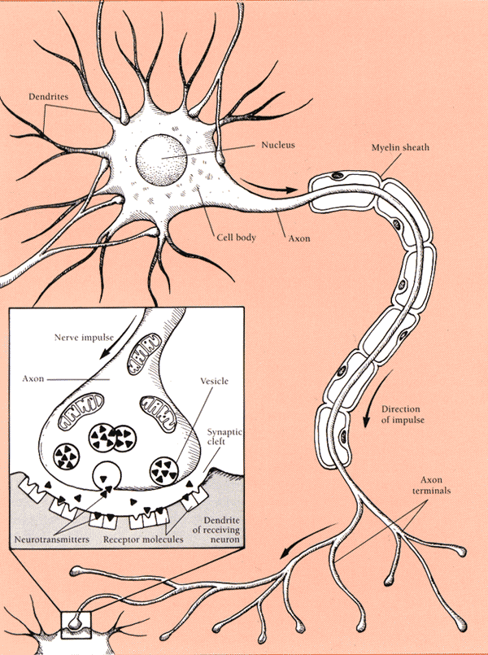
Da Brain
learning changes the physical structure of the brain
learning organizes and reorganizes the brain
different parts of the brain may be ready to learn at different stages of development

Slide 20
Rewiring
At birth, we have all our brain neurons
But, most synapses are yet to be developed
Synapses come and go
Those that are not used disappear
Those that are used persist
So, learning is an active process
That rewires our brains

Slide 21
Brain Rules
Explore each rule through illustrations, charts and video. These tutorials are designed
to reinforce the concepts in the book; we recommend reading the corresponding
chapter first.
EXERCISE | Rule #1: Exercise boosts brain power.
SURVIVAL | Rule #2: The human brain evolved, too.
WIRING | Rule #3: Every brain is wired differently.
ATTENTION | Rule #4: We don't pay attention to boring things.
SHORT-TERM MEMORY | Rule #5: Repeat to remember.
LONG-TERM MEMORY | Rule #6: Remember to repeat.
SLEEP | Rule #7: Sleep well, think well.
STRESS | Rule #8: Stressed brains don't learn the same way.
SENSORY INTEGRATION | Rule #9: Stimulate more of the senses.
VISION | Rule #10: Vision trumps all other senses.
GENDER | Rule #11: Male and female brains are different.
EXPLORATION | Rule #12: We are powerful and natural explorers.
EXERCISE | Rule #1: Exercise boosts brain power.
SURVIVAL | Rule #2: The human brain evolved, too.
WIRING | Rule #3: Every brain is wired differently.
ATTENTION | Rule #4: We don't pay attention to boring things.
SHORT-TERM MEMORY | Rule #5: Repeat to remember.
LONG-TERM MEMORY | Rule #6: Remember to repeat.
SLEEP | Rule #7: Sleep well, think well.
STRESS | Rule #8: Stressed brains don't learn the same way.
SENSORY INTEGRATION | Rule #9: Stimulate more of the senses.
VISION | Rule #10: Vision trumps all other senses.
GENDER | Rule #11: Male and female brains are different.
EXPLORATION | Rule #12: We are powerful and natural explorers.
John Modina (2008)

Slide 22
Myelin
The role of myelin may be crucial
Only developed by intense meaningful practice
Anyone can grow myelin
But “ignition” is often a barrier
The Talent Code – Daniel Coyle 2009

Slide 23

Three Principles of Learning
1. Recognize/Address Preconceptions
2. Expert Knowledge
  Deep foundation
  Contextual framework
  Organizational structure
3. Metacognition is Important
Bransford et al. (2000)

Slide 24
Metacognition Involves Reflection
Elapsed Time (mins) | 0 | 1 | 2 | 3 | 4 | 5 | 6 | 7 | 8 | 9 | 10 | 11 | 12 | 13 | 14 | 15 | 16 | 17 | 18 | 19
Read
Analyze
Explore
Plan
Implement
Verify
What kind of problem is this?
What is the best strategy for solving it?
How will I know if I solved it?
How could I do it better next time?
What additional information do I need?
What use is this new information?
How can I use my new understanding to solve different kinds of problems?
Notes:
Wirth - Cutting Edge Metacognition Workshop
10/7/11
24

Slide 25
Reflection Continuum
Dimension | Description
Habitual Action | Minimal thought and engagement; memorization is emphasized; correlated with surface learning; tasks treated as unrelated activities; an attitudinal state of unreflectiveness
Understanding | Focuses on comprehension without relation to one’s personal experience or other learning situations; book learning that is understanding-oriented; learning stays within boundaries of preexisting perspectives
Reflection | Learning is related to personal experience and other knowledge; involves challenging assumptions, seeking alternatives, identifying areas of improvement; active engagement; characteristic of deep approaches to learning
Critical or Intensive Reflection | Highest level of reflective learning; learners are aware of why they think, perceive, or act as they do; as a result, learner likely alters or changes firmly held personal beliefs and ways of thinking
Kember et al. (2000) modified from Mezirow (1991)
Notes:
Wirth - Cutting Edge Metacognition Workshop
10/7/11
25

Slide 26
Simple Metacognitive System
MODEL
Meta-level
Information flow
Control
Monitoring
Object-level
Nelson and Narens (1990)
Notes:
the brain, for it to be successful and efficient regulator for survival must proceed, in learning, by the formation of a model of its environment
meta-level contains an imperfect model of the object-level
dominance relation defined in terms of flow of information; monitoring = listening or feedback; control = speaking; meta-level modifies object level
metacognition can be construed as a supervisory or executive system
Two-level model can easily be generalized to more than two levels
meta-level probably located in prefrontal region; object-level in posterior cortical region

Slide 27
Expert Learners
Metacognitive Knowledge
(declarative, procedural, conditional)
Personal
Resources
Prior Knowledge
Available Strategies
Task
Requirements
Type of Learning
Appropriate Strategies
Modified from Ertmer and Newby (1996), Butler (1997), Winne and Hadwin (1998), Pintrich (2000), Lovett (2008)
Notes:
Strategies: cognitive, motivational, environmental
Strategies: self regulation, planning, monitoring, correcting errors, self-assessment

Slide 28
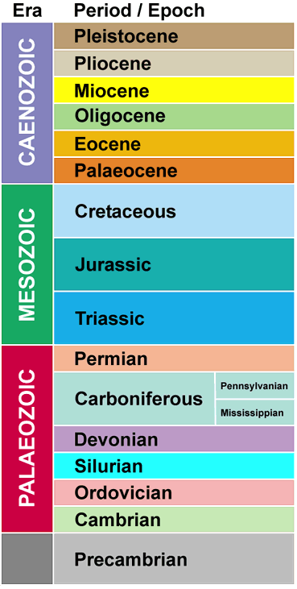
Geologic Time
Personal Resources
Prior Knowledge
Available Strategies
Task Requirements
Type of Learning Task
Appropriate Strategies

Slide 29
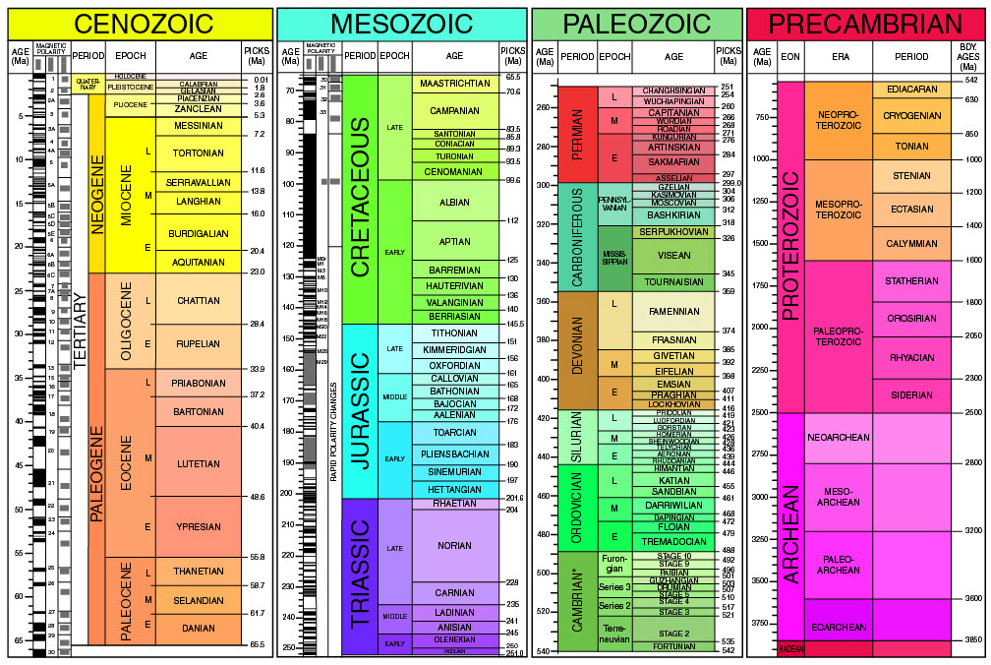
Geologic Time
GSA (2009)

Slide 30
Expert Learners
Metacognitive Knowledge
(declarative, procedural, conditional)
Metacognitive Control
(self-regulation)
Personal
Resources
Prior Knowledge
Available Strategies
Task
Requirements
Type of Learning
Appropriate Strategies
Plan
Evaluate
Monitor
Modified from Ertmer and Newby (1996), Butler (1997), Winne and Hadwin (1998), Pintrich (2000), Lovett (2008)
Notes:
Strategies: cognitive, motivational, environmental
Strategies: self regulation, planning, monitoring, correcting errors, self-assessment

Slide 31
Expert Learners - Reflection
Metacognitive Knowledge
(declarative, procedural, conditional)
Metacognitive Control
(self-regulation)
Personal
Resources
Prior Knowledge
Available Strategies
Task
Requirements
Type of Learning
Appropriate Strategies
Plan
Goals
Beliefs
Attitudes
Motivation
Evaluate
Monitor
Modified from Ertmer and Newby (1996), Butler (1997), Winne and Hadwin (1998), Pintrich (2000), Lovett (2008)
Notes:
Strategies: cognitive, motivational, environmental
Strategies: self regulation, planning, monitoring, correcting errors, self-assessment

Slide 32
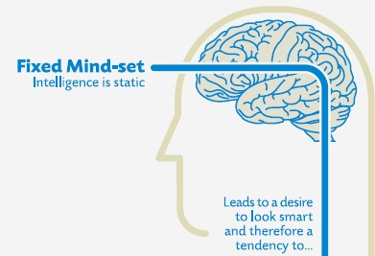
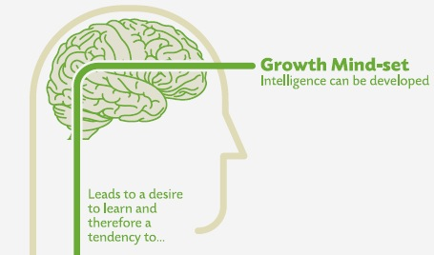
Another Example – Beliefs
avoid challenges
give up easily
see effort as fruitless
ignore feedback
be threatened by success of others
embrace challenges
persist in face of setbacks
see effort as path to mastery
Iearn from criticism
find lessons and inspiration in success of others
Dweck (2006)
Notes:
Wirth - Cutting Edge Metacognition Workshop
10/7/11
32

Slide 33
Expert Learners - Reflection
Metacognitive Knowledge
(declarative, procedural, conditional)
Metacognitive Control
(self-regulation)
Personal
Resources
Prior Knowledge
Available Strategies
Task
Requirements
Type of Learning
Appropriate Strategies
Plan
Reflection
Goals
Beliefs
Attitudes
Motivation
Reflection
Evaluate
Monitor
Reflection
Reflection
Modified from Ertmer and Newby (1996), Butler (1997), Winne and Hadwin (1998), Pintrich (2000), Lovett (2008)
Notes:
Strategies: cognitive, motivational, environmental
Strategies: self regulation, planning, monitoring, correcting errors, self-assessment

Slide 34
Kolb Cycle & Reflection
Reflection-for-action
Reflection-on-action
Reflection-in-action
Modified from Schön (1983), Cowan (1998), and Zull (2002)
Notes:
Strategies: cognitive, motivational, environmental
Strategies: self regulation, planning, monitoring, correcting errors, self-assessment

Slide 35
Pedagogical Challenge
Metacognition is a “self-imposed internal conversation”
Metacognition affects acquisition, comprehension, retention, application and transfer
Easily assumed that students can, and are, doing it
In fact, many college students lack metacognitive knowledge and skills
Challenge is to keep students in constant contact with their metacognition
Instruction must be explicit and embedded within different subject areas
Bransford et al., 2000; Pintrich (2002)
Notes:
Wirth - Cutting Edge Metacognition Workshop
10/7/11
35

Slide 36
Metacognitive Activities
Activity | Metacognitive Knowledge or Skill
How I Earned an “A” | Goal-setting
Reading Reflections | Monitoring
Learning Reflections | Evaluation & Planning
Knowledge Surveys | Goal-setting, Monitoring & Evaluation
Exam Wrappers | Evaluation & Planning

Slide 37
Previewing activity
Don’t cheat
Half of you close your eyes and put your head down on the desk
The other half look at the screen
No talking!

Slide 38

Previewing activity
Don’t cheat
Half of you close your eyes and put your head down on the desk
The other half look at the screen
No talking!
You are about to read a passage about a kite.

Slide 39
Previewing activity
A newspaper is better than a magazine, and on a seashore is a better place than a street. At first it is better to run than to walk. Also you may have to try several times. It takes some skill but it's easy to learn. Even young children can enjoy it. Once successful, complications are minimal. Birds seldom get too close. One needs lots of room. Rain soaks in very fast. Too many people doing the same thing can also cause problems. If there are not complications, it can be very peaceful. A rock will serve as an anchor. If things break loose from it, however, you will not get a second chance.

Slide 40
Write down as many of the phrases as you can remember.

Slide 41
Goal-Setting:
Reflection-for-Action

Slide 42
Planning and Goal-Setting
Journal Activity:
Write a letter describing what you accomplished in this course. The letter should be dated for the end of the semester and written in the past tense. Tell me what you did, how you did it, and how your thinking and understanding changed.
Begin your letter with:
I earned an “A” in this course because…
The Art of Possibility (Zander and Zander, 2000)

Slide 43
Example Responses
“When it came time for me to do assignments… I also pondered the reasons my professor assigned them and what I should be have been learning by doing them.”
“I have challenged myself to think… in strange and new ways.”
“I have also realized that seeking help, especially from my peers, is an important step in the academic process...”
Notes:
Wirth - Cutting Edge Metacognition Workshop
10/7/11
43

Slide 44
Reading Reflections:
Supporting Content Learning with Reflection-in-Action

Slide 45
Strategic Reading
Expert Readers:
read with a purpose and in “extensive mode”
accomplished in use of prior knowledge
utilize a wide variety of strategies for monitoring and comprehension (e.g., prediction, integration, self-questioning, reflecting)
Novice Readers:
focus on decoding single words or phrases
fail to adjust for different texts or purposes
seldom use text-processing strategies
Paris et al. (1996)

Slide 46
Reading Reflections
Completed after each reading assignment
Short responses to three questions
Submitted online before class
Credit awarded for “reflective” submissions
What is the main point of this reading?
What did you find surprising? Why?
What did you find confusing? Why?

Slide 47
Metacognitive Goals of Reflections
What is the main point of this reading?
Summarizing (Anderson & Thiede, 2008)
Keywords (Thiede et al., 2005)
What did you find surprising? Why?
Misconceptions (Bransford et al., 2000)
Affect (Winne & Hadwin, 1998; Pintrich and Zusho, 2007)
What did you find confusing? Why?
Monitoring, Evaluation, and Reflection (Ertmer and Newby, 1996; Zimmerman, 2002)

Slide 48

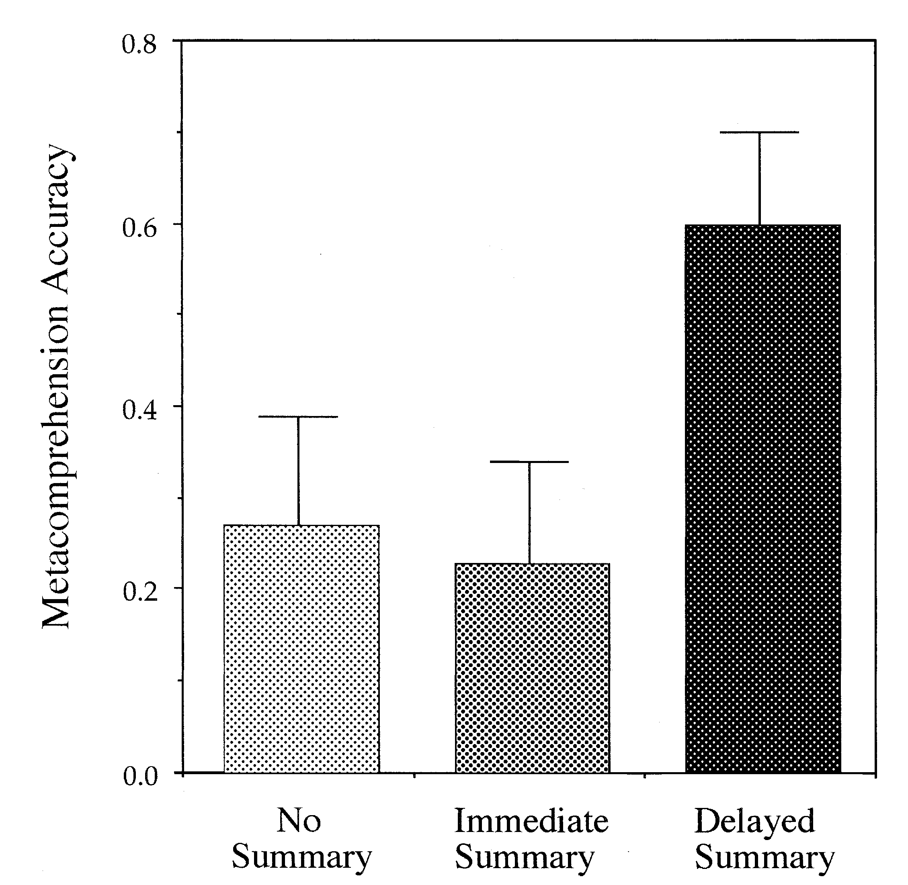
Summarizing & Metacomprehension
Thiede and Anderson (2003)

Slide 49
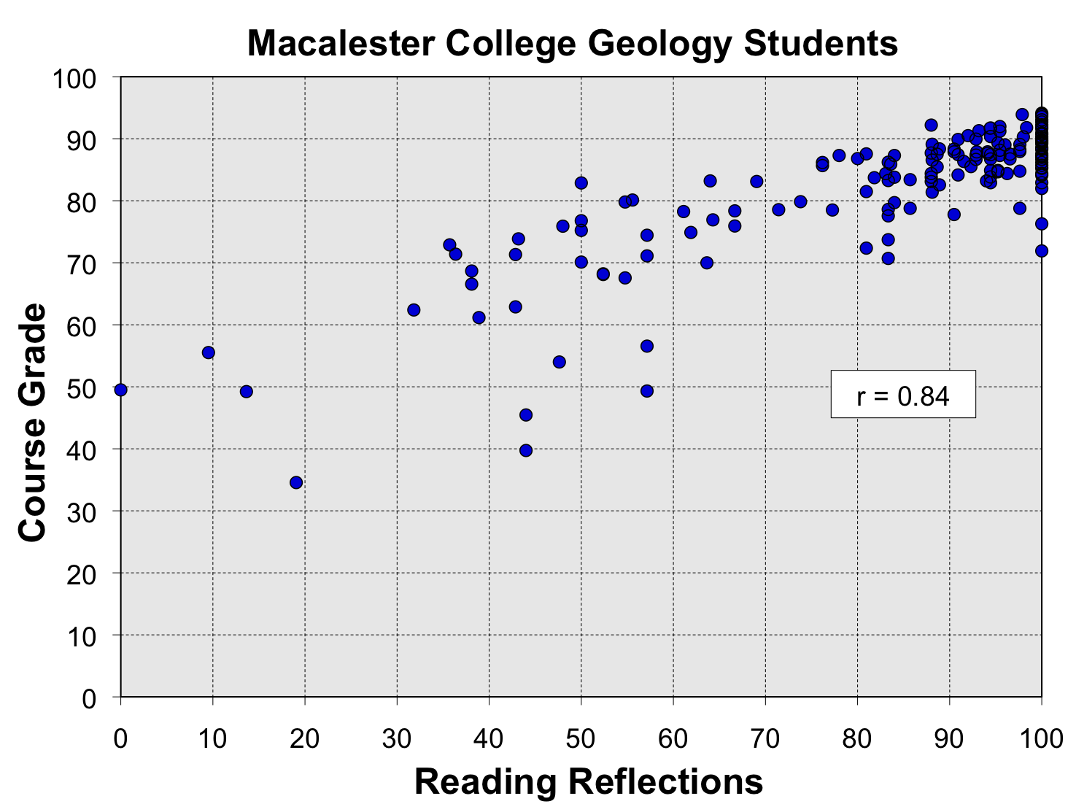
Initial Observations
Pearson = 0.842
p-value = <0.001

Slide 50
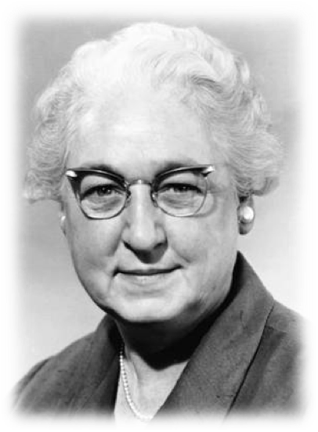
APGAR Check (credit/not graded)
Did you read the material for today’s class meeting?
Not at all
Skimmed it
Read to get it done
Read for deep understanding

Slide 51
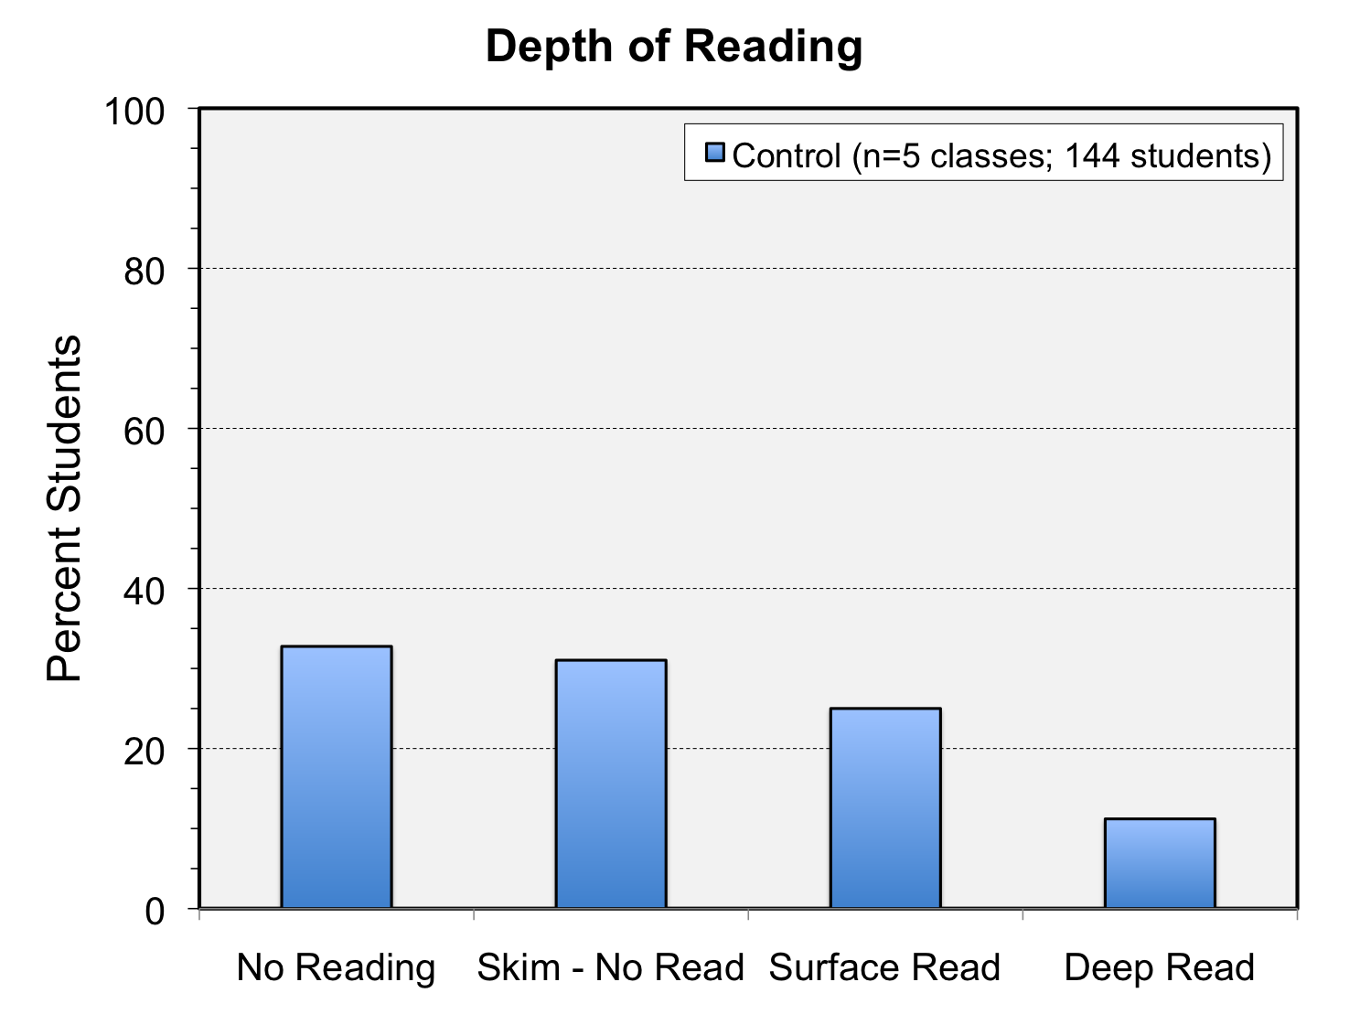

Slide 52
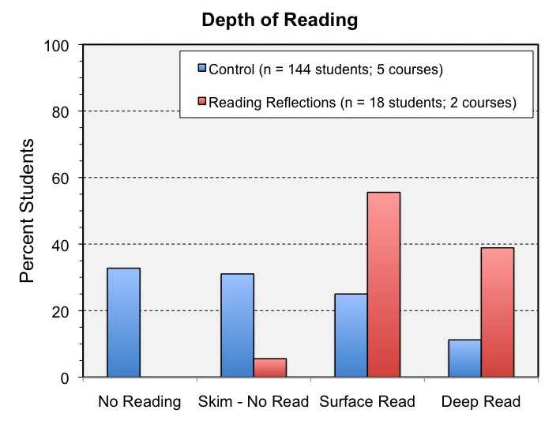

Slide 53
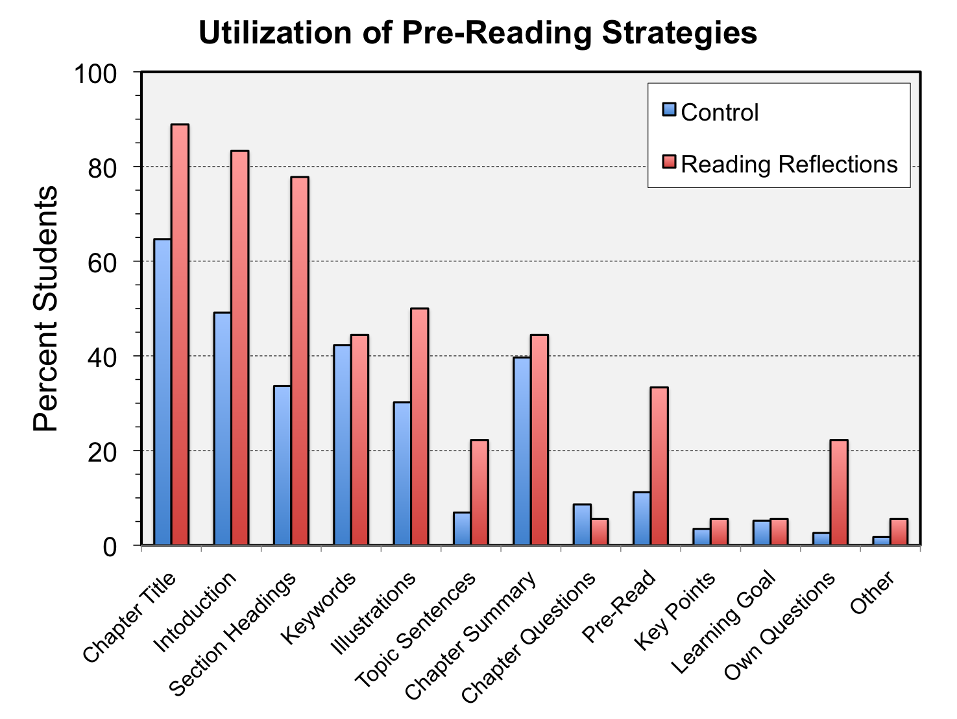

Slide 54
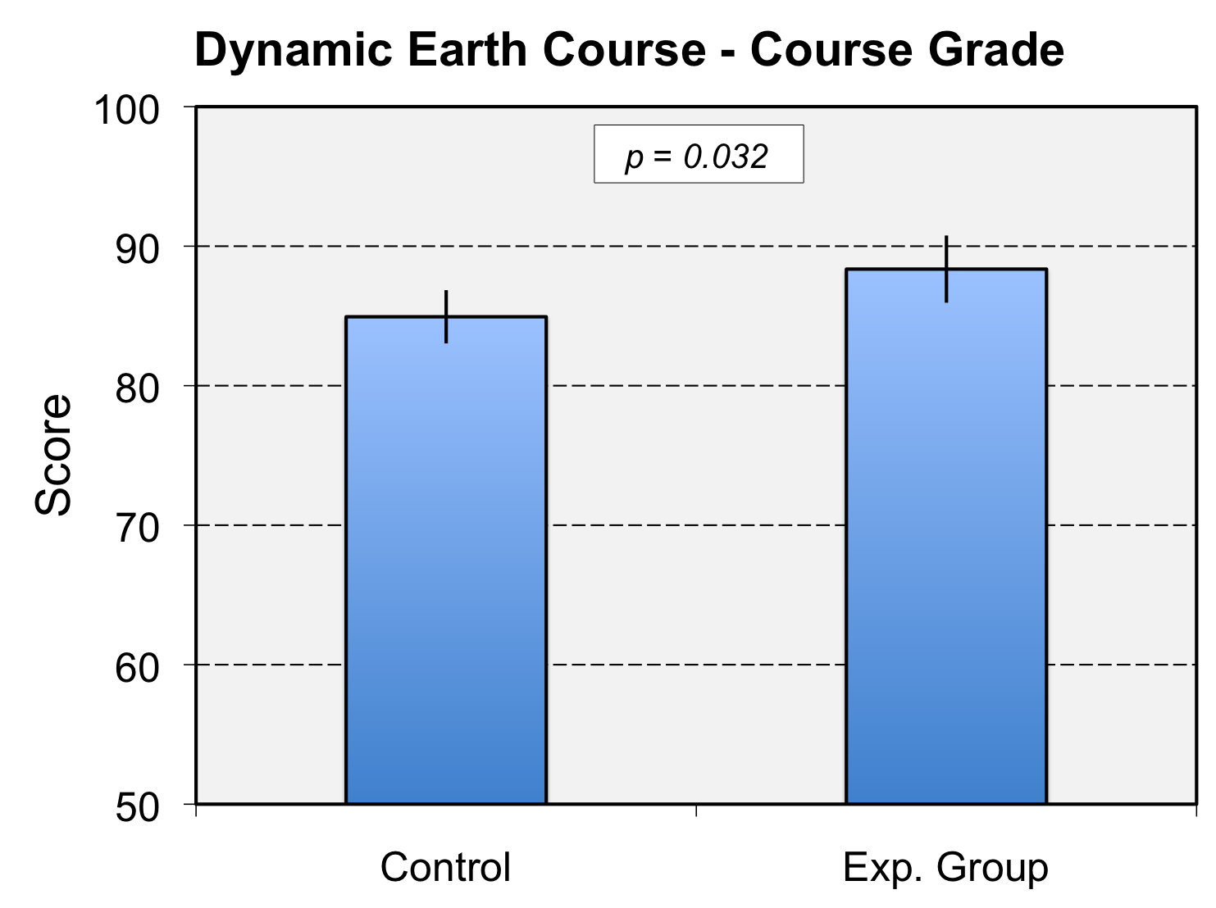
Effect Size = 0.71 (Large)

Slide 55
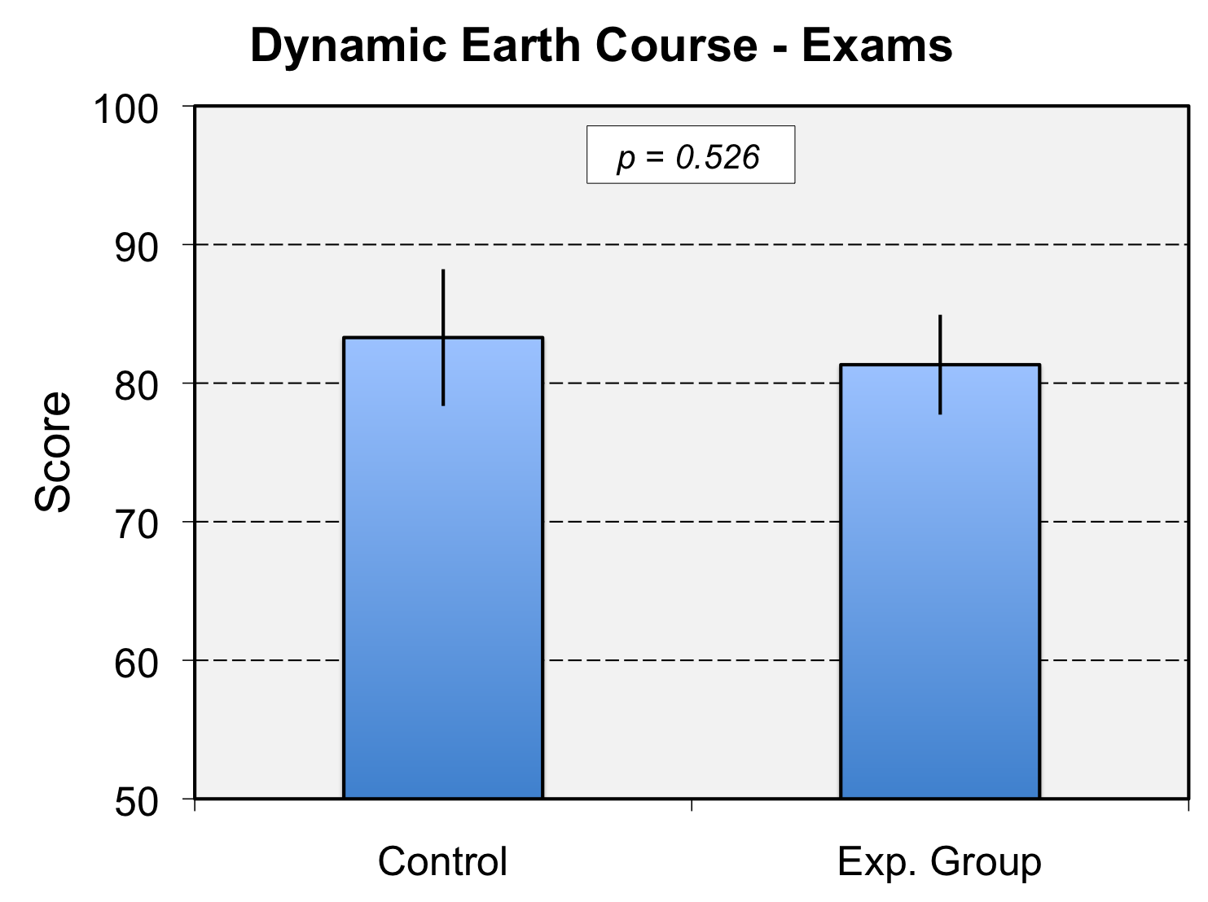
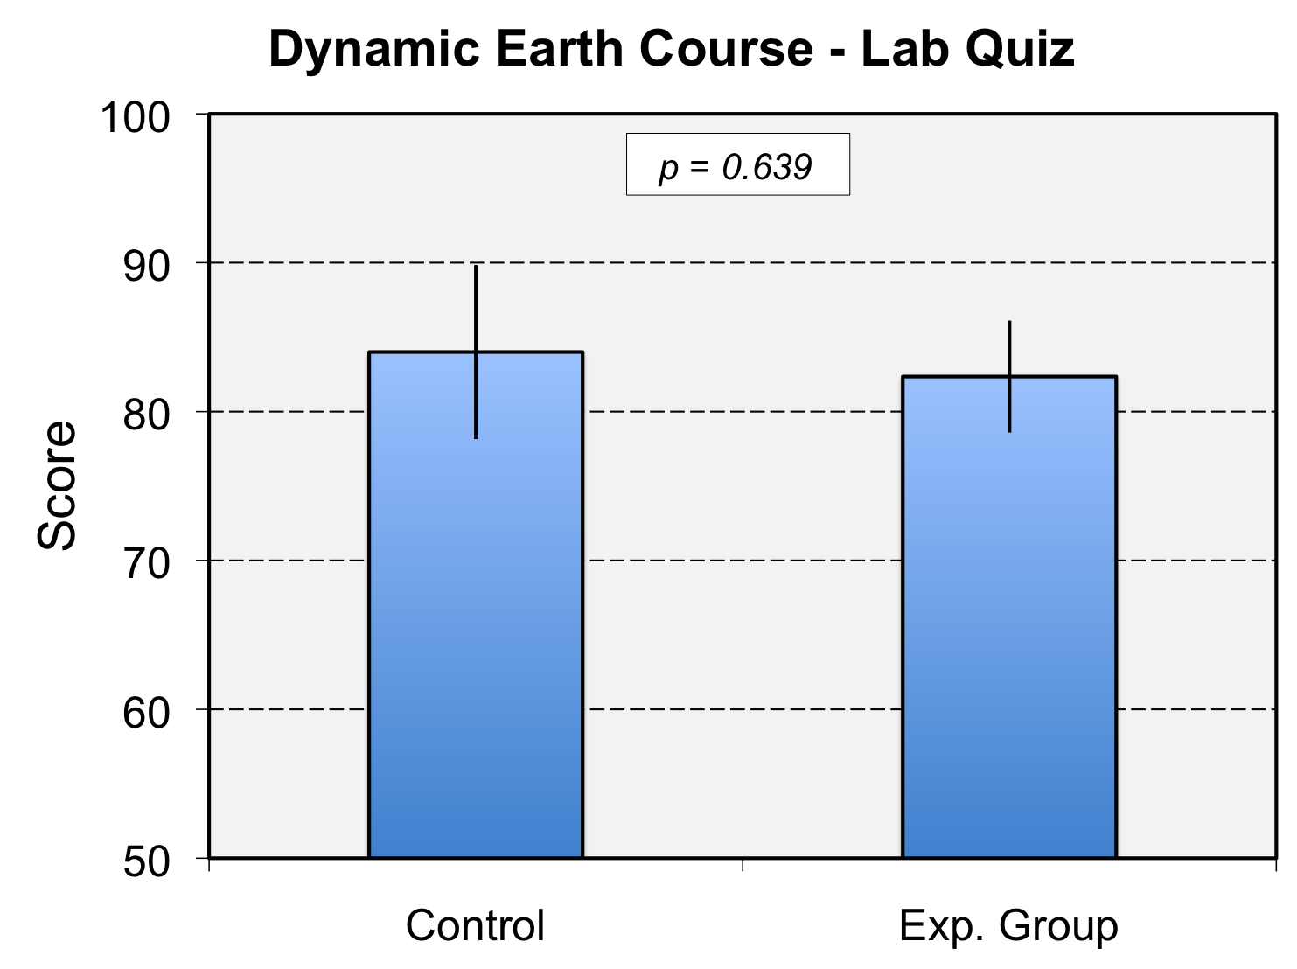
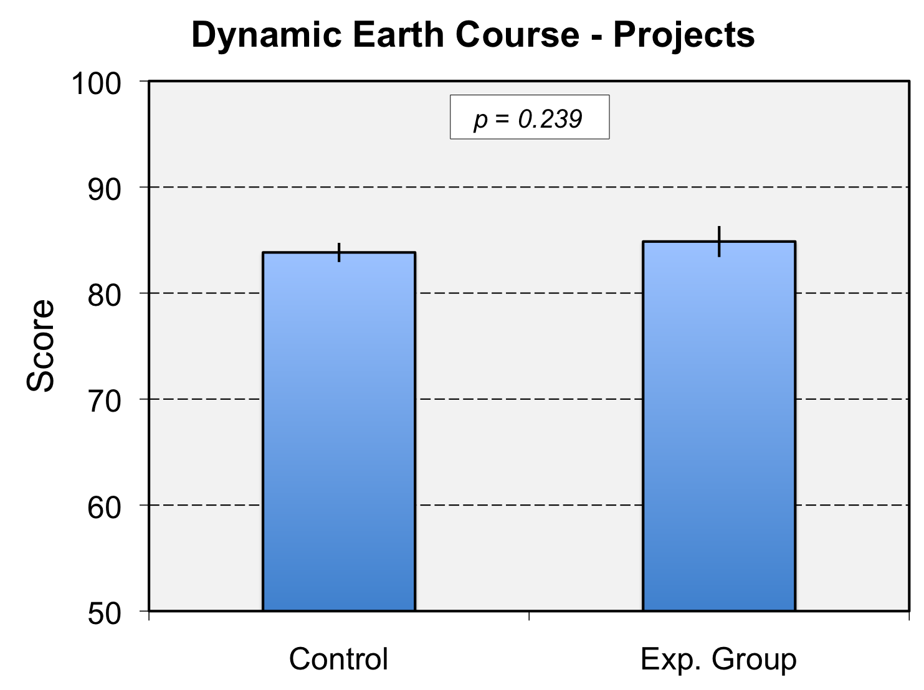
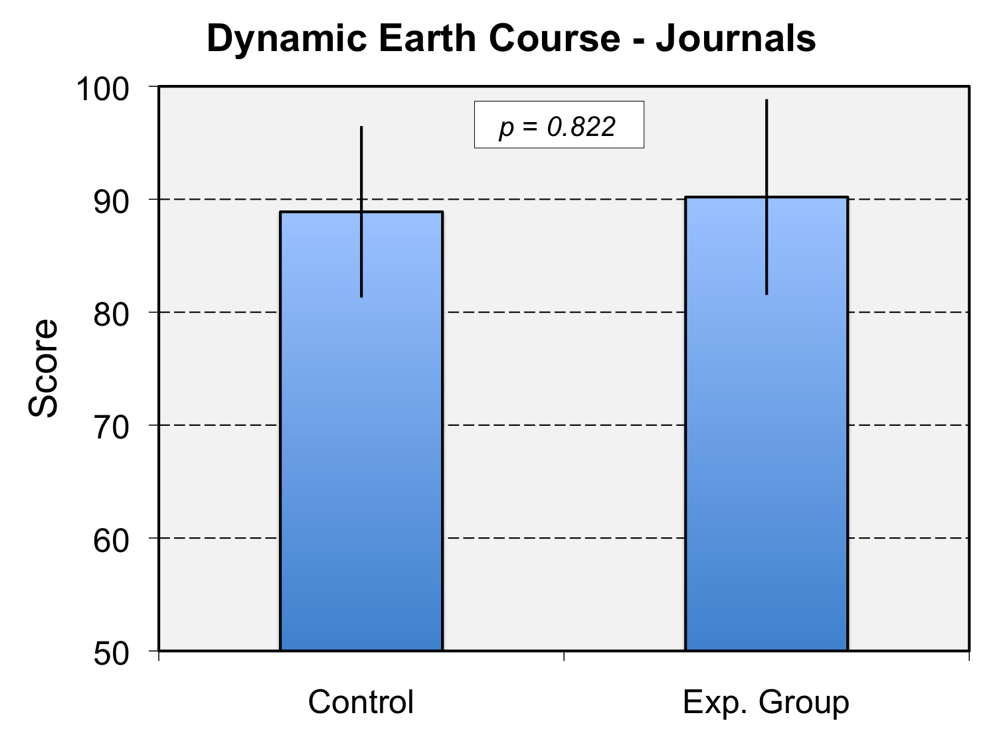

Slide 56
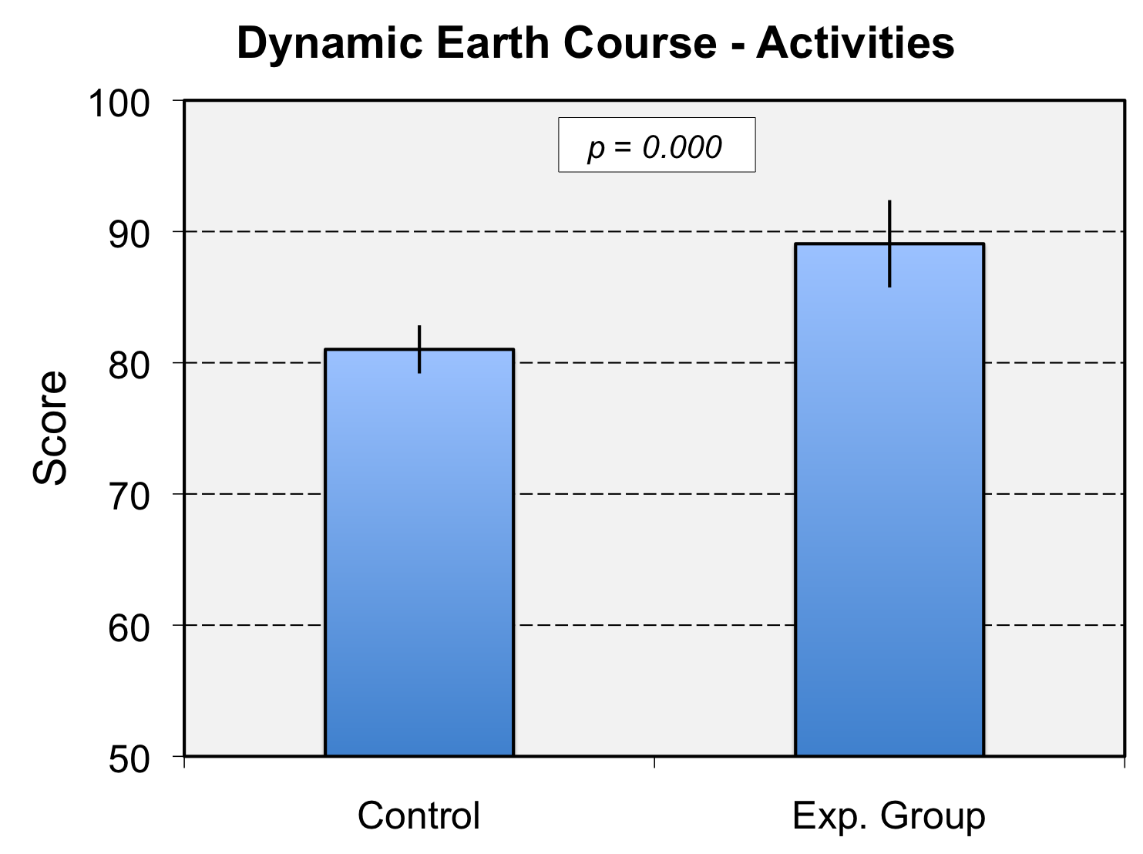
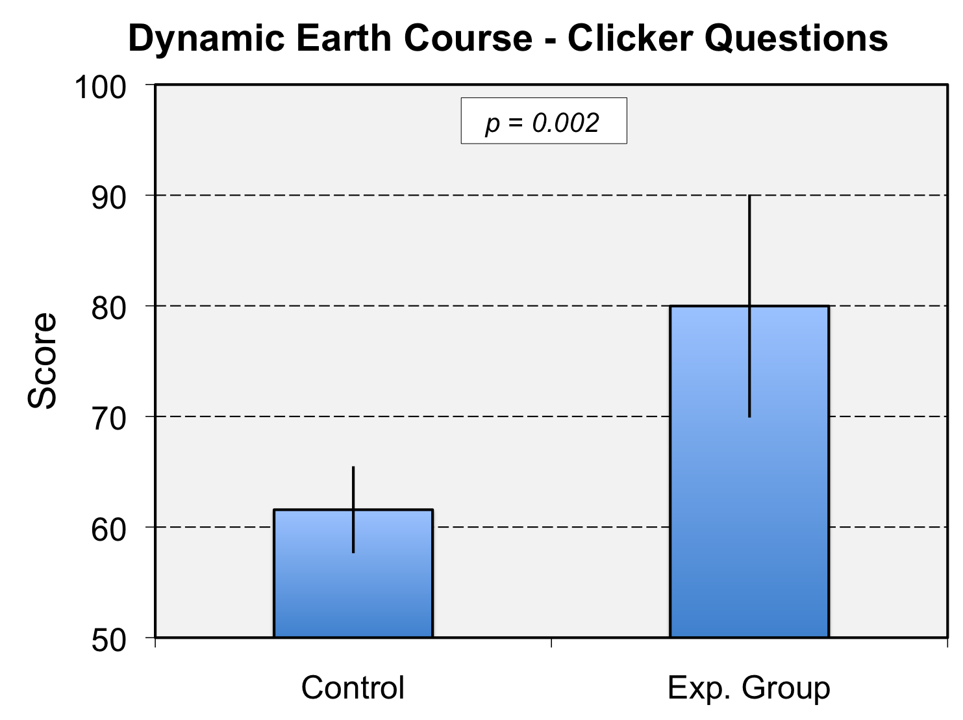
Classroom Activities
Effect Size = 1.35 (Large)
Clicker Questions
Effect Size = 1.08 (Large)

Slide 57
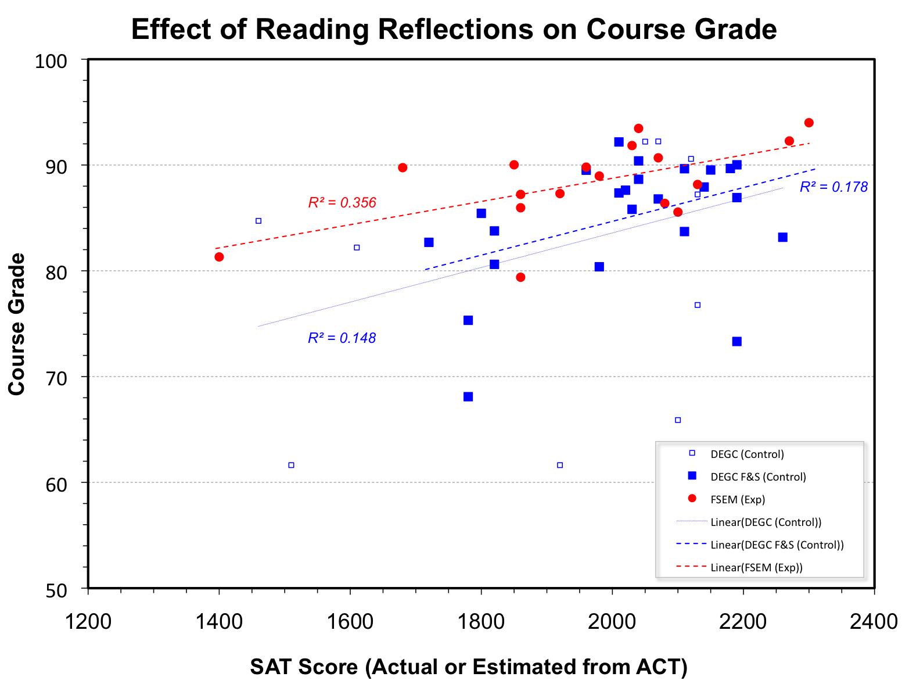

Slide 58
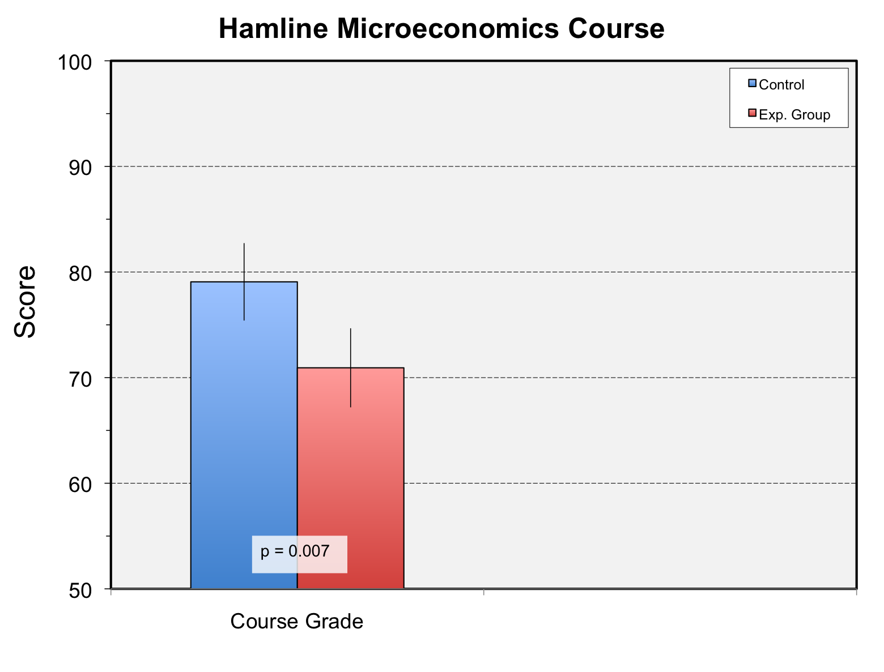

Slide 59
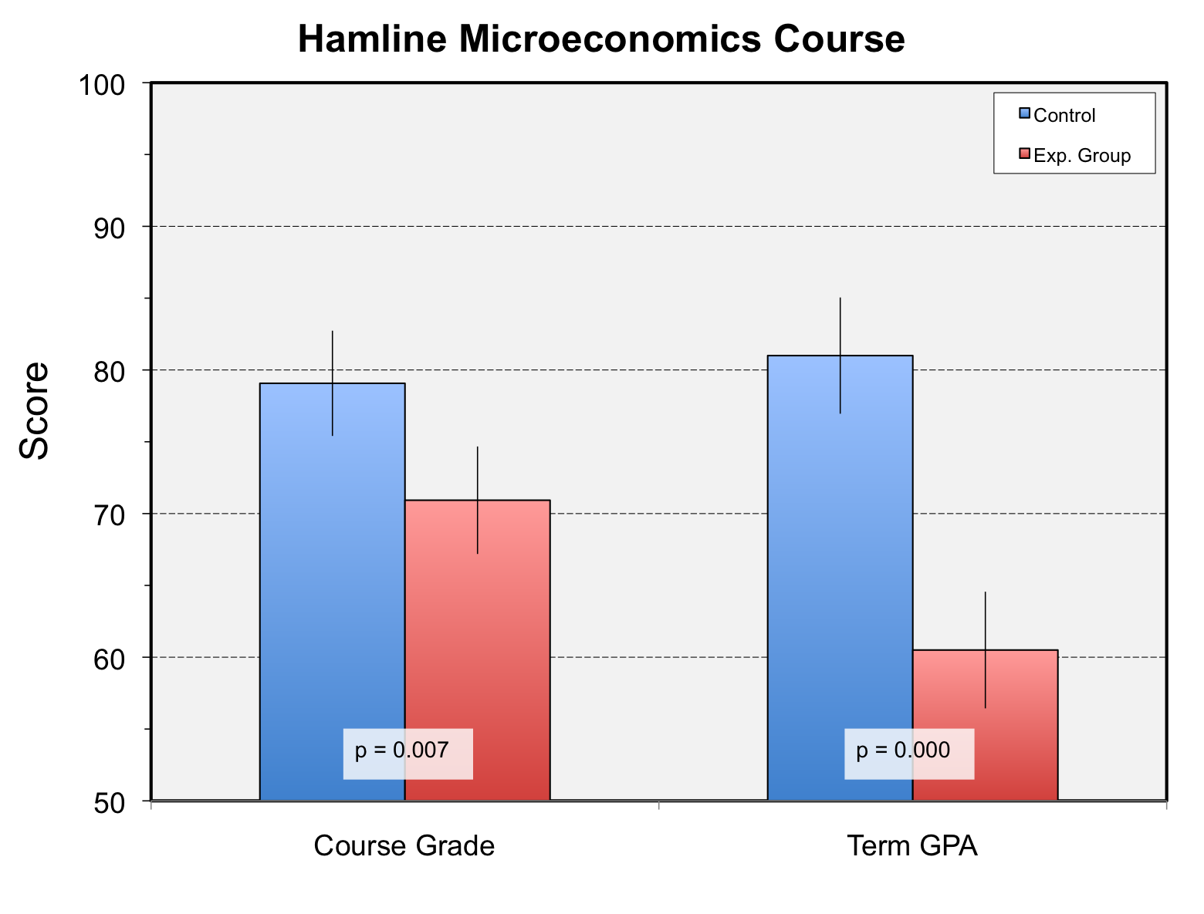

Slide 60
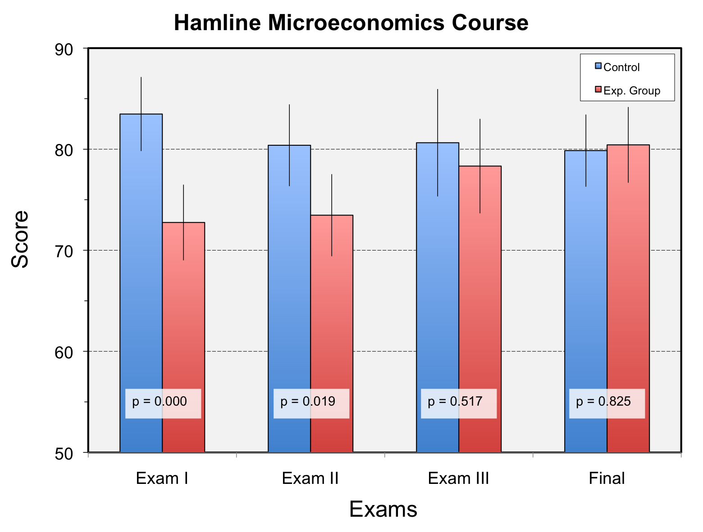
Reading Reflections

Slide 61
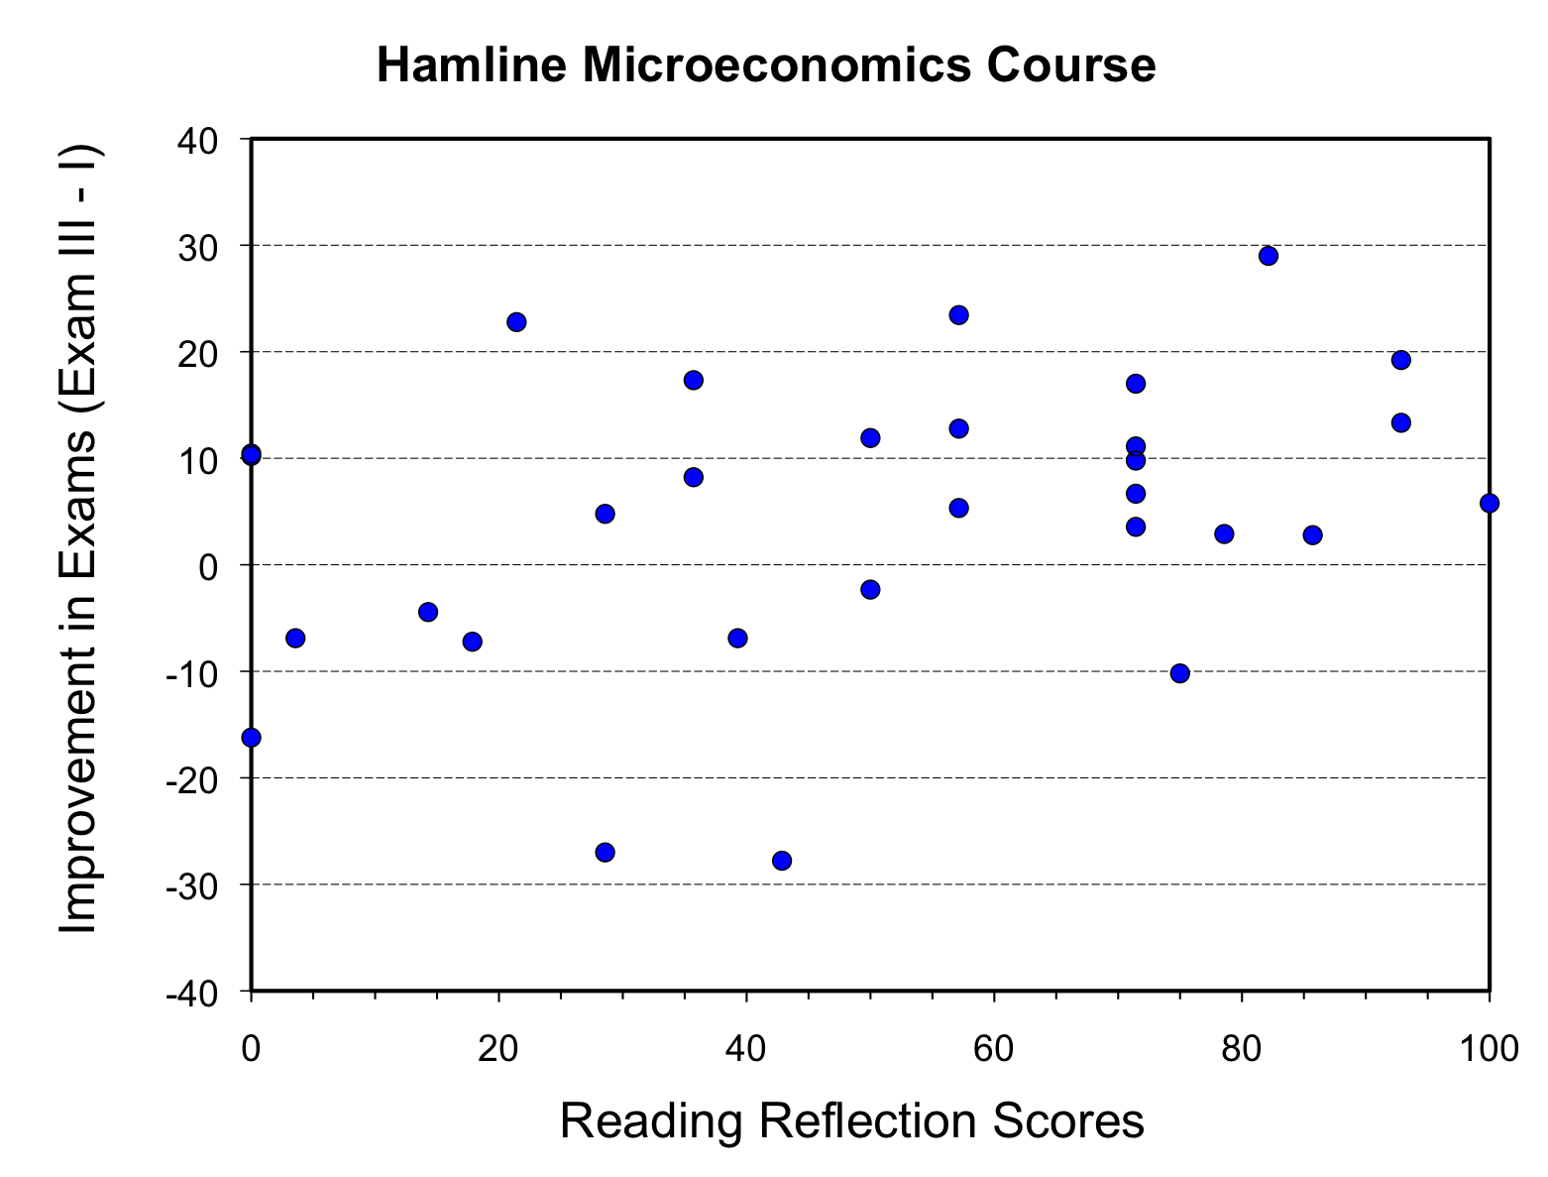
r = 0.340
p = 0.066

Slide 62
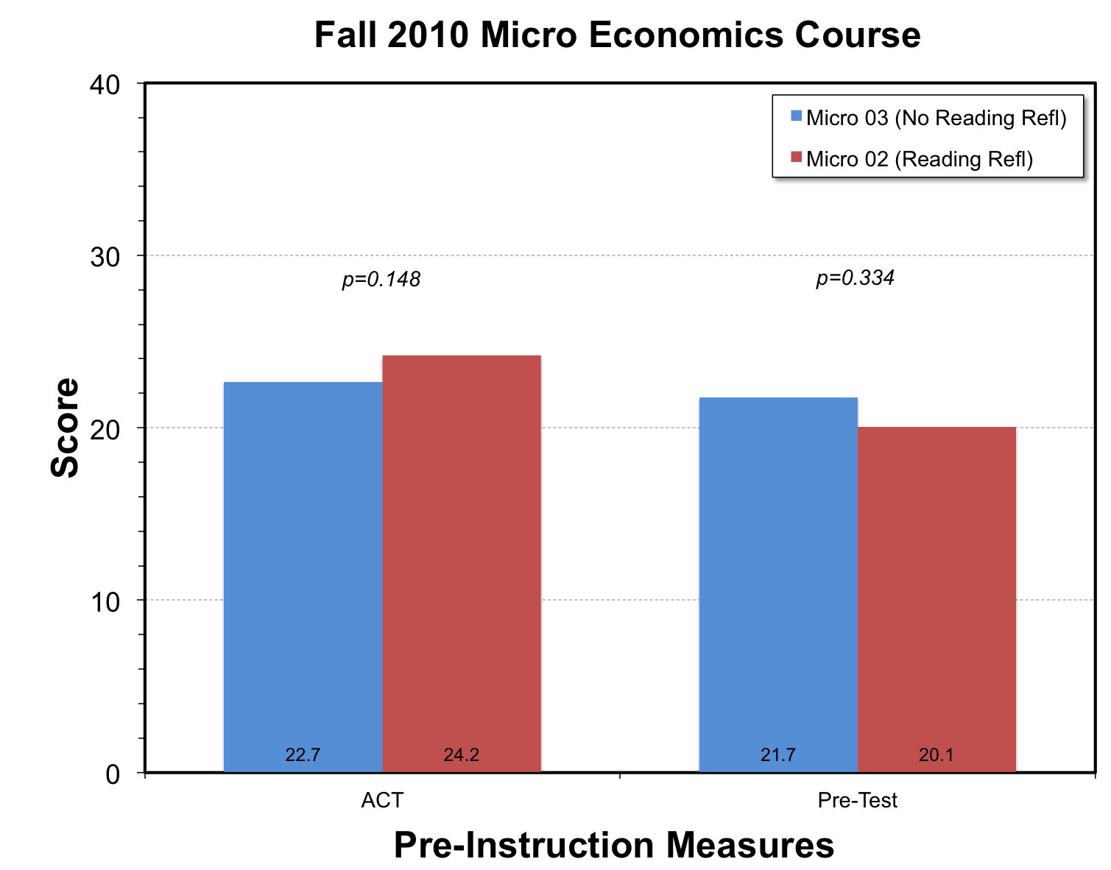

Slide 63
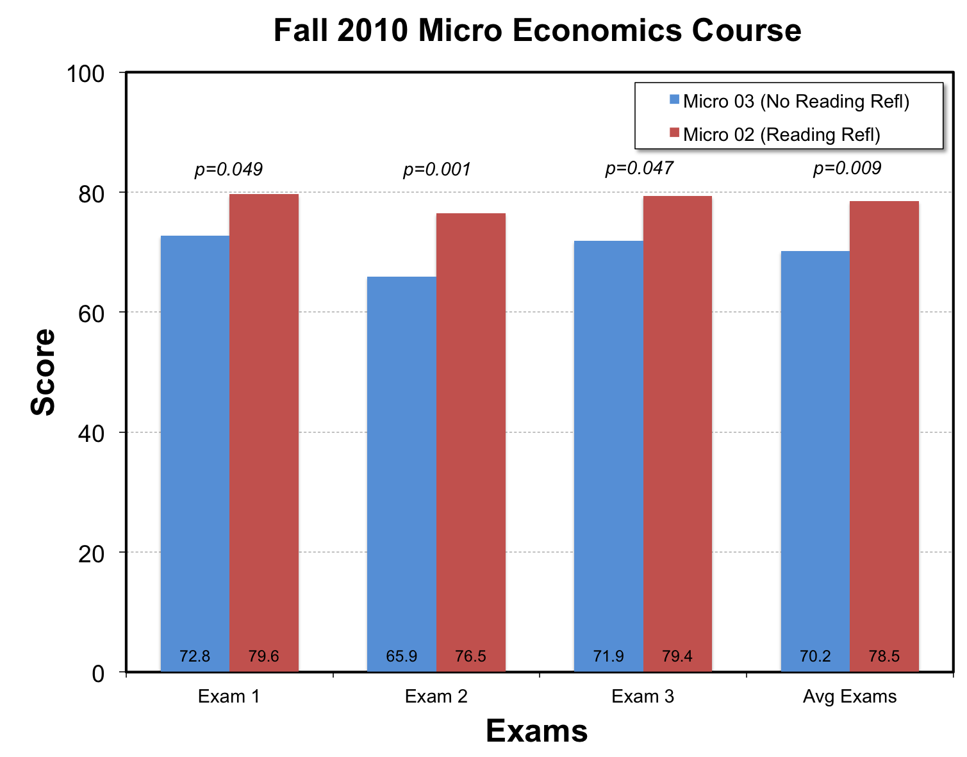

Slide 64
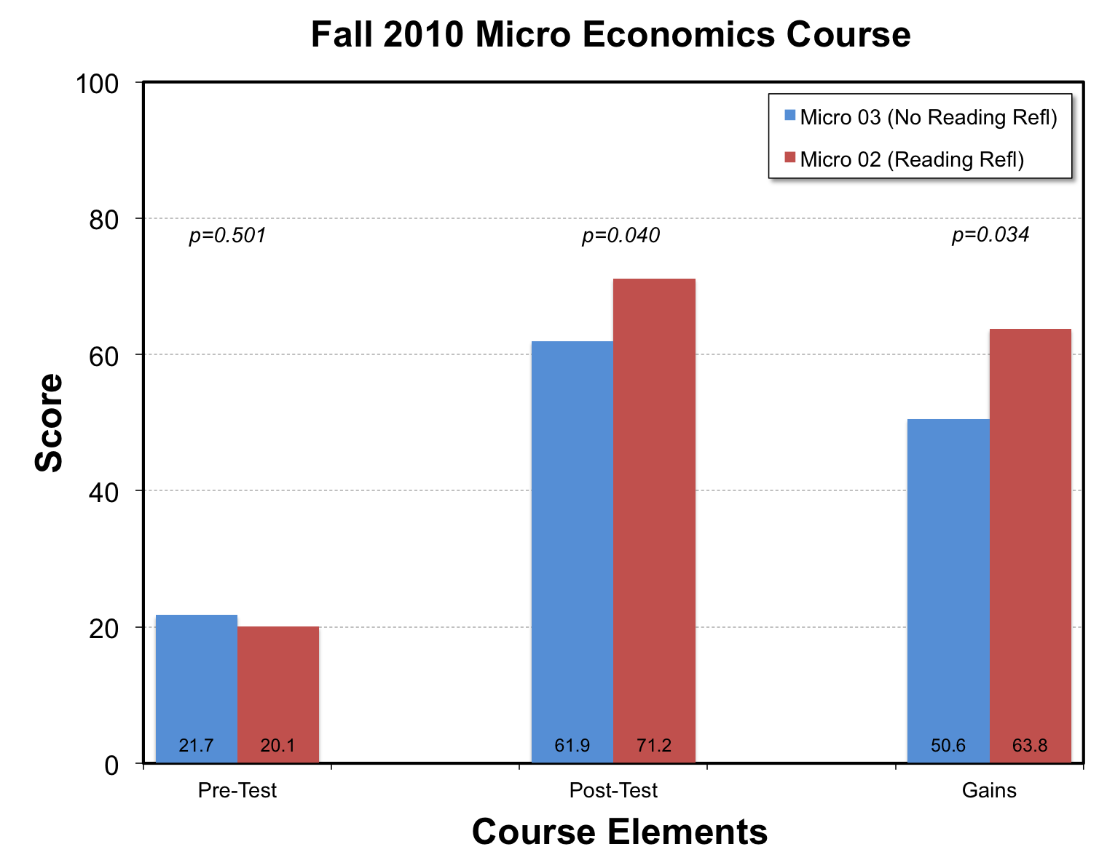

Slide 65
Learning Reflections:
Supporting Learning with
Reflection-on-Action

Slide 66
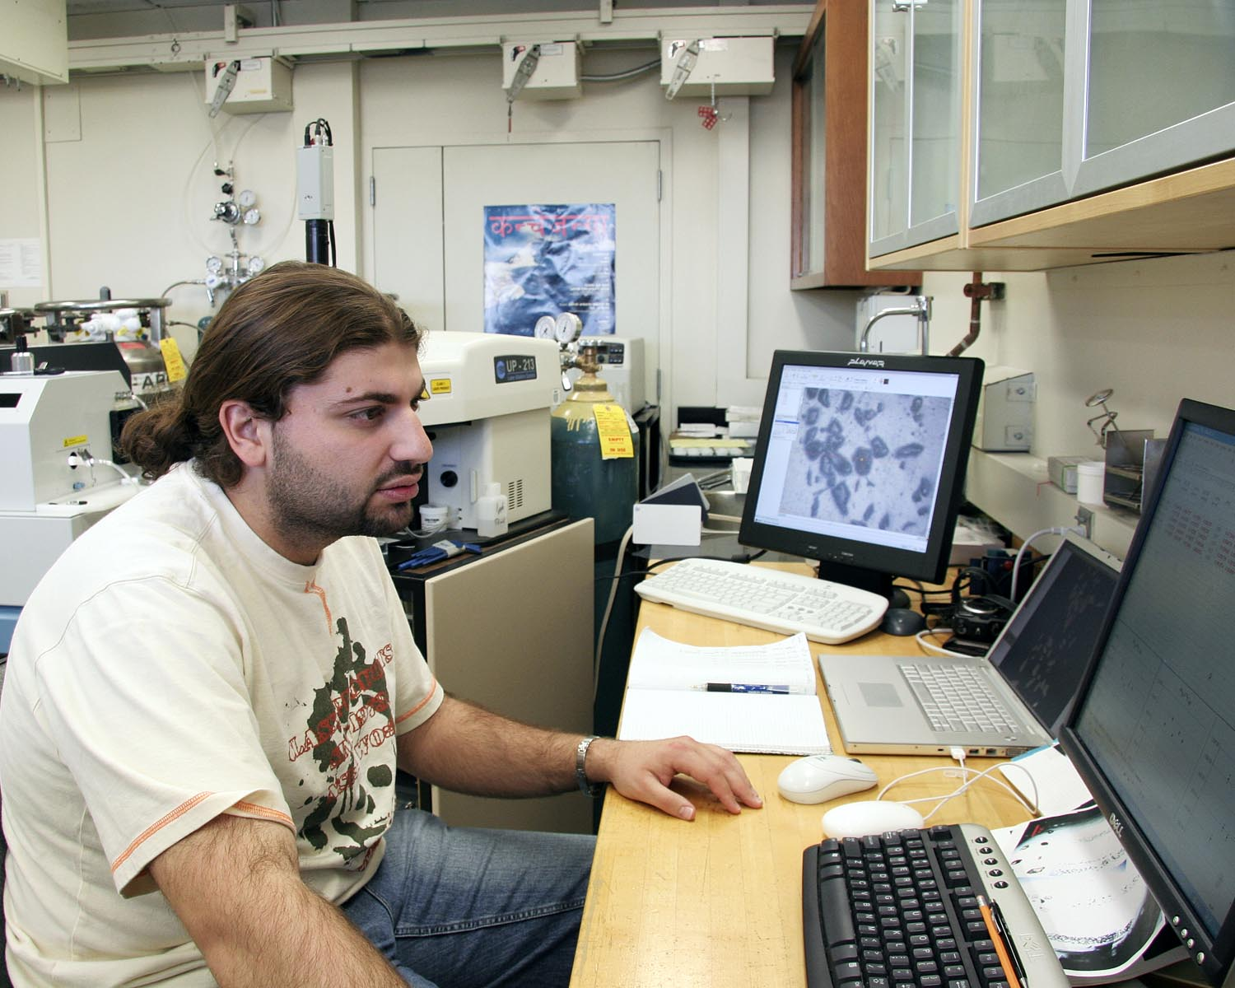
Reflecting on Learning
What are the three most important things you have learned? Why?
Describe the learning
strategies that you are using.
How might they be adapted
for more effective learning?
How does learning in this course relate to other courses?

Slide 67

Learning Portfolios/Journaling
Everything that students do goes in a binder
Collect every 2 weeks
Along with their graded work
They include 1-2 page essays

Slide 68
Portfolios - Essay Topics
Motivation and Value
Why are you taking this course?
How hard do you think you will work for this class?
Why will what you learn in this class be important in the future?
Levels of Thinking
Consider the projects and assignments that you have completed in this class.
What level of thinking and reasoning do they represent? Use Bloom’s scale to answer this question.

Slide 69
Portfolios - Essay Topics
Strategies:
What things taking place outside of this class are helping you do well in this class?
What things are hindering your ability to do well?
What can/should you do to take advantage of the good things and to avoid the bad?
Learning and Affect:
What personal characteristics do you have that help or hinder your ability to succeed in this class?
Compare your answers to Krathwohl’s hierarchy of the affective domain

Slide 70
Portfolios - Essay Topics
Task Value:
What is/are the most important thing/s you have learned so far in this class?
How long do you think you will retain that knowledge after the end of the semester?
Development:
Where do you rate yourself using Perry’s level of intellectual development?
Where do you expect to be by the end of your college career?

Slide 71
Portfolios - Essay Topics
Critical Thinking:
Give three examples of critical thinking that you have done as part of this class.
Explain why the examples represent critical thinking.
Studying:
How do you study for exams in this class?
Is your studying working?
Explain why or why not.
If not, what alternative approaches will you use in the future?

Slide 72
Portfolios - Essay Topics
Review the material in your portfolio:
Which projects and activities have most/least contributed to your learning this semester?
Why?
Read the essays you have put into your portfolio:
Do you see any evolution/change in your thinking about learning since the beginning of the semester?
Explain and use evidence from other material in the portfolio to support your explanation.

Slide 73
Analysis of Reflective Essays
Individually, skim the four essays provided
2289
1279
4196
3288
Consider the following:
Which of these is the most reflective?
Do some of the responses seem superficial?
What do you think students have learned from writing these essays
Which essay was written by the “A” student?
Notes:
pre-frontal cortex, associated with cognitive control, undergoes significant restructuring well into the 20’s
Research shows that metacognitive skills and self-regulatory processes are teachable and can lead to increases in student motivation and achievement. However, few teachers effectively prepare students to be independent, self-directing learners.

Slide 74
A little focusing goes a long way
When we tell you, turn over the sheet and “learn” the phrases
You have (about) 30 seconds

Slide 75
Write down as many of the phrases as you can remember.

Slide 76
Knowledge Surveys:
Monitoring, Evaluating, and Planning

Slide 77
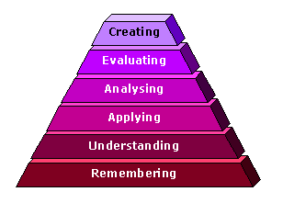
Goal-Setting, Monitoring &
Self-Assessment
Knowledge Surveys:
Introduced by Nuhfer (1993, 1996)
Content & skill objectives of course
Span levels of thinking (Bloom levels)
Students indicate knowledge/ability
I don't know the answer
I know some of the answer
I know the answer

Slide 78
Example Knowledge Survey
1 | List the cognitive processes in Bloom’s taxonomy.
2 | Explain how knowledge surveys might be used to improve student learning in a course.
3 | Write a knowledge survey and use it to assess learning and instructional practices in one of your courses.
4 | Compare the assessment of student learning using knowledge surveys with other forms of authentic assessment.
5 | Appraise the efficacy of knowledge surveys for learning and classroom assessment.
6 | Design an integrated assessment plan for your course that includes knowledge surveys and use it to understand and improve instruction.
I don't know the answer
I know ~50% of answer
I know the answer

Slide 79
Example Survey Items
Items | Level
What is a mineral? | Remember
Describe the cooling of a basaltic magma using Bowen’s Reaction Series. | Understand
Calculate the relief of a region using a map. | Apply
Compare the generation of melts along convergent and divergent plate boundaries. | Analyze
Evaluate three potential sites for a landfill. | Evaluate
Construct a model of the origin of a suite of rocks from the Sonju Lake Intrusion. | Create

Slide 80
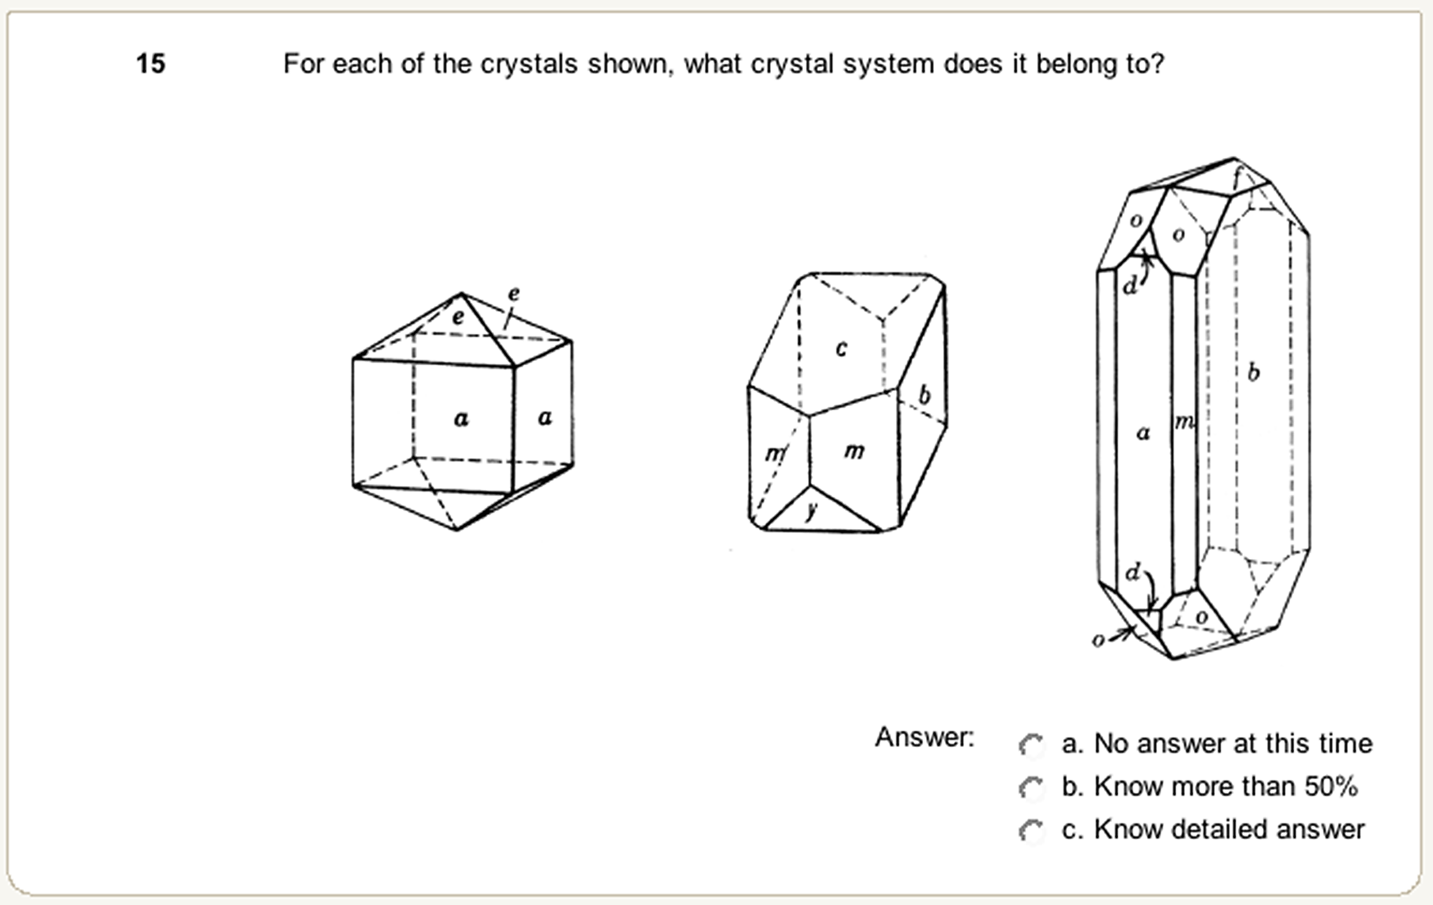
Survey Items

Slide 81
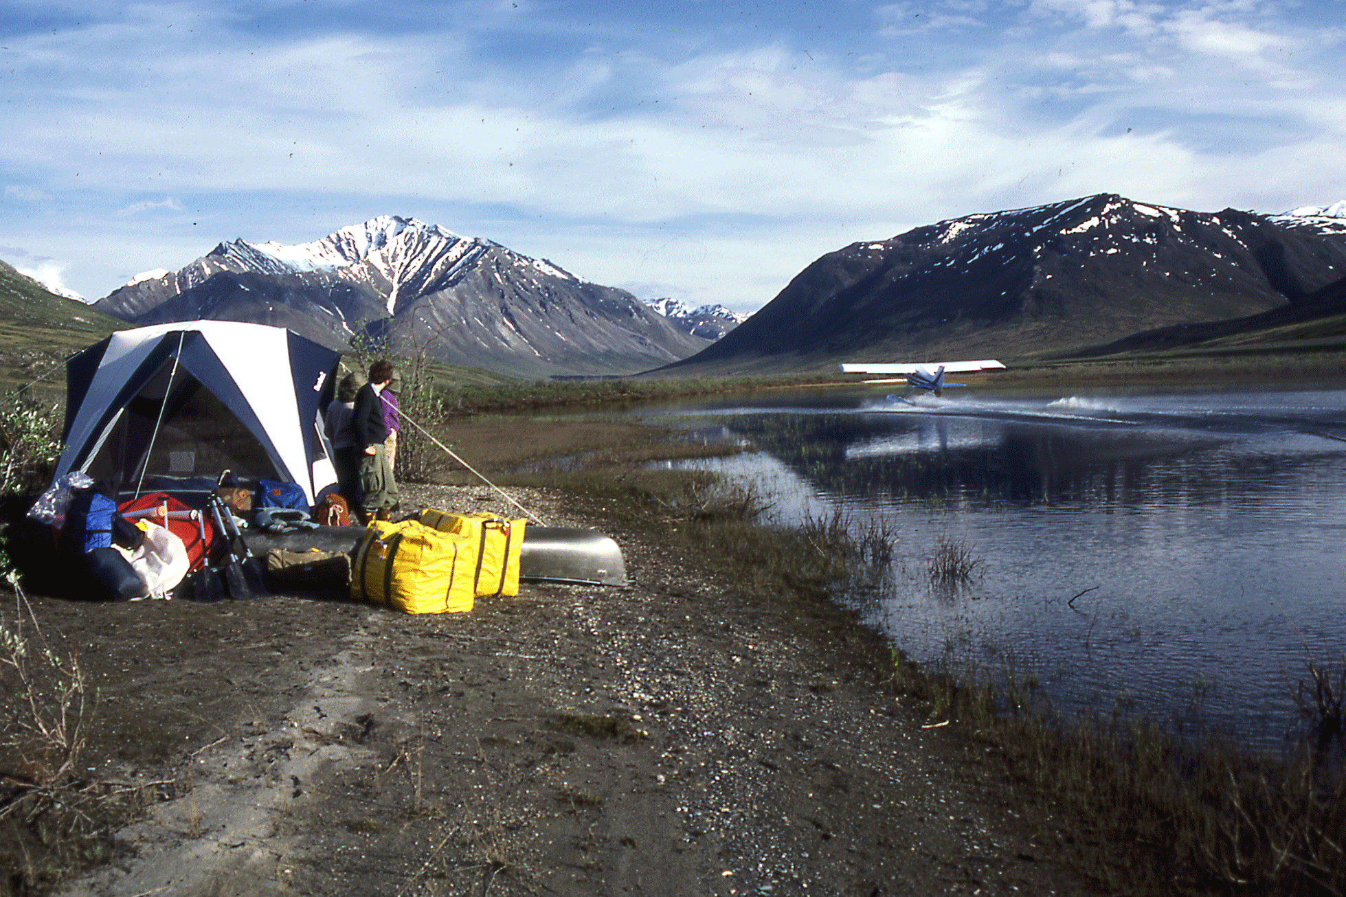
Administering Knowledge Surveys
Single class, Unit, Course, Curriculum
Paper (in-class)
Electronic (out-of-class; data management)
Beginning of Course
End-of-Course
Pre-Exam
Graduating Seniors
Alumni

Slide 82
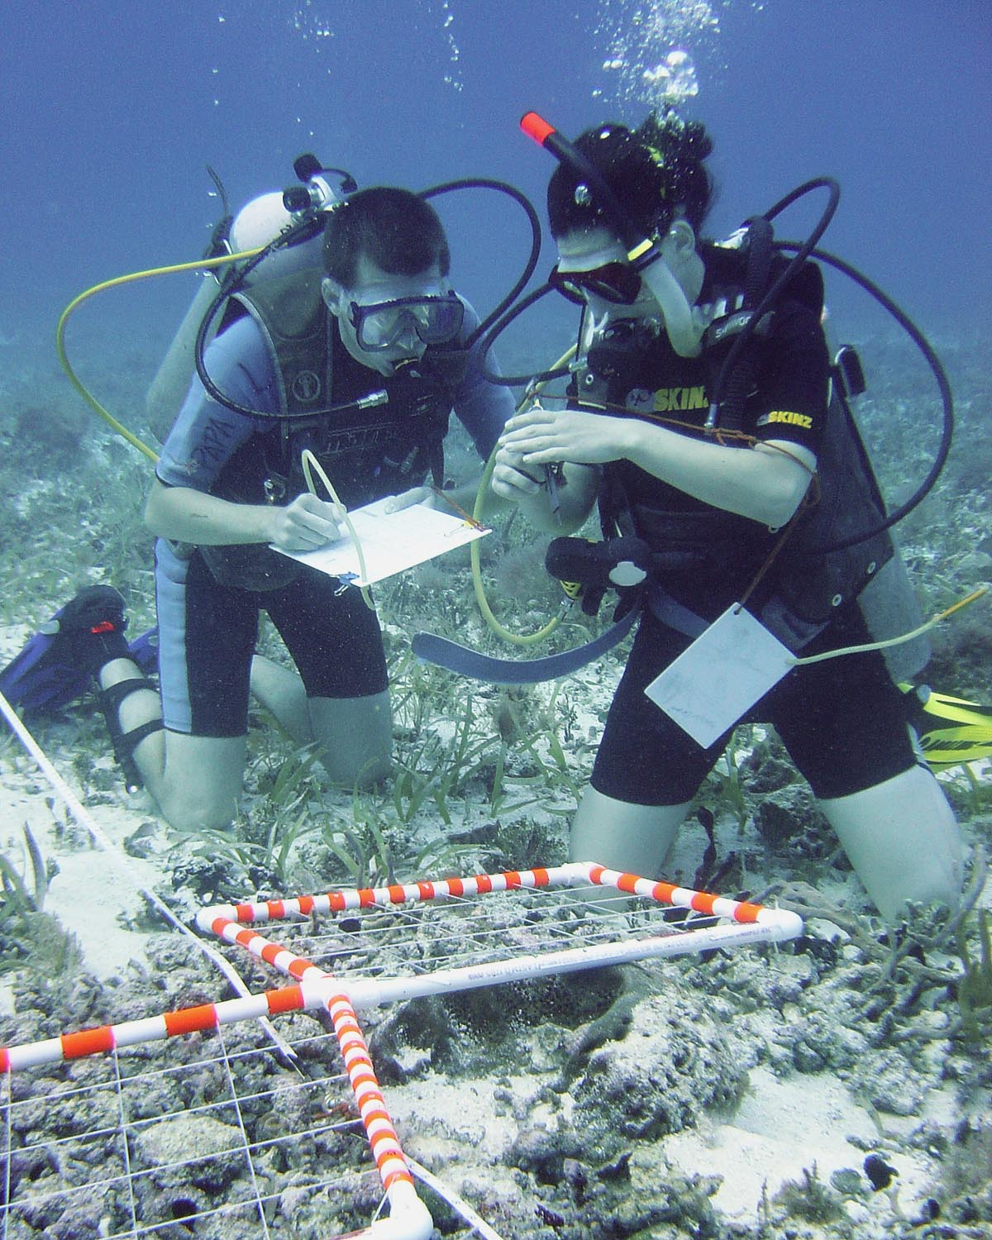
Utility of Knowledge Surveys
Course Design
Clarification of course objectives and structure
Improved organization and preparation
Students
Full disclosure of course objectives and expectations
Study guide
Formative assessment tool
Development of self-assessment skills
Instructors
Assessment of learning gains
Course assessment
Assessment of instructional practices
Programs
Program Objectives
Student Learning

Slide 83
KS Results - Individuals

Slide 84
Knowledge Survey & Exam Results

Slide 85
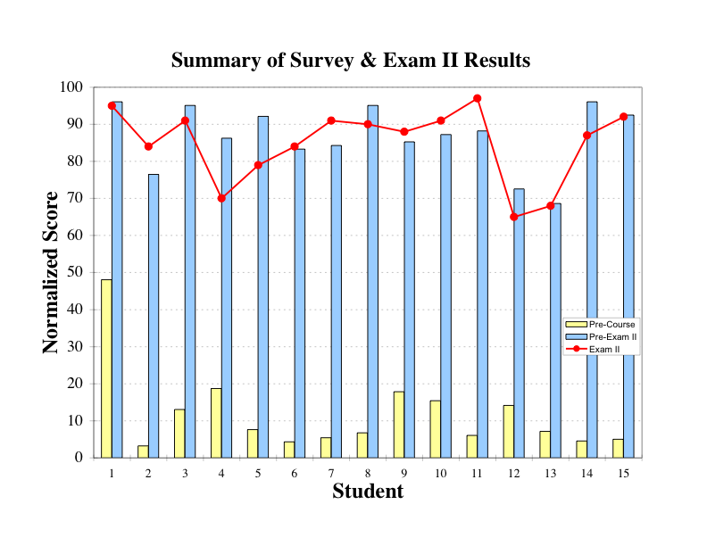
Knowledge Survey Results

Slide 86
KS & Exam Results - Learning

Slide 87
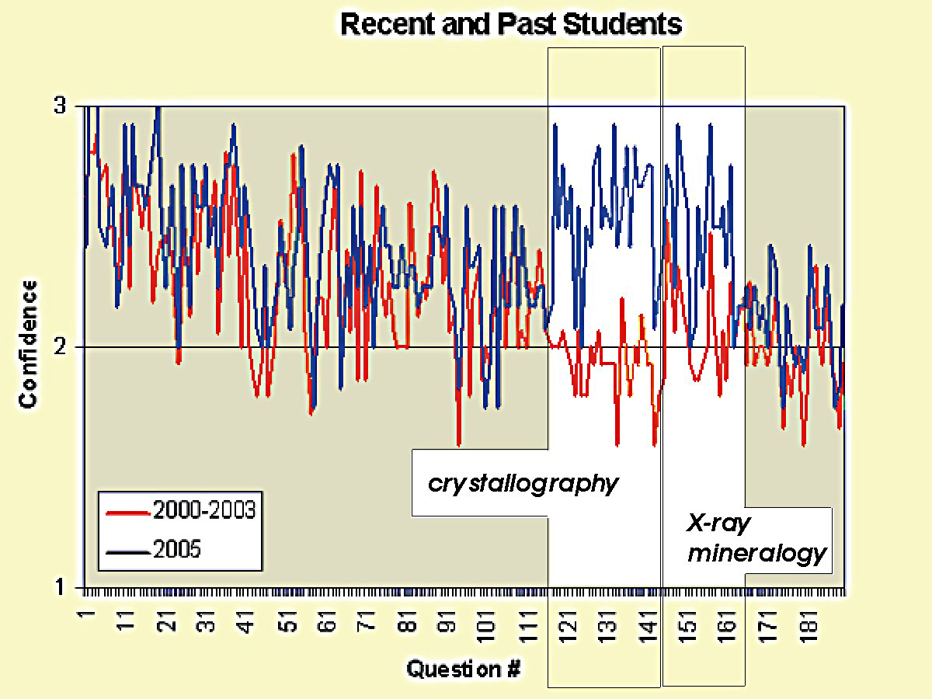

Slide 88
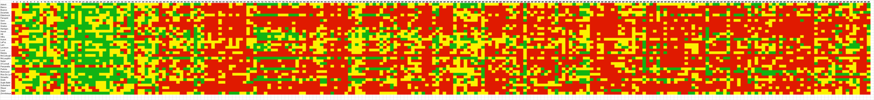
“Map” of Learning for Dynamic Earth
Pre-Course Survey
Students
Survey Items

Slide 89
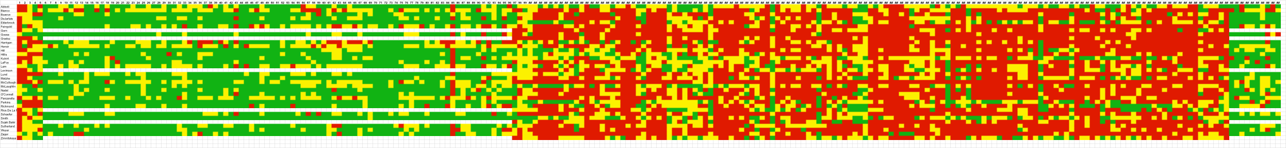
“Map” of Learning for Dynamic Earth
Pre-Course Survey
Pre-Exam I Survey

Slide 90
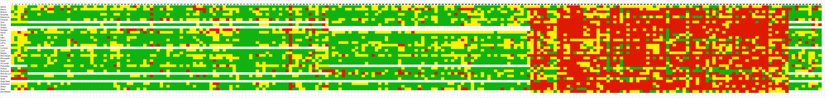
“Map” of Learning for Dynamic Earth
Pre-Course Survey
Pre-Exam I Survey
Pre-Exam II Survey

Slide 91
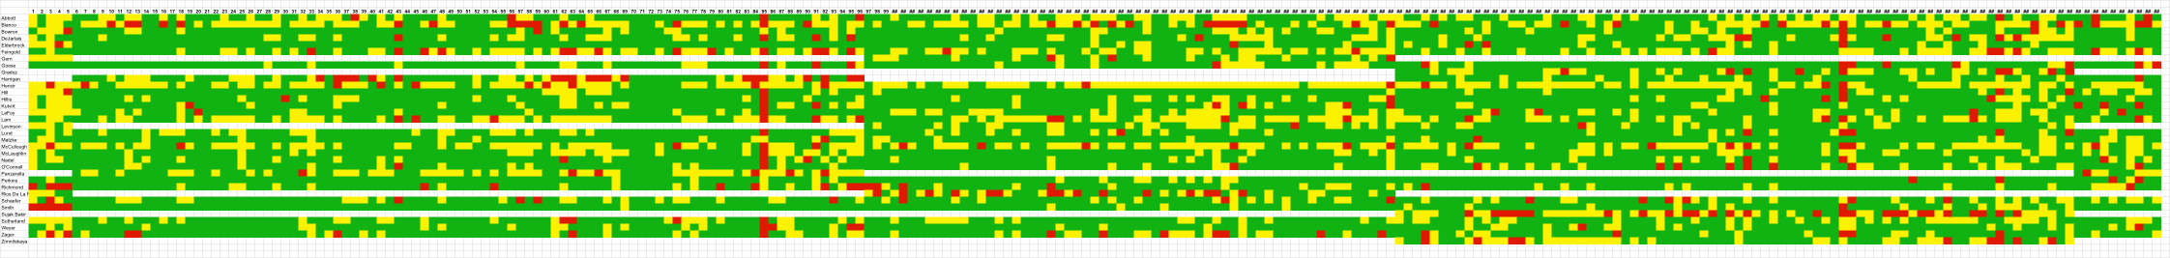
“Map” of Learning for Dynamic Earth
Pre-Course Survey
Pre-Exam I Survey
Pre-Exam II Survey
Pre-Exam III Survey

Slide 92
Interpreting Knowledge Surveys
In groups discuss the following for each of knowledge survey plots:
What is shown?
What does it mean?
On the basis of these results, what ideas do you have for improving learning?

Slide 93
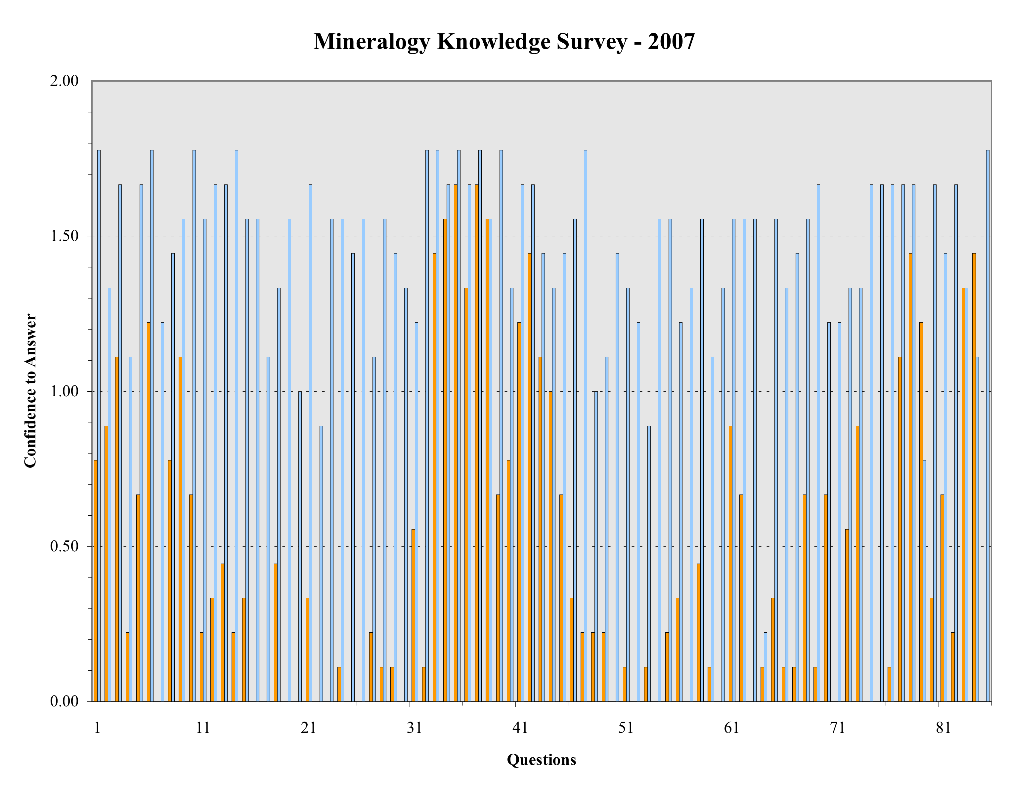
Results of pre-course knowledge survey and pre-exam I knowledge survey. Full scale = “know answer.”

Slide 94
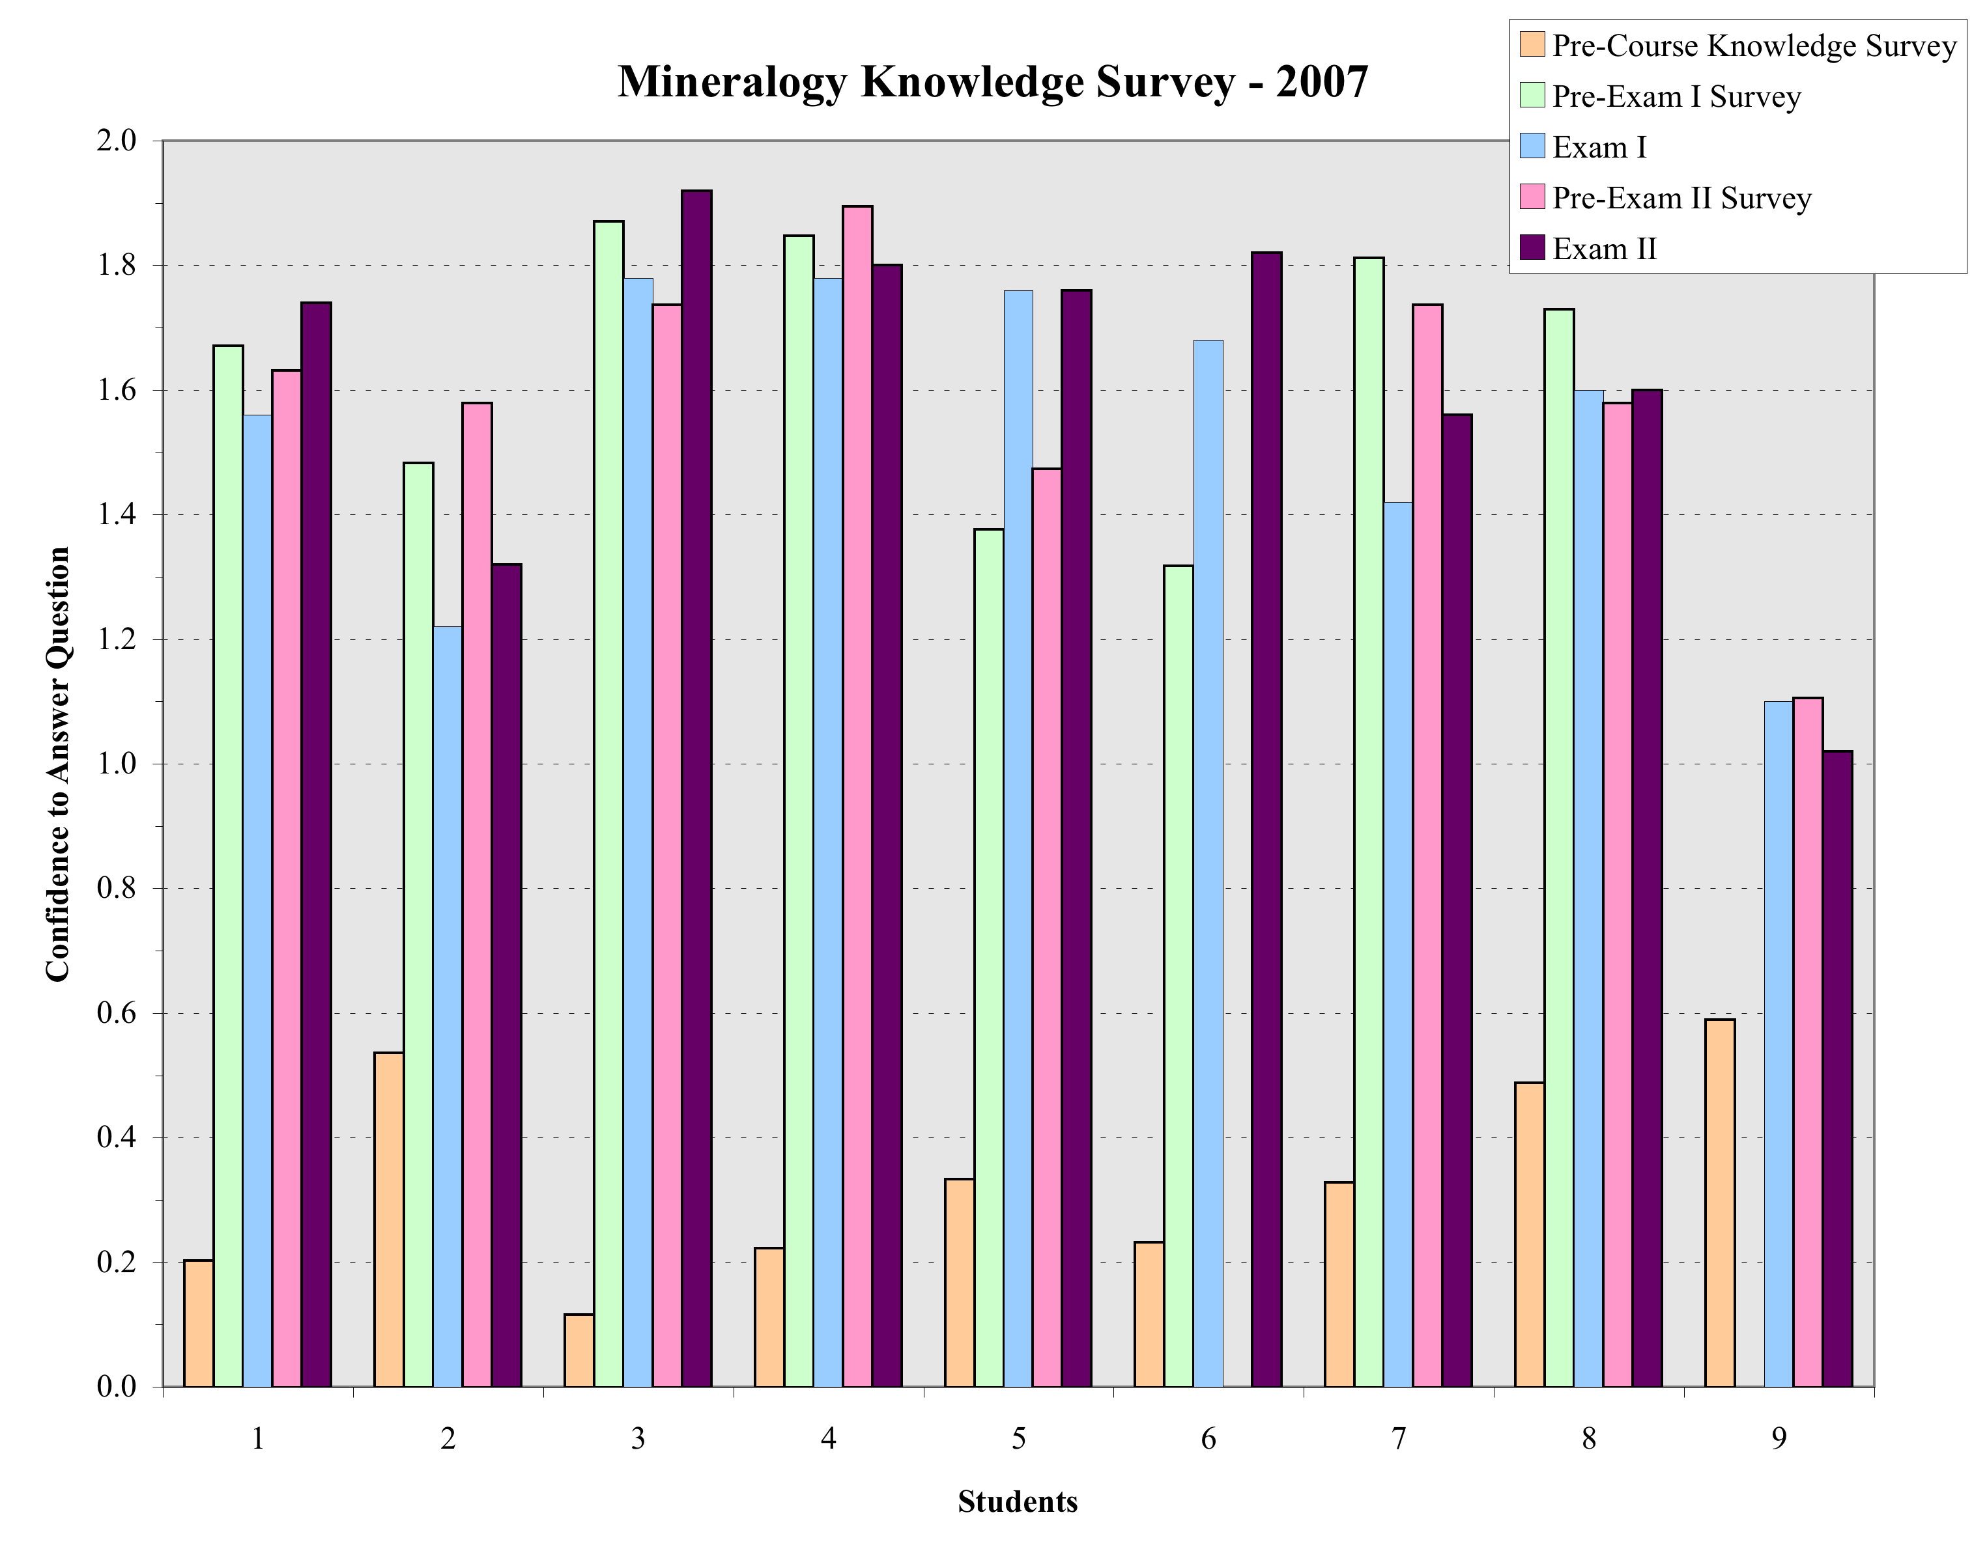
Results of pre-course knowledge survey, pre-exam I and II knowledge surveys and exam I and II scores.

Slide 95
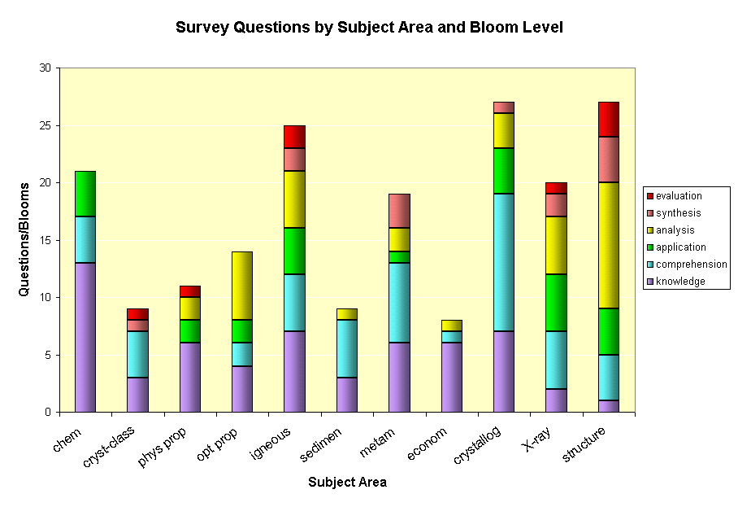
Blooms levels of survey items for different units of a course.

Slide 96
Results of pre- and post-course surveys. Items sorted by pre-course responses and Bloom levels.

Slide 97
Post-course knowledge survey results from two different sections of the same course; one taught with traditional lecture and lab, the other with problem-based learning.

Slide 98

Results of knowledge survey conducted at the end of the 2005 academic year of students who completed the Mineralogy course in 2005, 2004, and 2000-2003.

Slide 99

Learning Through the Curriculum
Pre- and post-course survey results for one course in each year of a curriculum. Scale: 1 = no answer; 3 = know answer.
(Courtesy of Ed Nuhfer)

Slide 100

Learning Through the Curriculum
Bloom levels of knowledge survey questions in one course in each year of curriculum.
(Courtesy of Ed Nuhfer)

Slide 101
Wrappers:
A Structured Reflection-for-Action

Slide 102

Exam “Wrapper”
Self Evaluation
Preparation Strategies
Performance Analysis
Planning
Achacoso (2004)
Lovett (2008)
Notes:
Wirth - Cutting Edge Metacognition Workshop
10/7/11
102

Slide 103

Exam Preparation

Slide 104


Exam “Wrapper” Results
Study Strategies
Analysis of Errors
Notes:
Wirth - Cutting Edge Metacognition Workshop
10/7/11
104

Slide 105

Exam “Wrapper” Results
Notes:
Wirth - Cutting Edge Metacognition Workshop
10/7/11
105

Slide 106

Exam “Wrapper” Results
Notes:
Wirth - Cutting Edge Metacognition Workshop
10/7/11
106

Slide 107
Next Steps – Theory into Action
Describe one thing that you will do when you return to improve student learning:
Reflect individually
Share with small groups
Whole-group discussion

Slide 108

Reflection and closing thoughts…?

Slide 109


Slide 110
Why not start an EXPLICIT conversation about learning with your students/faculty today?

Slide 111

Purpose of Higher Education…?

Slide 112

Why Not Give Them A Map?
How will they get there…
…if they don’t know where they are going ?

Slide 113

Addressing The
Effect Of The Affect With A
Co-Curriculum On Learning
Karl Wirth
Macalester College
Dexter Perkins
University of North Dakota
6th Quadrennial Conference of the
International Geoscience Educators Organisation
Johannesburg, South Africa
01 September 2010

Slide 114
Analysis of Reflective Essays
Individually, skim the last essay (#3288), which is a response to the prompts:
Contrast and compare Perry’s four main levels of intellectual development.
Where do you think you fit on Perry’s scale. Explain.
Look at the sub-stages of Perry’s scale. Use these to characterize your current stage of development.
Do you agree with the statement “The affective domain is the greatest barrier to learning?”
What is metacognition, and how important is it to develop metacognitive skills?
Notes:
pre-frontal cortex, associated with cognitive control, undergoes significant restructuring well into the 20’s
Research shows that metacognitive skills and self-regulatory processes are teachable and can lead to increases in student motivation and achievement. However, few teachers effectively prepare students to be independent, self-directing learners.

