Slide 1

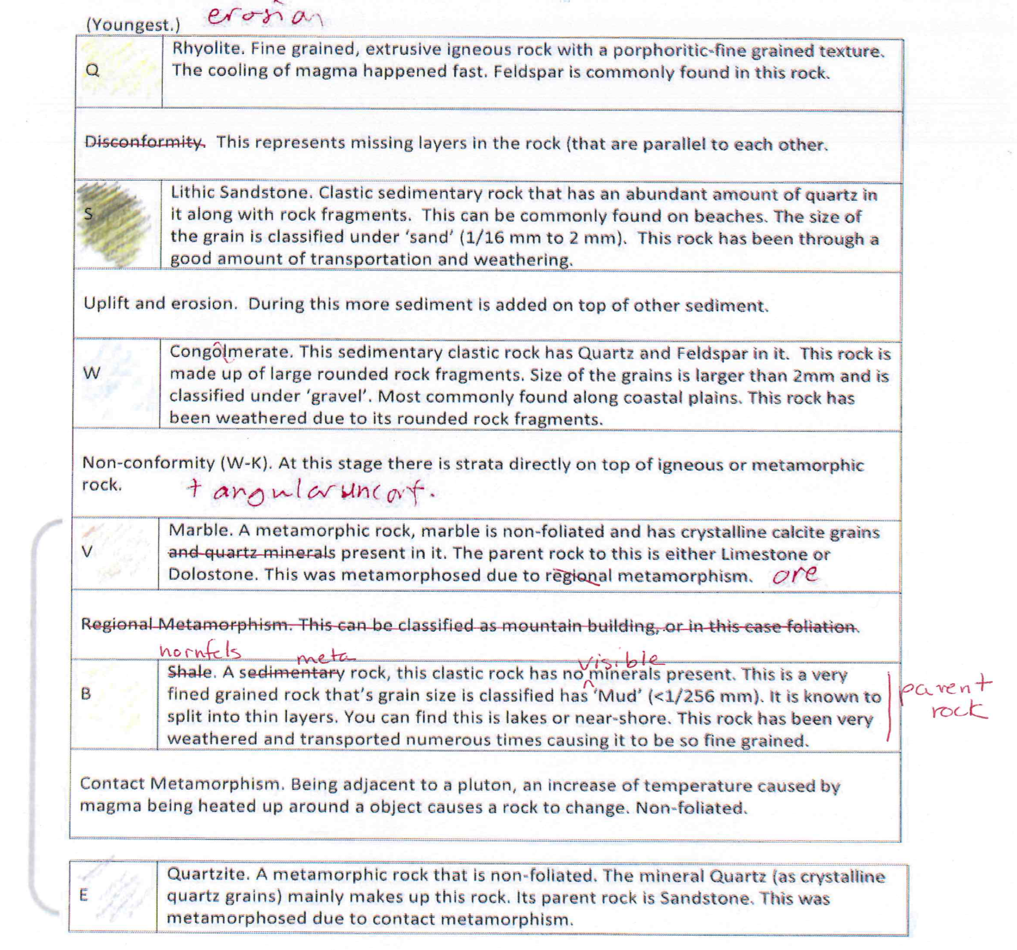
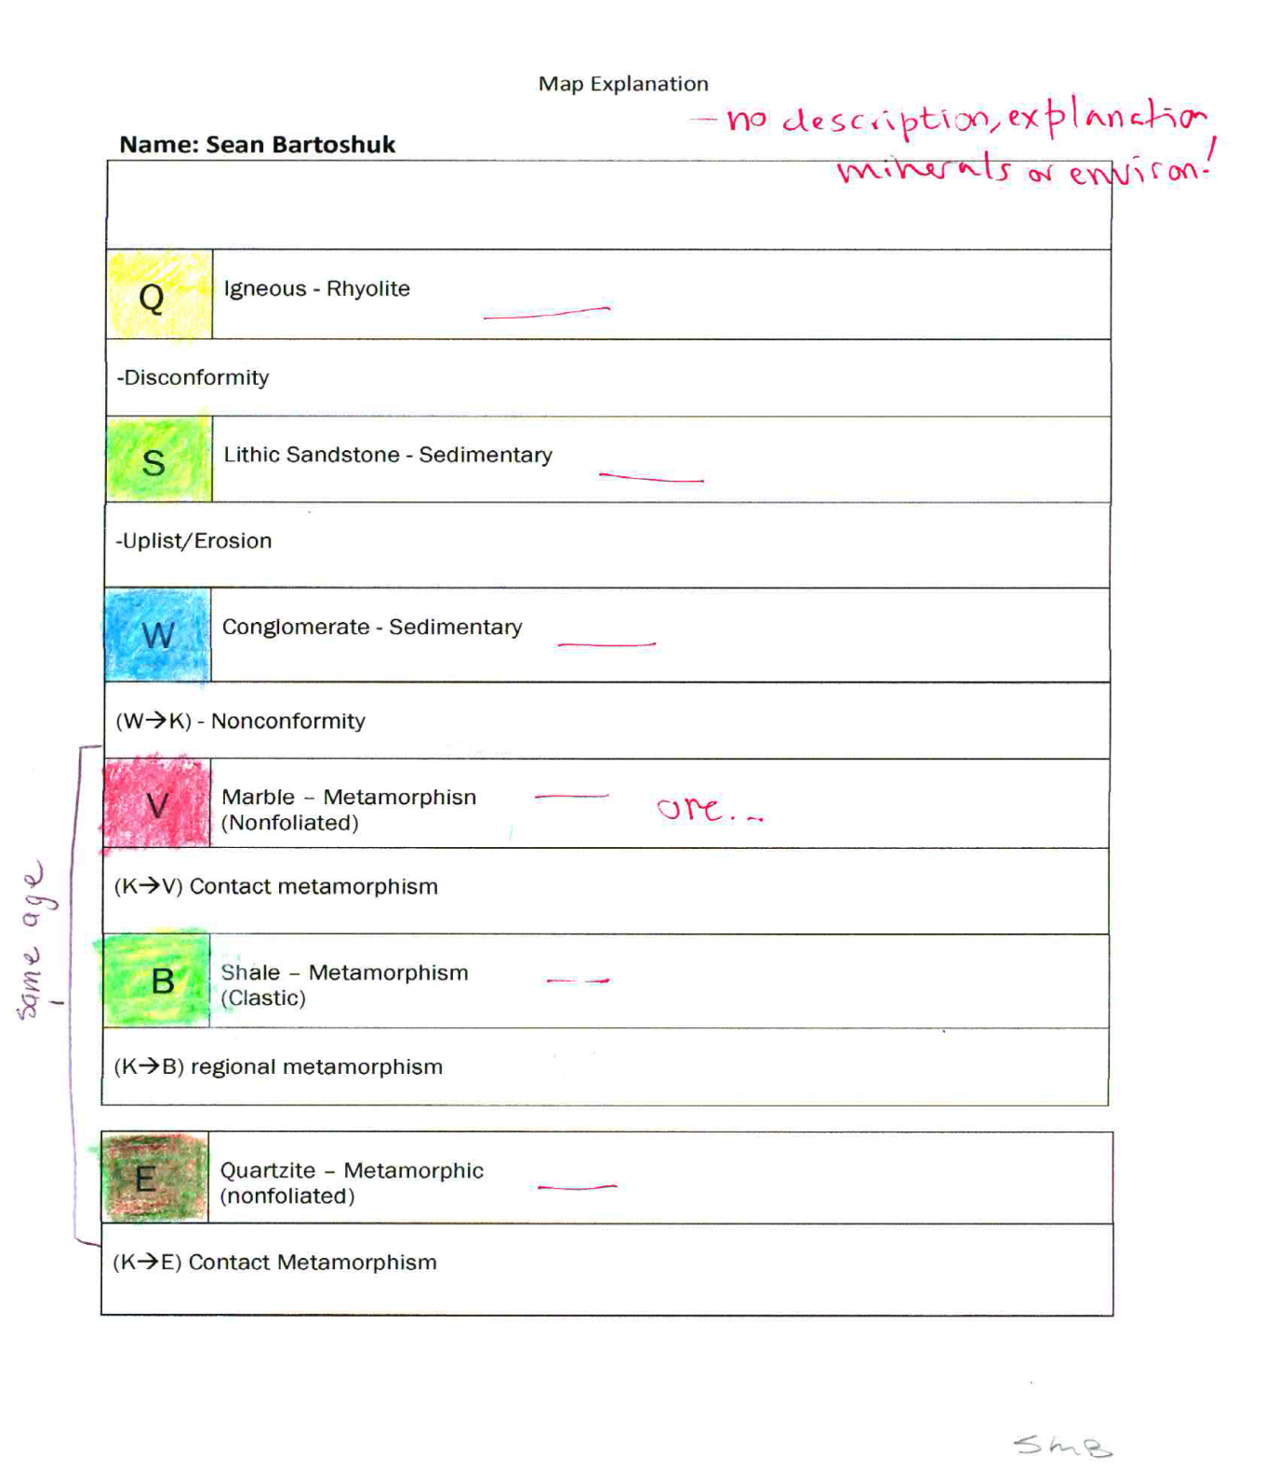
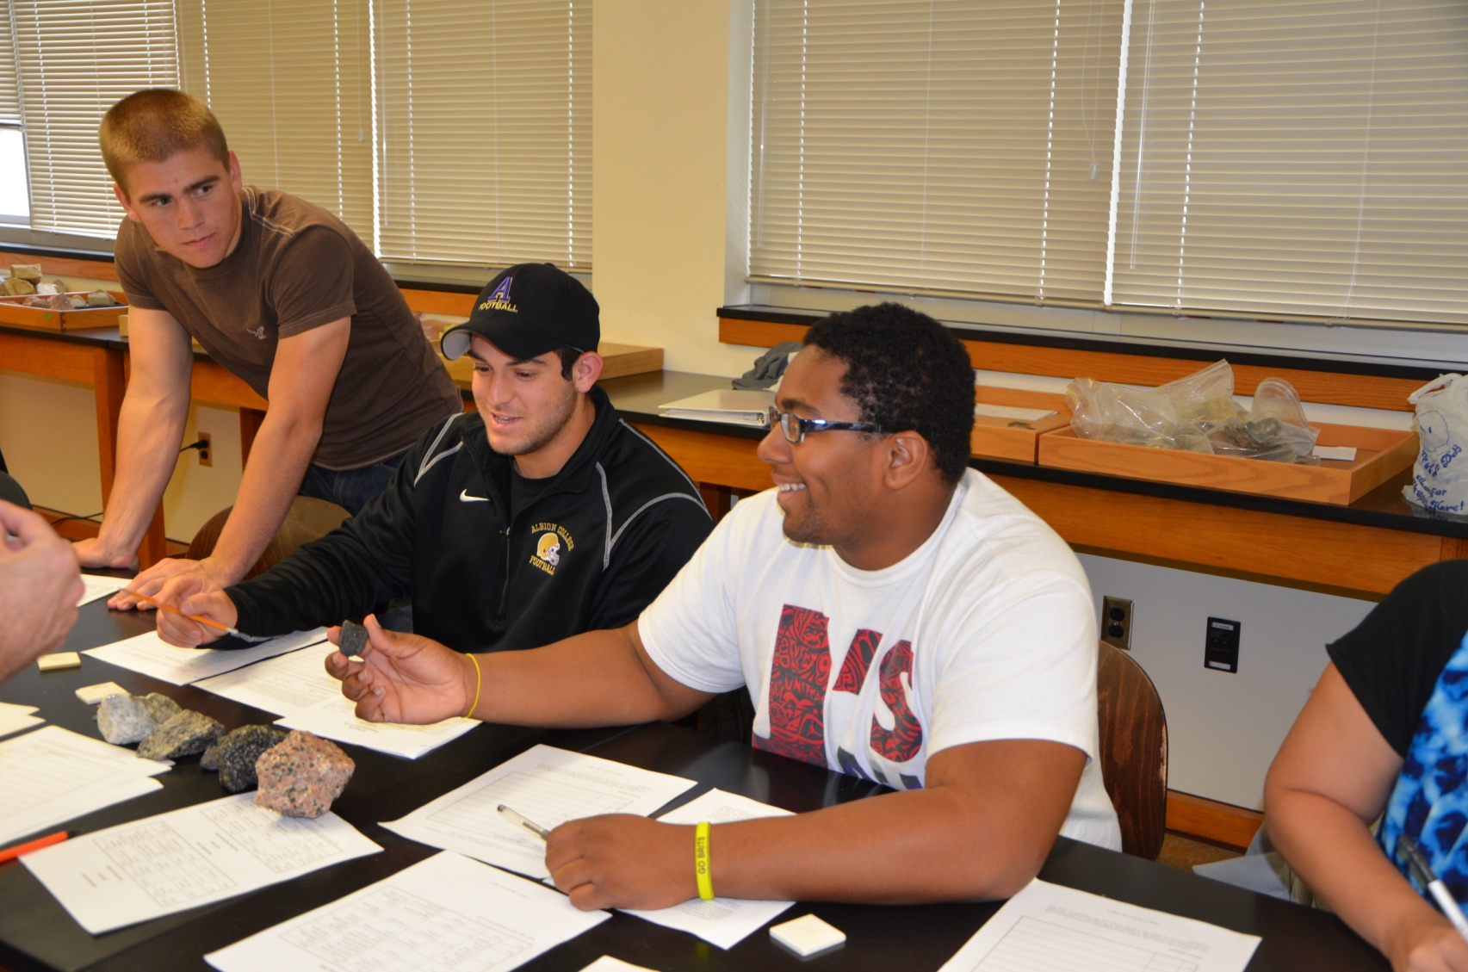
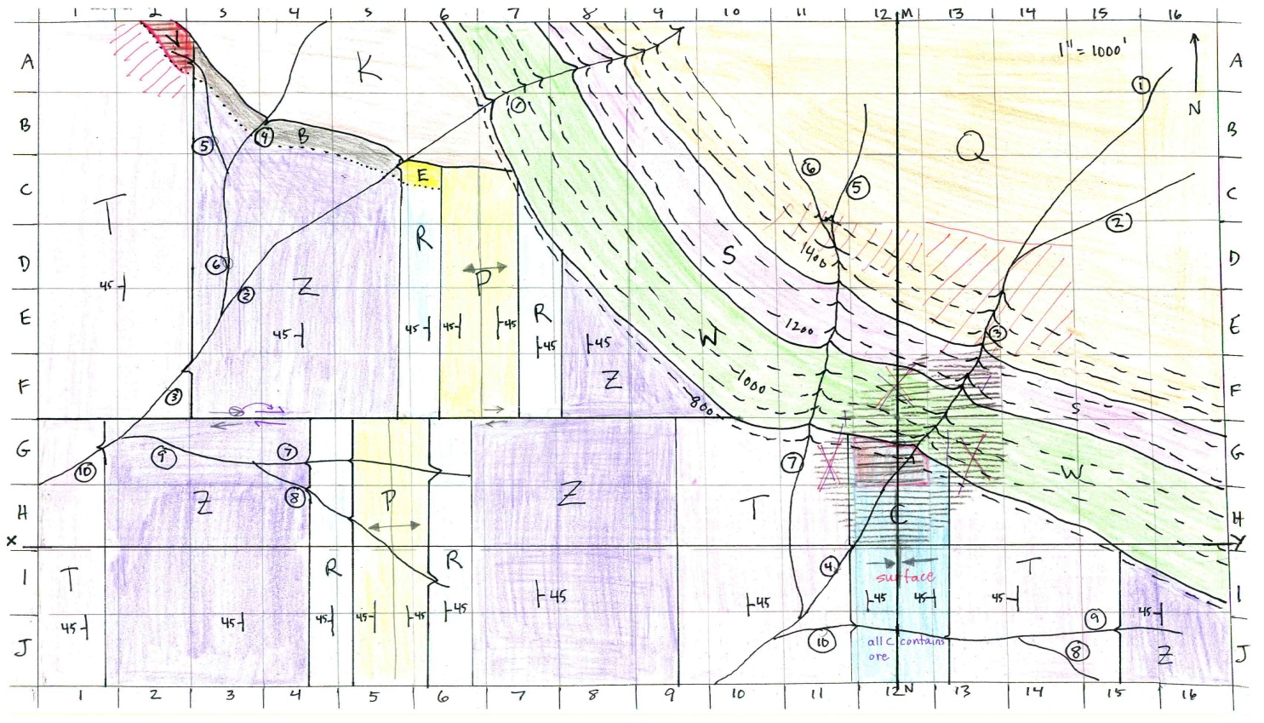
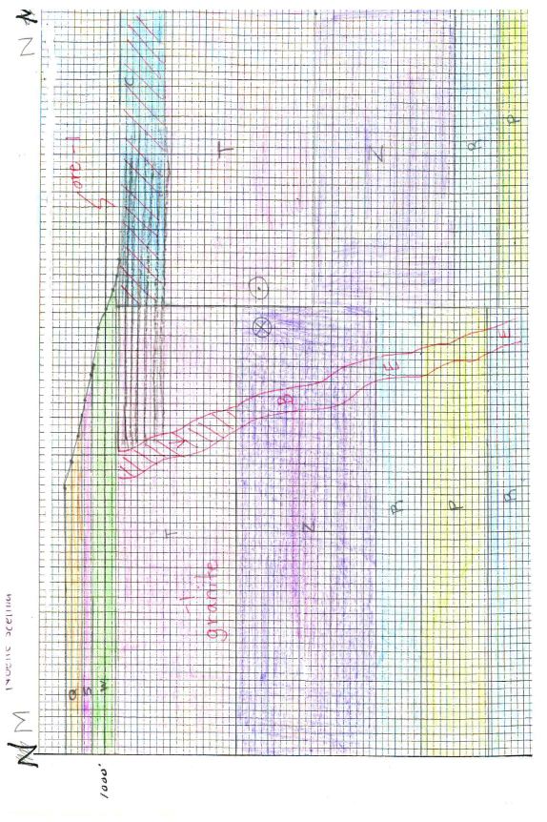
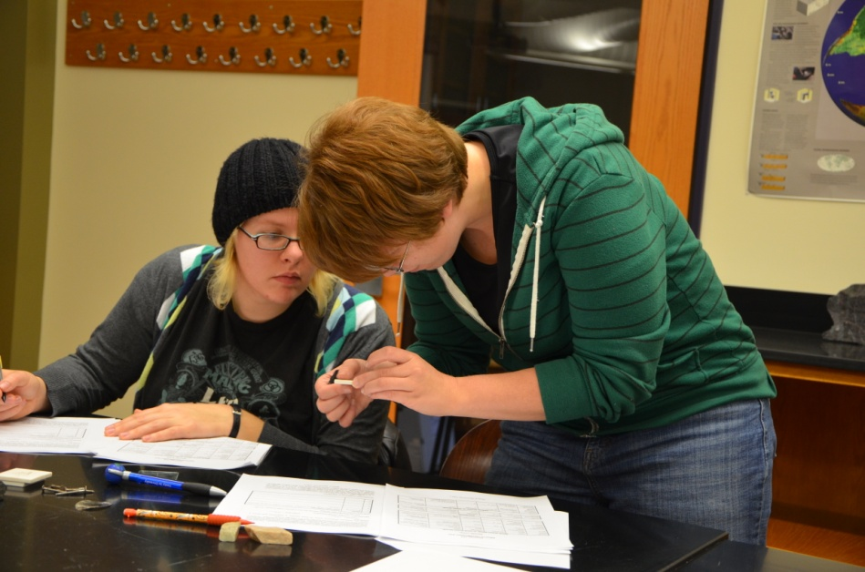
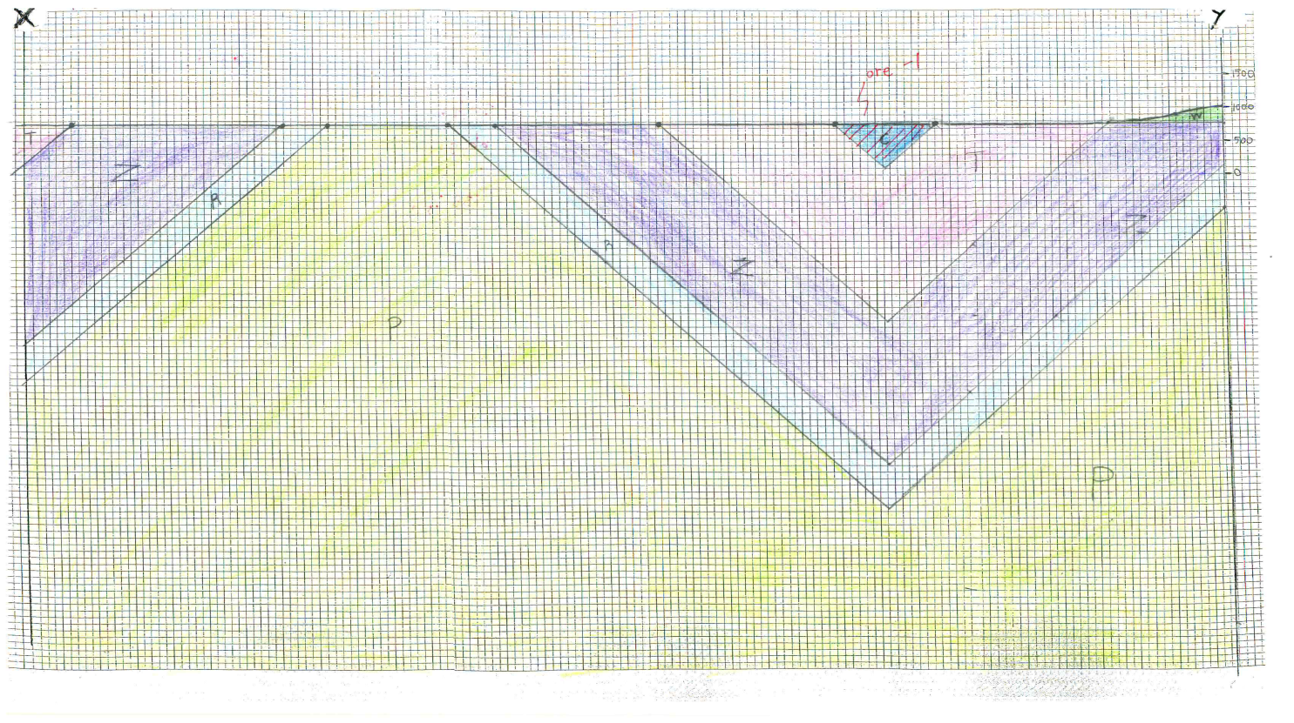
Albion College’s Ore Exploration Game: An Integrative Exercise
Beth Lincoln, Timothy Lincoln, Thomas Wilch, Carrie Menold, and Michael McRivette
Geology Department, Albion College, Albion, MI 49224
Blincoln@albion.edu
Paper #45-4
Booth 333
Abstract
Geology 101 Introductory Geology at Albion College meets the Science Mode requirement through which students learn the process of science and the impact of geology on their own lives. To help students achieve these goals, we devised two multiple-week projects to serve as the culmination of each half of the semester, replacing traditional lab exams. One of these is a research project, described in Lincoln et al. 2007. The other is the ore exploration game, which requires students to integrate material covered in 6 weeks of lectures and labs on minerals, rocks, structures and topographic and geologic maps, and to apply what they have learned to a practical problem. Students divide into teams or “mineral exploration companies” of 3 to 4 members. They are given rules for the game, an exploration budget, a geologic map, a set of rock samples keyed to the map, and worksheets to fill out as they collect information. Their assignment is to use this information to locate ore bodies both exposed and hidden and to acquire the rights to these through an auction on the last day of the project. In week 1, they identify and describe samples, label structures on the map, draw cross sections, and develop a geologic history. In week 2, the groups buy geochemical and drill hole data and use these along with the geology to locate and describe ore bodies. By the end of this lab, each group will have described at least one kind of ore. Deposits are hidden with varying degrees of subtlety, allowing all students to find some ore and the best to demonstrate their abilities. In week 3, students hand in completed maps and cross sections (done as teams), and a geologic history of the area that includes descriptions of samples and structures as well as interpretations of their environments of formation, along with a two-page paper on the ore deposits (papers and histories written as individuals). Groups use the funds left in their exploration budget to bid on squares of the map they believe contain ore. To be successful, students must approach the problem as geologists, going beyond simple rock and structure identification to interpretation of rock assemblages in the context of a geologic map and synthesis of these interpretations into a coherent narrative history. This project will be used to assess the integrative thinking component of our assessment plan.
Week 2
Goal: Locate ore deposits
Tasks:
Decide on an exploration strategy. Each group is given an exploration budget of $500,000.
  Stream surveys: Geochemical assays are available for purchase for each labeled point on a stream. The cost is $15,000 per river system.
  Surface surveys: A group can pay $5,000 to find out if there is any ore at the surface in a particular square on the map.
  Drill hole data: The group marks a point on the map, and the instructor drafts a log showing the rock types below that point, including any ore, and the depth at which they were encountered. The cost is $50,000.
  Ore intercept: For $25,000, groups may purchase an ore intercept, which tells them whether or not the drill intersected any ore, but gives no other information.
Carry out the exploration
Describe the ore. Once a group has located an ore body, they are allowed to see the type of ore they have discovered.
Search their map and cross sections for hidden ore.
Determine a bidding strategy.
Finish the outline of the geologic history
Excerpts from Student Ore Description Papers
“One of the ores found was galena, which is the natural form of lead. The minerals sphalerite and calcite were also present ... It was found in marble that was formed when a granite pluton intruded into bioclastic limestone rock causing contact metamorphism to occur creating the marble. This granite pluton also caused the galena ore to from by a hydrothermal process. Hot water and metal rich fluid that was present in the granite as it moved toward the surface and cooled reacted with the minerals in the limestone causing the galena ore to form. High concentrations of lead and zinc were found in a river downstream of the pluton that lead us to find it. The galena is only present in the marble around the pluton on only one square of the map.”
“We started off by purchasing two stream surveys, one for the eastern stream and one for the western river. After conducting a stream survey on the west river ore was found through sections three, five and six of the river. We then conducted three surface surveys on those three squares but no ore was found. Assuming that the ore flowed down river and is being deposited at the end of the river, a surface survey conducted on square A2 revealed ore deposits. The ore we found contained four different minerals but no concentrated metals. The minerals found in rock l are Plagioclase feldspar, Galena, Pyrite and garnet. These were found at the end of the eastern stream in Rock (T), which is sedimentary limestone.”
Students write the ore description papers individually. In these two-page papers, they are required to describe the ore they found and interpret its origin. This provides another opportunity for them to combine their own observations with classroom material. The paper on the left is focused on describing and interpreting the ore. This student has integrated material from lecture and the text with her own observations in her discussion of the type of deposit and its formation. In contrast, the paper on the right, describing the same deposit, is focused on the group’s actions, not the ore. There is no coherent description of the ore, of the deposit type, or of the formation of the deposit.
Week 1
Goal: Describe the geology.
Tasks:
Describe and identify hand samples keyed to a geologic map.
Identify structures on the map and describe them on a worksheet.
Draw two cross sections This is the task with which the students have the least experience, and so is the only one for which they receive help. The instructor may walk the class as a whole through the start of the first topographic profile and, when the profile is completed, through the start of the transfer of the geologic relations. The instructor plus the teaching assistants move from group to group as they work on their profiles, helping students think through problems as they encounter them.
Begin to outline the geologic history..
Portions of Student Map Explanations/ Geologic Histories
Week 3
Goal: Bid on and win ore
Tasks:
Review bidding strategy. The first 20 to 30 minutes of the lab are available for groups to finalize their bidding strategies, and write in any changes to these on their papers.
Hand in projects. After bids are submitted, individuals hand in a map with labeled folds and faults, 2 cross sections, a detailed geologic history, and a 2-page paper describing the ore deposits and their bidding strategies.
Reward the winners. Once the projects are collected, the teaching assistants compile the bids and determine winners while the instructor goes over the project. Typically there is enough ore on the map that every group manages to win at least one square with ore, thereby earning the bonus points. We do not have any requirements that the ore be present in a certain concentration or above a certain depth in order for it to count; winning any ore occurrence earns the bonus points.
A typical project map, with completed cross sections. Letters on the map are keyed to a set of hand samples. Circled numbers along rivers are sites for which stream sediment assays may be purchased as part of mineral exploration in Week #2. Numbers and letters along the sides function as a bingo-like grid, allowing students to designate squares of land both for surface surveys in Week #2 and for placing bids at the end of the project. Students add fold symbols and fault U’s and D’s, and show surface ore in solid red and concealed ore with stripes.
Assessment
We plan to use the map explanation and paper to assess integrative thinking. A portion of the rubric we plan to use is as follows:
Only rock names listed, no events or descriptions
Rock names and events listed, minimal descriptions or generic descriptions copied directly from the text book
Rocks and events fully and appropriately described, using the student’s own observations
Rocks and events fully and appropriately described, using the student’s own observations; interpretations of environments and sequences.
Rocks and events fully and appropriately described, using the student’s own observations; interpretations of environments and sequences with evidence to support the interpretation.
Each student completes the map explanation/history individually, using information collected by the team. The explanation is where students have the opportunity to demonstrate that they can appropriately integrate their own observations with material from previous lectures and labs into coherent descriptions of rocks and events. The explanation on the left, while it has errors, provides rock descriptions that are thorough and based on the samples the student examined, not generic textbook descriptions, and includes interpretations with evidence for those interpretations (“This rock has been weathered due to its rounded rock fragments.”). The explanation on the right, produced by another member of the same team, contains minimal information, lacking descriptions and interpretation.
Acknowledgements
We would like to thank all the Geo 101 students and teaching assistants who have helped us improve this exercise.
References
Lincoln, Beth Z.; Bartels, William S.; Lincoln, Timothy N.; Menold, Carrie; Van de Ven, Christopher; and Wilch, Thomas I. (2007) Research experiences for first and second year students at Albion College. Geol. Soc. Am. Abstracts with Programs v. 39, no. 6, p. 247.

