Slide 1
Framework for K-12 Science Education: Practices, Crosscutting Concepts
and Core Ideas

Slide 2
The New National K-12 Science Standards:
A 2-Step Process
“Conceptual Framework for New Science Education Standards” --- A National Academy of Science report by the NRC (National Research Council), came out THIS MONTH!
Actual standards will be written by Achieve, Inc. (finished late-2012???)

Slide 3
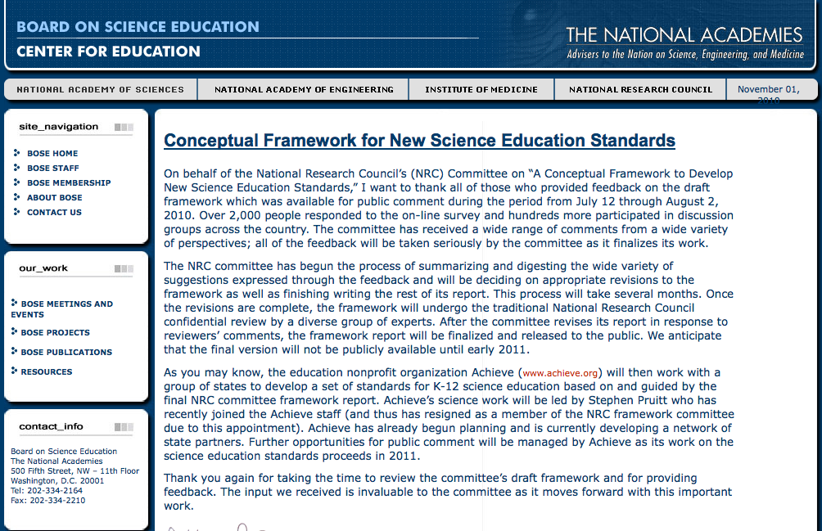
National Research Council’s Conceptual Framework for New Science Education Standards

Slide 4
Question: What year did American schools first use any kind of standards?

Slide 5
Question: What year did American schools first use any kind of standards?
Answer: 1852
Horace Mann convinces Massachusetts to adopt the Prussian Education System
Started by Prussian King Frederick II in 1763 – made schooling compulsory for all children ages 5-13.

Slide 6

BRIEF HISTORY OF SCIENCE STANDARDS
  The Harvard Descriptive List of Physics Laboratories (1891)
  The Committee of Ten (1893)
  A Nation at Risk (National Commission on Excellence in Education, 1983)
  Educating Americans for the 21st Century (Commission on Precollege Education in Mathematics, Science, Technology of the National Science Board, 1983)
  PROJECT 2061 (1985)
  National Governors’ Conference (1989)
  Curriculum and Evaluation Standards for School Mathematics(NCTM, 1989)
  AMERICA 2000: An Education Strategy (1991)
  Benchmarks for Science Literacy (AAAS, 1993)
  GOALS 2000: Educate America Act (1994)
  National Science Education Standards (1995)
[Bybee, 2010]
Notes:
The Committee of Ten, led by Harvard President Charles Eliot, was a working group of educators that, in 1892, recommended the standardization of American high school curriculum.
Nation At Risk – documented the decline of US education: For example, the report notes that average SAT scores dropped "over 50 points" in the verbal section and "nearly 40 points" in the mathematics section during the period 1963-1980. Nearly forty percent of 17 year olds tested could not successfully "draw inferences from written material," and "only one-fifth can write a persuasive essay; and only one-third can solve a mathematics problem requiring several steps."

Slide 7
Major components of the Framework
Vision of high quality science education
Practices, crosscutting concepts, and disciplinary core ideas
Guidance for standards developers
Discussion of implementation issues
Attendance to diversity and equity
Suggestions for future research
Notes:
Helen
Vision of high quality science education for all
3 Dimensions
Additional chapters to provide supportive information – use different chapters if audience warrants it. For example, some audiences may be more interested in Diversity and Equity chapter

Slide 8
NRC Conceptual Frameworks Committee
Science Content:
Helen Quinn, Stanford, Chair (Physics)
Wyatt Anderson, University of Georgia (Biology)
Tanya Atwater, UCSB (Geophysics)
Rodolfo Dirzo, Stanford University (Bioecology)
Phillip Griffiths, Institute for Advanced Study (Mathematics)
Dudley Herschbach, Harvard University (Biology)
Linda Katehi, UC Davis (Engineering)
John Mather, NASA Goddard Space Flight Center (Astrophysics)
Rebecca Richards-Kortum, Rice University (Bioengineering)
Education and Learning
Philip Bell, University of Washington
Thomas Corcoran, Columbia University, Teachers College
Tom Keller, NRC
Brett Moulding, Utah Partnership for Effective Sci Teaching &Learning
Jonathan Osborne, Stanford
James W. Pellegrino, University of Illinois
Stephen L. Pruitt, Georgia Department of Education
Brian Reiser, Northwestern University
Heidi Schweingruber, NRC
Walter Secada, University of Miami
Deborah C. Smith, Pennsylvania State University

Slide 9
Four Design Teams:
Earth and Space Science:
Michael Wysession, Washington University, St. Louis, MO (Team Lead)
Don Duggan-Haas, Museum of the Earth, Ithaca, NY
Scott Linneman, Western Washington University, Bellingham, WA
Eric Pyle, James Madison University, Harrisonburg, VA
Dennis Schatz, Pacific Science Center, Seattle, WA
Life Science
Rodger Bybee, BSCS, Colorado Springs, CO (Team Lead)
Bruce Fuchs, National Institutes of Health, Bethesda, MD
Kathy Comfort, WestEd, San Francisco, CA
Danine Ezell, Energy Project, San Diego, CA
Physical Science
Joseph Krajcik, University of Michigan, Ann Arbor, MI (Team Lead)
Shawn Stevens, University of Michigan, Ann Arbor, MI
Sophia Gershman, Princeton Plasma Physics Lab, Princeton, NJ
Arthur Eisenkraft, University of Massachusetts, Boston, MA
Angelica Stacy, UC Berkeley, Berkeley, CA
Engineering and Applied Science
Cary Sneider, Portland State University, Portland, OR (Team Lead)
Rodney (Rod) L. Custer, Illinois State University, Normal, IL
Jacob (Jake) Foster, Mass. Dept Elementary & Secondary Ed, Malden, MA
Yvonne Spicer, Museum of Science, Boston, MA
Maurice Frazier, Chesapeake Public School System, Chesapeake, VA

Slide 10
What is the Framework about?
“The Framework is designed to help realize a vision for education in the natural sciences and engineering in which (all) students, over multiple years of school, actively engage in science and engineering practices and apply crosscutting concepts to deepen their understanding of the core ideas in these fields.” (emphasis added)
Notes:
Helen

Slide 11
Framework Goals: By the end of Grade 12, students should be able to
engage in public discussions on science-related issues,
be critical consumers of scientific information related to their everyday lives,
to continue to learn about science throughout their lives.
to appreciate that science and the current scientific understanding of the world are the result of many hundreds of years of creative human endeavor
^{(Chapter 1 page 3)}
Notes:
Helen

Slide 12
What’s New??
Content that is shorter but deeper
Fewer factoids; More process
Greater integration among the sciences
Greater integration with engineering and technology
Greater integration of and focus on human-related content

Slide 13
Three dimensions
Scientific and engineering practices
Crosscutting concepts
Disciplinary core ideas
Notes:
Helen - Consistent with the vision

Slide 14
Scientific and engineering practices
Asking questions and defining problems
Developing and using models
Planning and carrying out investigations
Analyzing and interpreting data
Using mathematics, information and computer technology
Notes:
Helen

Slide 15
Scientific and engineering practices (cont’)
Constructing explanations
Engaging in argument
Obtaining, evaluating, and communicating information
Notes:
Helen

Slide 16
Crosscutting concepts
Patterns
Cause and effect
Scale, proportion and quantity
Systems and system models
Energy and matter
Structure and function
Stability and change
Notes:
Helen - Crosscutting concepts unify the study of science and engineering through their common application across fields.

Slide 17
Recommendations for Standards Writers
Recommendation 1: Standards should set rigorous learning goals that represent a common expectation for all students.
Recommendation 2: Standards should be scientifically accurate yet also clear, concise, and comprehensible to science educators.
Recommendation 3: Standards should be limited in number.
Recommendation 4: Standards should emphasize all three dimensions articulated in the framework

Slide 18
Recommendations continued
Recommendation 5: Standards should include performance expectations that integrate the three dimensions. These expectations should require that students demonstrate knowledge-in-use and include criteria for identifying successful performance.
Recommendation 6: Standards should incorporate boundary statements, including what does not need to be taught in order for students to achieve the standard.

Slide 19
Recommendations continued
Recommendation 7: Standards should be organized as sequences that support students’ learning over multiple grades. They should take into account how students’ command of the concepts, core ideas, and practices becomes more sophisticated over time with appropriate instructional experiences.

Slide 20
Recommendations continued
Recommendation 8: Whenever possible, the progressions in standards should be informed by existing research on learning and teaching.
  In cases in which insufficient research is available to inform a progression, or in which there is a lack of consensus on the research findings, the progression should be developed on the basis of a reasoned argument about learning and teaching. The sequences described in the framework can be used as guidance.

Slide 21
Recommendations continued
Recommendation 9: The committee recommends that the diverse needs of students and of states be met by developing grade-band standards. For those states that prefer or require grade-by-grade standards, a suggested elaboration on grade-band standards could be provided.
Recommendation 10: If grade-by-grade standards are written, these standards should provide a coherent progression within each grade band.

Slide 22
Recommendations continued
Recommendation 11: Any assumptions about the resources, time, and teacher expertise needed for students to achieve particular standards should be made explicit.
Recommendation 12: The standards for the sciences and engineering should align coherently with those for other K-12 subjects. Alignment with the Common Core standards in mathematics and English/language arts is especially important.

Slide 23
Recommendations continued
Recommendation 13: In designing standards and performance expectations, issues related to diversity and equity need to be taken into account. In particular, performance expectations should provide students with multiple ways of demonstrating competence in science.

Slide 24
Organizational Structure
Core Idea (Ex. LS1)
  Sub-ideas (Ex. LS1.A)
    Grade-band endpoints (ex. By the end of grade 2)

Slide 25
Life Sciences: Core Ideas
LS1 - From Molecules to Organisms: Structures and Processes
LS2 - Ecosystems: Interactions, Energy, and Dynamics
LS3 - Heredity: Inheritance and Variation of Traits
LS4 - Biological Evolution: Unity and Diversity

Slide 26
Physical Sciences: Core Ideas
PS1 - Matter and Its Interactions
PS2 - Motion and Stability: Forces and Interactions
PS3 - Energy
PS4 - Waves and Their Applications in Technologies for Information Transfer

Slide 27
Engineering, Technology, and Applications of Science Core Ideas
ETS1 - Engineering Design
ETS2 - Links Among Engineering, Technology, Science, and Society

Slide 28
Earth and Space Sciences: Core Ideas
ESS1 - Earth’s Place in the Universe
ESS2 - Earth’s Systems
ESS3 - Earth and Human Activity

Slide 29


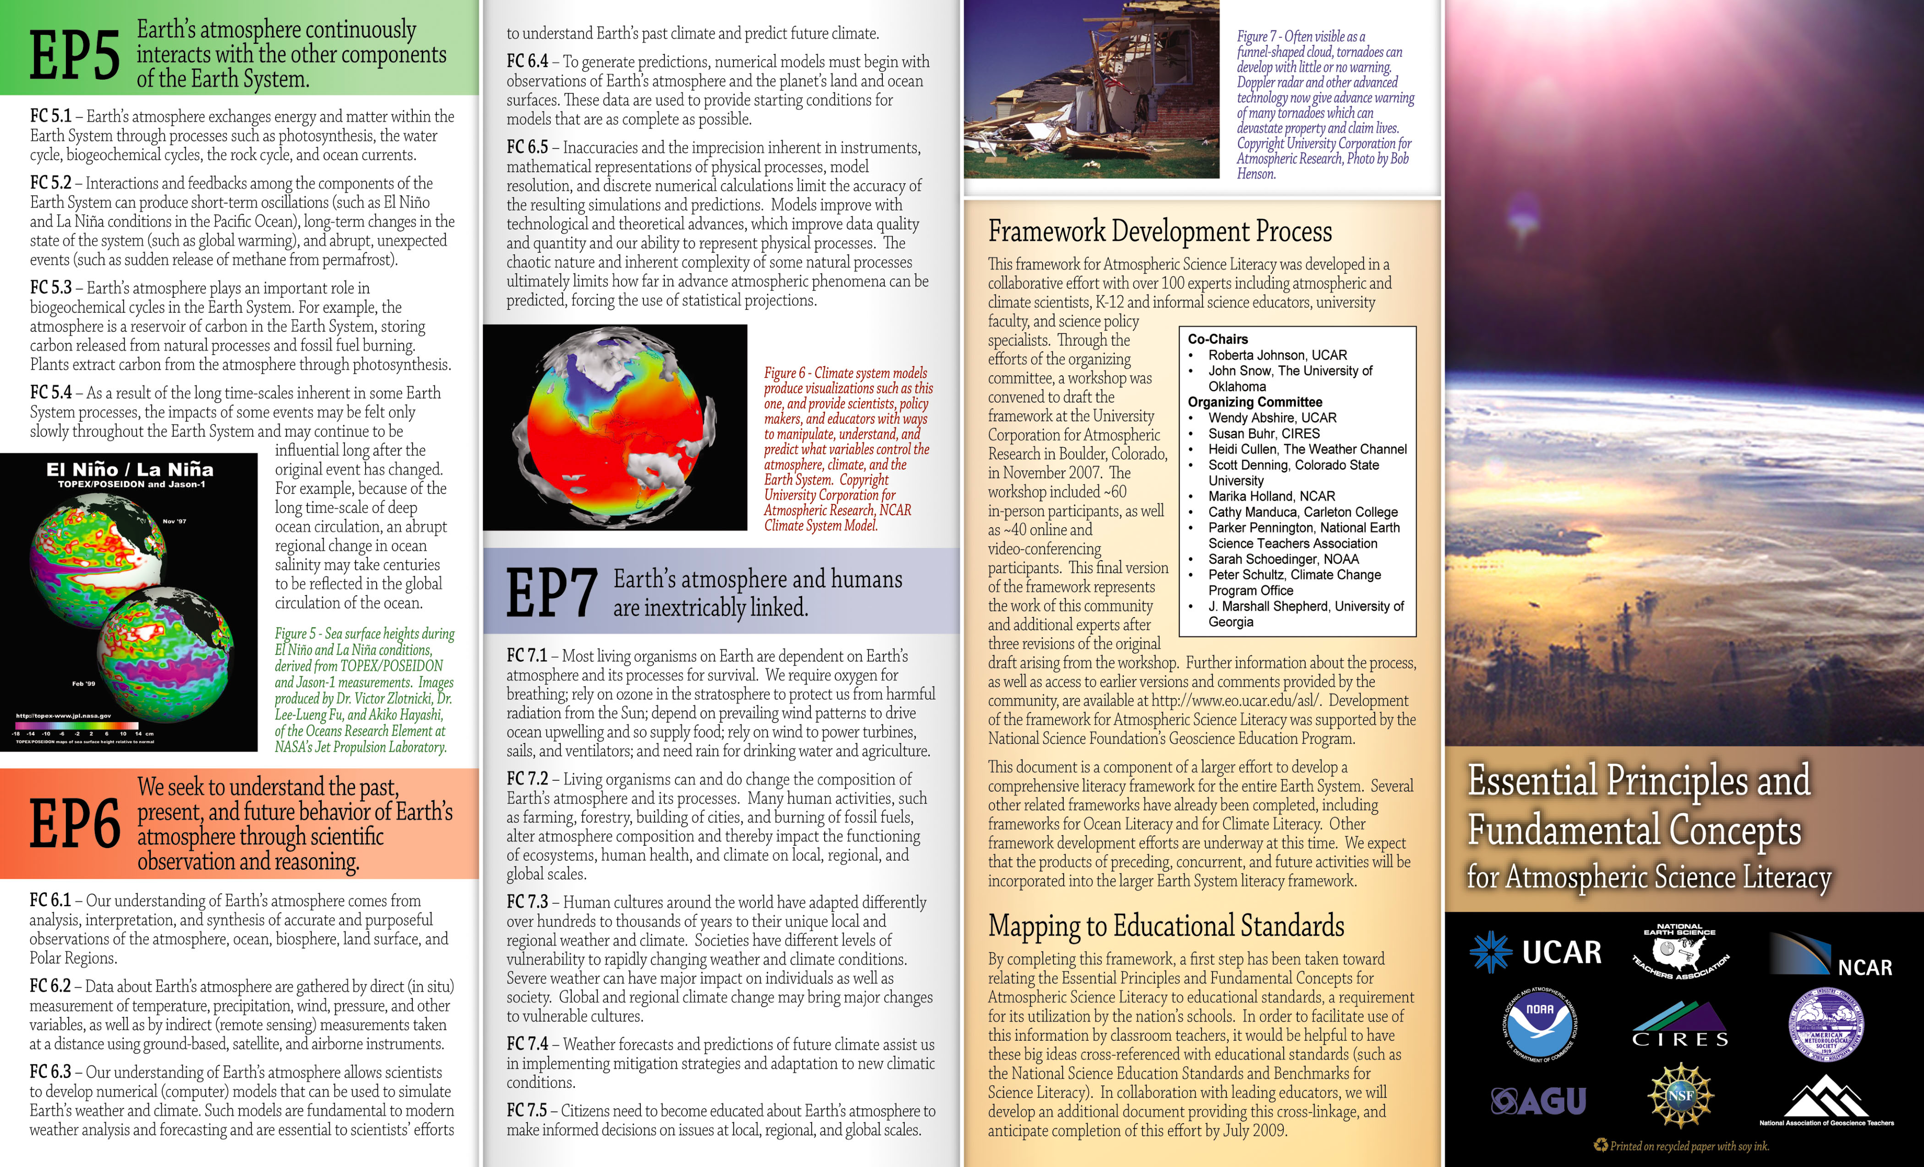

Current work is supported by several recent community-organized literacy efforts
→ Example, for Geoscience:

Slide 30
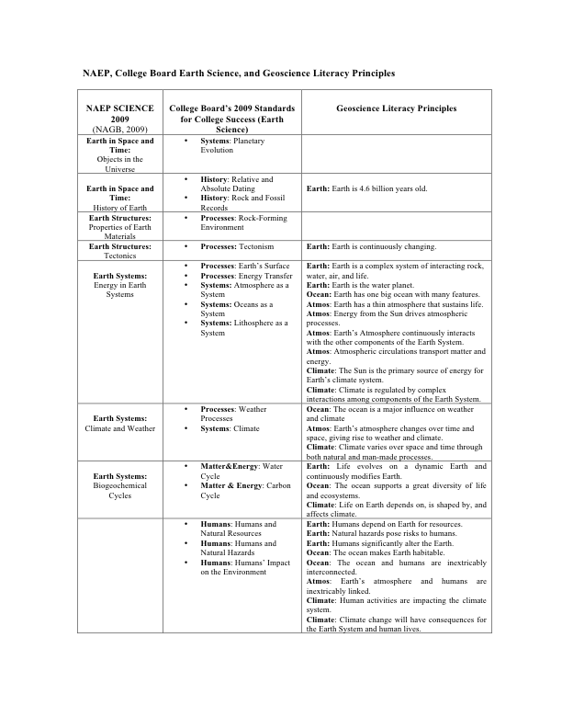
Earth and Space Sciences: Core Ideas

Slide 31
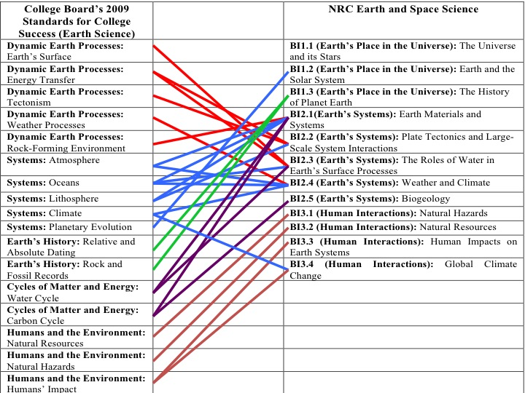
Earth and Space Sciences: Core Ideas

Slide 32
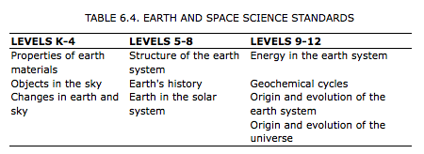
NSES (1996): Earth and Space Science

Slide 33
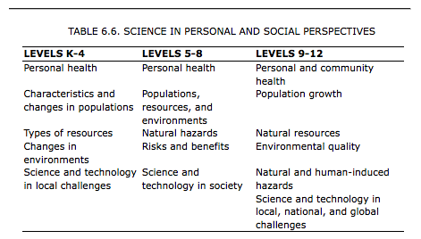
NSES (1996): Science in Personal and Social Perspectives

Slide 34
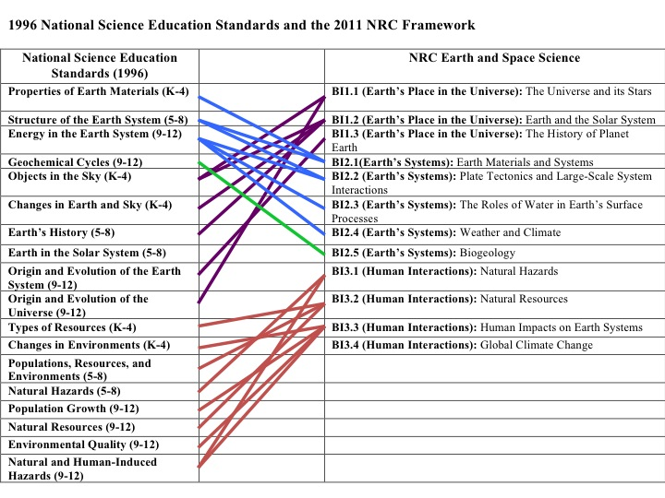
Earth and Space Sciences: Core Ideas

Slide 35
Earth and Space Sciences: Core Ideas
ESS1 - Earth’s Place in the Universe
ESS2 - Earth’s Systems
ESS3 - Earth and Human Activity

Slide 36
ESS1 - Earth’s Place in the Universe
ESS1.A: The Universe and Its Stars
ESS1.B: Earth and the Solar System
ESS1.C: The History of Planet Earth

Slide 37
ESS2 - Earth’s Systems
ESS2.A: Earth Materials and Systems
ESS2.B: Plate Tectonics and Large-Scale System Interactions
ESS2.C: The Roles of Water in Earth’s Surface Processes
ESS2.D: Weather and Climate
ESS2.E: Biogeology

Slide 38
ESS3 - Earth and Human Activity
ESS3.A: Natural Resources
ESS3.B: Natural Hazards
ESS3.C: Human Impacts on Earth Systems
ESS3.D: Global Climate Change

Slide 39
What’s Next??

Slide 40
What Happened….
1989, President George H.W. Bush organized a Governor’s meeting to attempt a standards-based approach to school reform. Result was only a vague endorsement of "voluntary national standards" (didn’t go far).
(Politics of “National” “Standards”)
Notes:
Democrats don’t like some implications of standards. Republicans don’t like “National” (state’s rights)

Slide 41
What Happened….
1989, President George H.W. Bush organized a Governor’s meeting to attempt a standards-based approach to school reform. Result was only a vague endorsement of "voluntary national standards" (didn’t go far).
(Politics of “National” “Standards”)
1994, President Bill Clinton raised federal money for standards-based reform. Effort left up to states, leading to wild variety of expectations and ideological battles over Math and English curricula.
Notes:
Democrats don’t like some implications of standards. Republicans don’t like “National” (state’s rights)

Slide 42
What Happened….
2001, President George W. Bush pushes through No Child Left Behind.
→ Requires that each state ensures that its students achieve "universal proficiency" in Reading and Math
Notes:
Democrats don’t like some implications of standards. Republicans don’t like “National” (state’s rights)

Slide 43
What Happened….
2001, President George W. Bush pushes through No Child Left Behind.
→ Requires that each state ensures that its students achieve "universal proficiency" in Reading and Math
→ Scores in Reading and Math improve
Notes:
Democrats don’t like some implications of standards. Republicans don’t like “National” (state’s rights)

Slide 44
What Happened….
2001, President George W. Bush pushes through No Child Left Behind.
→ Requires that each state ensures that its students achieve "universal proficiency" in Reading and Math
→ Scores in Reading and Math improve
→ Education in all other areas (science, social studies, arts, Gifted Ed) declines
Notes:
Democrats don’t like some implications of standards. Republicans don’t like “National” (state’s rights)

Slide 45
What Happened….
2001, President George W. Bush pushes through No Child Left Behind.
→ Requires that each state ensures that its students achieve "universal proficiency" in Reading and Math
→ Scores in Reading and Math improve
→ Education in all other areas (science, social studies, arts, Gifted Ed) declines
→ States get to determine their own standards, resulting in a “Race to the Bottom” as standards are set low enough to obtain “universal proficiency”
Notes:
Democrats don’t like some implications of standards. Republicans don’t like “National” (state’s rights)

Slide 46
What Happened….
2001, President George W. Bush pushes through No Child Left Behind.
→ Requires that each state ensures that its students achieve "universal proficiency" in Reading and Math
→ Scores in Reading and Math improve
→ Education in all other areas (science, social studies, arts, Gifted Ed) declines
→ States get to determine their own standards, resulting in a “Race to the Bottom” as standards are set low enough to obtain “universal proficiency”
→ Example: Mississippi. According to the standards they set for themselves, 89% of Mississippi 4th-graders were proficient in reading (best in the country). According to NAEP (National Assessment of Educational Progress), only 18% of 4th-graders were proficient in reading (worst in the country).
Notes:
Democrats don’t like some implications of standards. Republicans don’t like “National” (state’s rights)

Slide 47
What Happened….
2009, President Barack Obama and Secretary of Education Arne Duncan announce $4.35 billion for "Race to the Top" funds as part of the Stimulus Package
→ Incentives for states to make "dramatic progress" in meeting goals that include improving standards.
Notes:
Democrats don’t like some implications of standards. Republicans don’t like “National” (state’s rights)

Slide 48
What Happened….
2009, President Barack Obama and Secretary of Education Arne Duncan announce $4.35 billion for "Race to the Top" funds as part of the Stimulus Package
→ Incentives for states to make "dramatic progress" in meeting goals that include improving standards.
→ Involves a detailed 500 point system (Delaware – 454.6; Tennessee – 444.2; South Dakota – 135.8)
Notes:
Democrats don’t like some implications of standards. Republicans don’t like “National” (state’s rights)

Slide 49
What Happened….
2009, President Barack Obama and Secretary of Education Arne Duncan announce $4.35 billion for "Race to the Top" funds as part of the Stimulus Package
→ Incentives for states to make "dramatic progress" in meeting goals that include improving standards.
→ Involves a detailed 500 point system (Delaware – 454.6; Tennessee – 444.2; South Dakota – 135.8)
→ 48 states initially sign on, promising to adopt “common core” standards for Math and English Language Arts (ELA)
Notes:
Democrats don’t like some implications of standards. Republicans don’t like “National” (state’s rights)

Slide 50
What Happened….
2009, President Barack Obama and Secretary of Education Arne Duncan announce $4.35 billion for "Race to the Top" funds as part of the Stimulus Package
→ Incentives for states to make "dramatic progress" in meeting goals that include improving standards.
→ Involves a detailed 500 point system (Delaware – 454.6; Tennessee – 444.2; South Dakota – 135.8)
→ 48 states initially sign on, promising to adopt “common core” standards for Math and English Language Arts (ELA)
→ March 29, 2010 – Delaware and Tennessee win Phase 1 funding
Notes:
Democrats don’t like some implications of standards. Republicans don’t like “National” (state’s rights)

Slide 51
What Happened….
2009, President Barack Obama and Secretary of Education Arne Duncan announce $4.35 billion for "Race to the Top" funds as part of the Stimulus Package
→ Incentives for states to make "dramatic progress" in meeting goals that include improving standards.
→ Involves a detailed 500 point system (Delaware – 454.6; Tennessee – 444.2; South Dakota – 135.8)
→ 48 states initially sign on, promising to adopt “common core” standards for Math and English Language Arts (ELA)
→ March 29, 2010 – Delaware and Tennessee win Phase 1 funding
→ August 24, 2010 – Phase 2 funding goes to the District of Columbia, Florida, Georgia, Hawaii, Maryland, Massachusetts, New York, North Carolina, Ohio, and Rhode Island
Notes:
Democrats don’t like some implications of standards. Republicans don’t like “National” (state’s rights)

Slide 52

Notes:
Democrats don’t like some implications of standards. Republicans don’t like “National” (state’s rights)

Slide 53

“Achieve, Inc.:”
Created in 1996 by the nation's governors (CCSSO - The National Governors Association and the Council of Chief State School Officers) and corporate leaders, Achieve is an independent, bipartisan, non-profit education reform organization based in Washington, D.C. that helps states raise academic standards and graduation requirements, improve assessments and strengthen accountability.

Slide 54
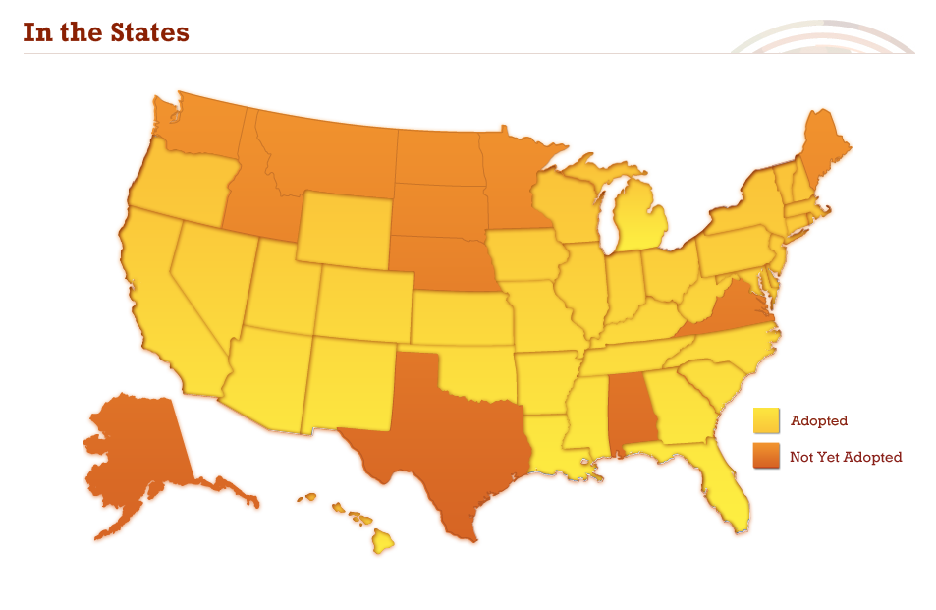
Notes:
Democrats don’t like some implications of standards. Republicans don’t like “National” (state’s rights)

Slide 55

Notes:
Democrats don’t like some implications of standards. Republicans don’t like “National” (state’s rights)

Slide 56
National “Next Generation” Science Standards now being written by Achieve, Inc.:
The content will be taken from the Framework, but will be combined into complete standards that integrate concepts, big ideas, and practices.
These are not part of the “Common Core” (there will be no Common Core science standards)
These will hopefully be adopted by many states or play a major role in influencing new state standards (“Build it and they will come.”)

